Slide 1

Ezekiel 18:20
“The soul that sinneth, it shall die”

Slide 2
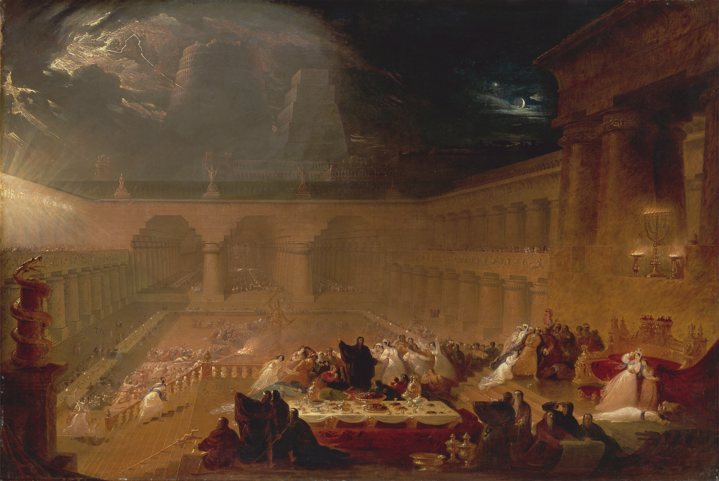
Notes:
it’s 23 years later

Slide 3
Psalm 9:17
“The wicked shall be turned to hell, and all the nations that forget God.”

Slide 4
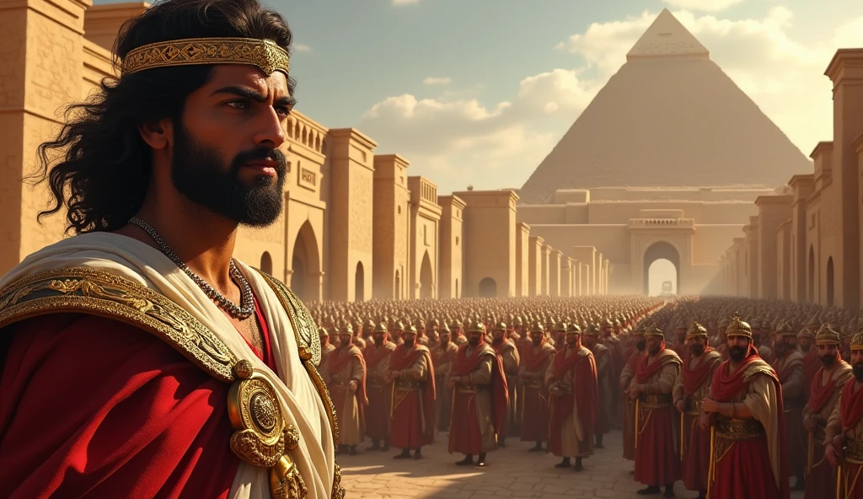
Notes:
Cyrus the Great

Slide 5
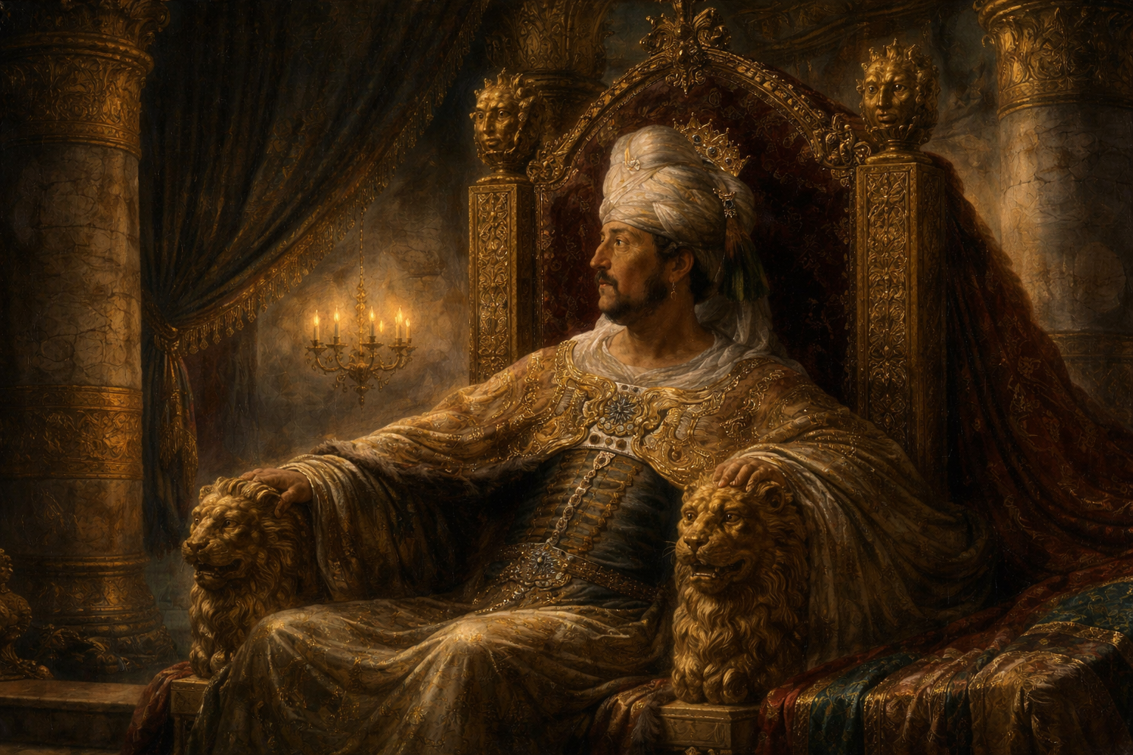
Notes:
Belshazzar sat in the banquet hall

Slide 6
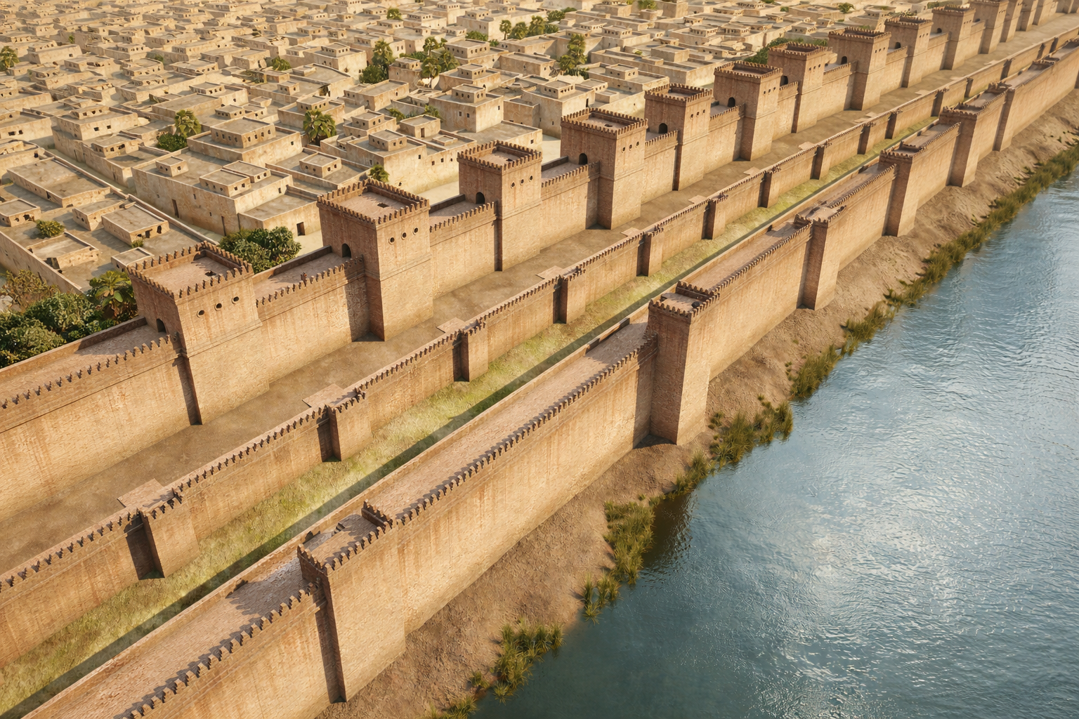
Notes:
87 feet thick

Slide 7
Notes:
Gold and silver vessels

Slide 8
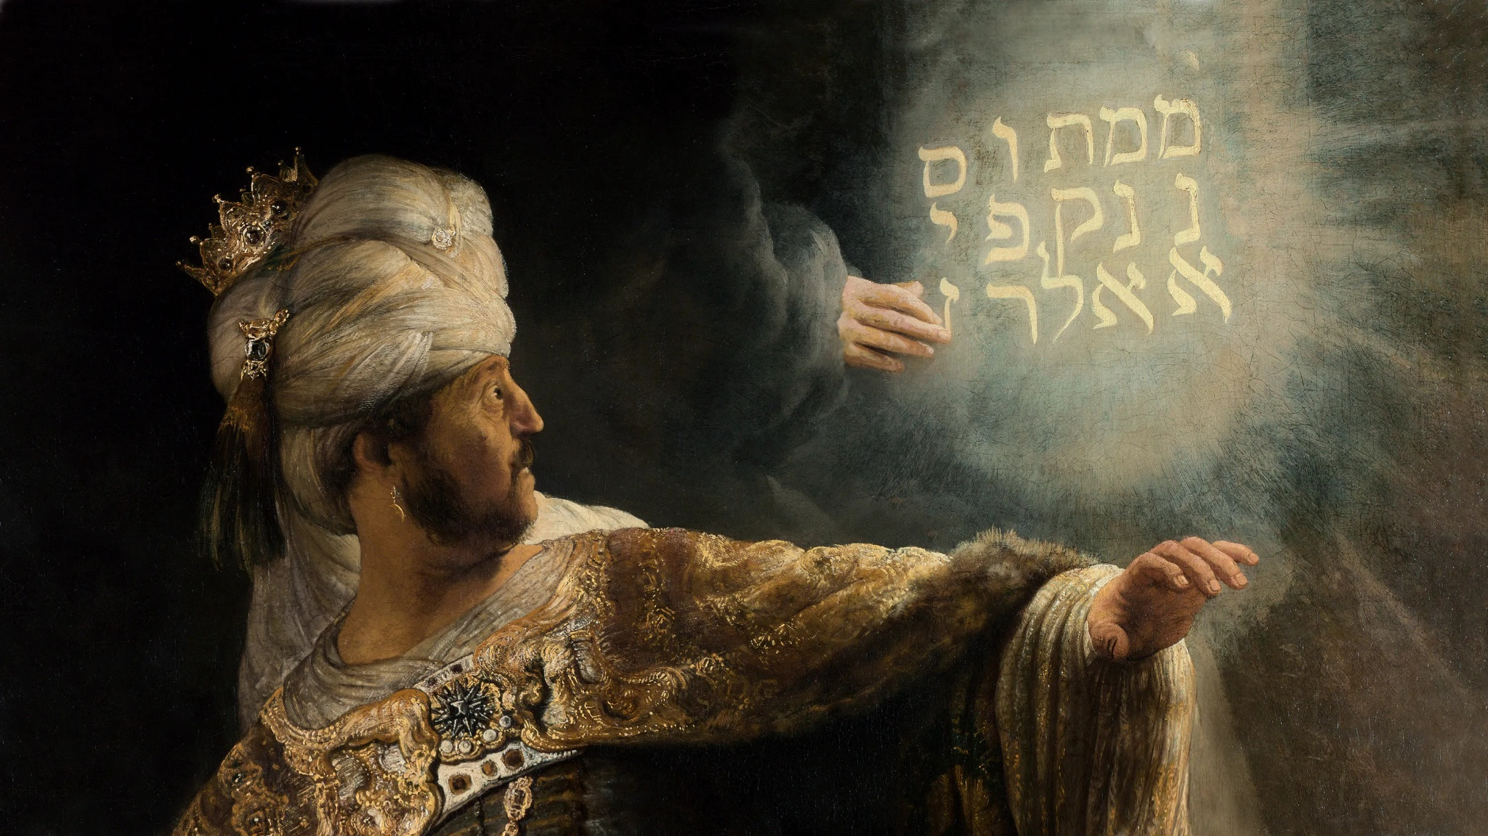
Notes:
Came forth fingers

Slide 9
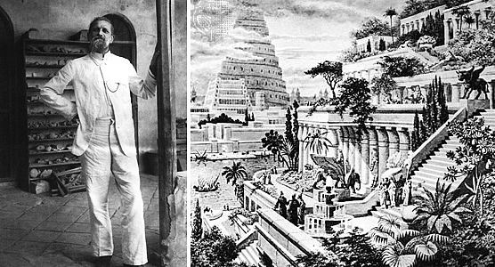
Notes:
archeologist Koldewey

Slide 10
Notes:
He is troubled

Slide 11
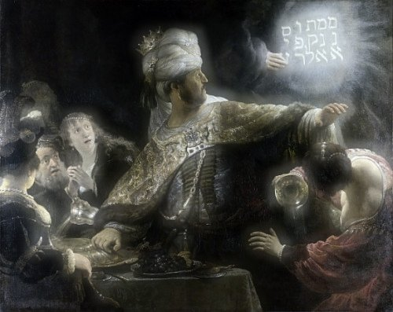
Notes:
Humpty Dumpty

Slide 12
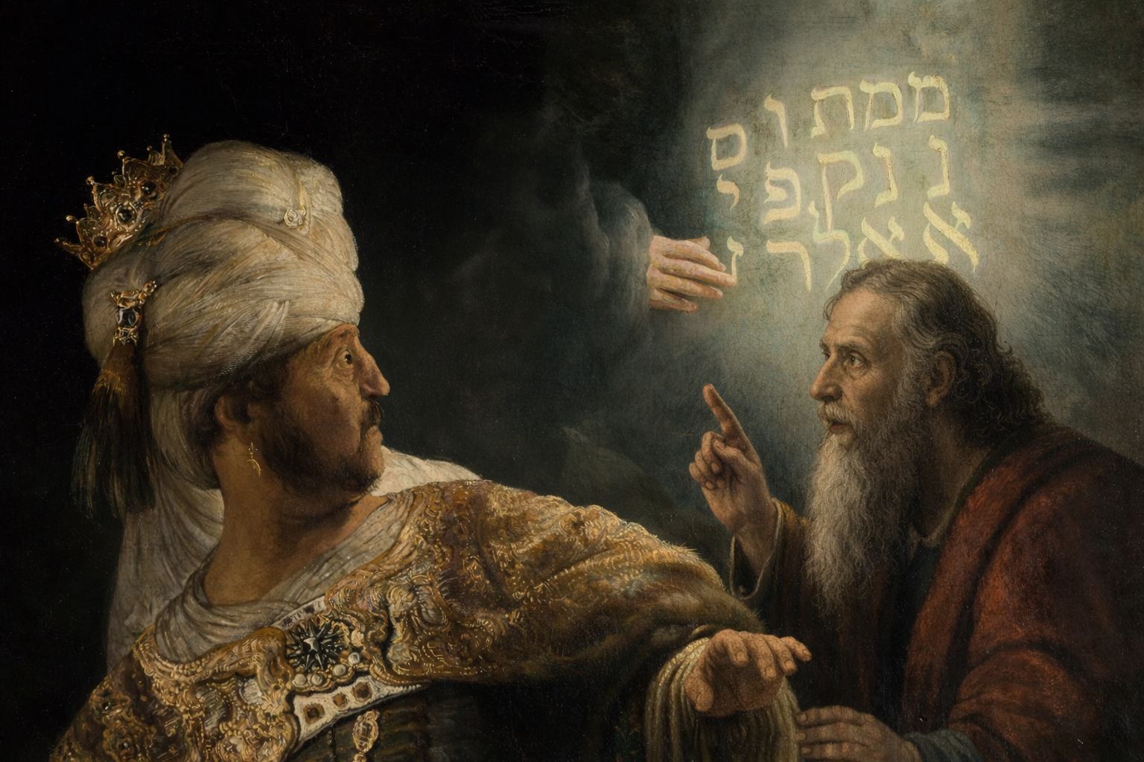
Notes:
“Then was Daniel brought in before the king.”

Slide 13
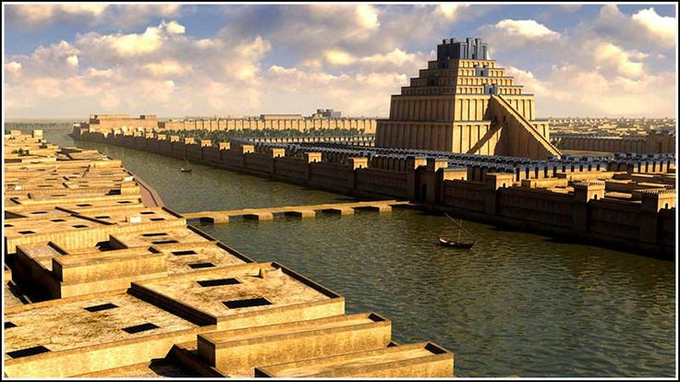
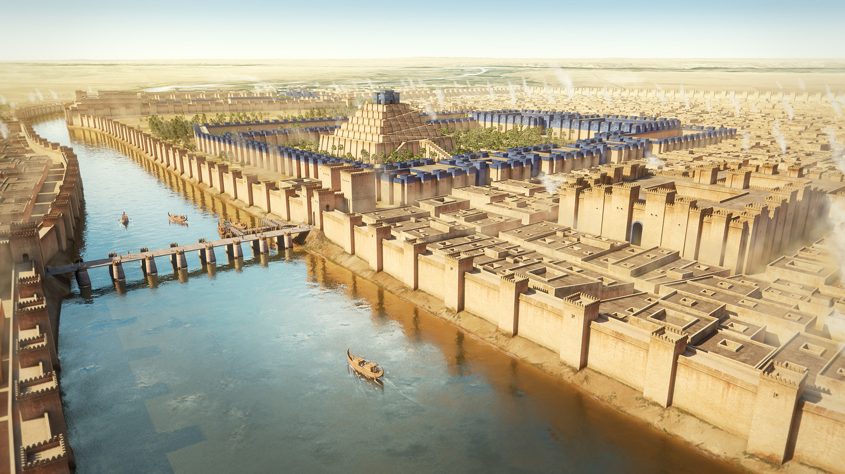
Notes:
History records what happened

Slide 14
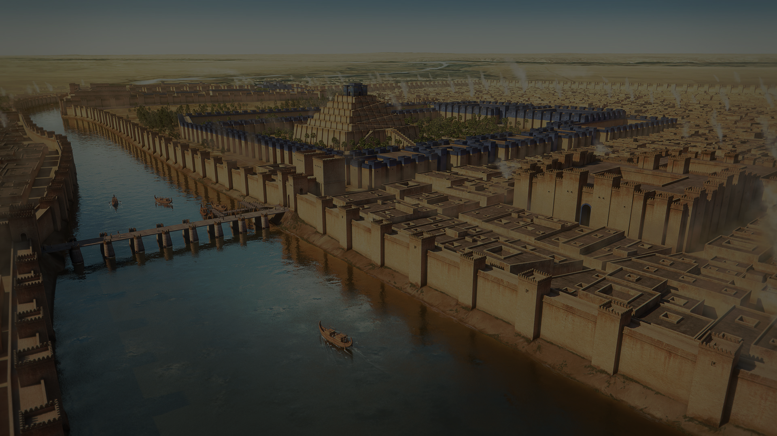
Notes:
Now it is nighttime

Slide 15
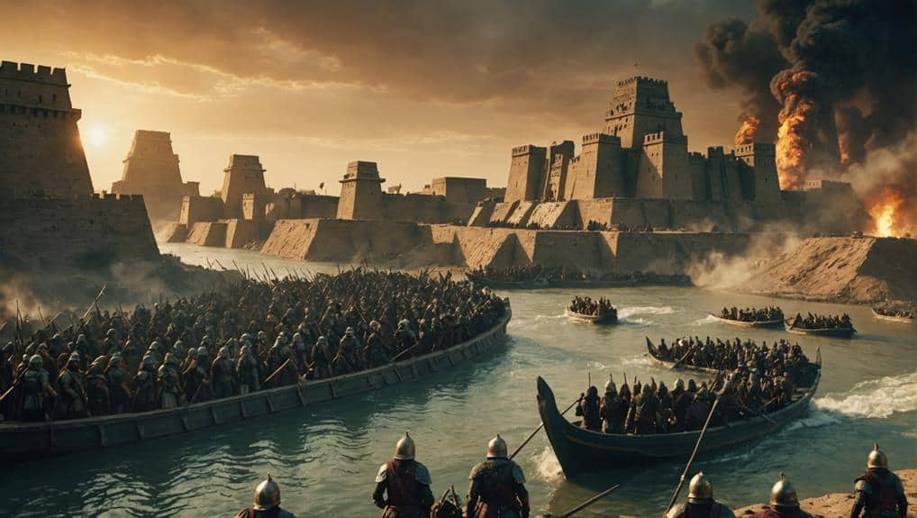
Notes:
threw open the gates

Slide 16
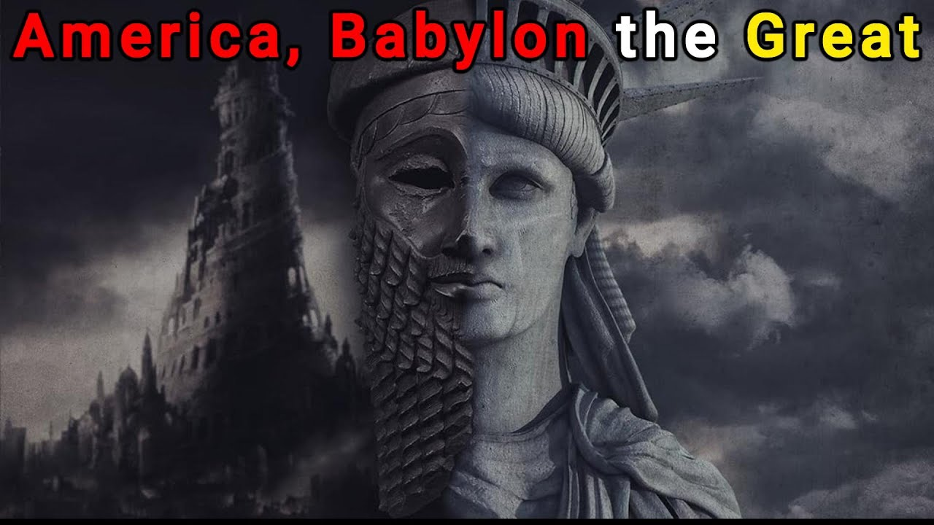
Notes:
the Babylon of Revelation 17 and 18

Slide 17
Ezekiel 18:20
“The soul that sinneth, it shall die”

