Slide 1
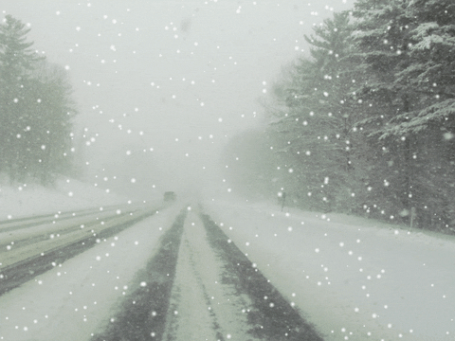

Slide 2
Matthew 22:14,
"Many are cold, and a few are
frozen"

Slide 3
Matthew 22:14,
"Many are called, but few are chosen"

Slide 4
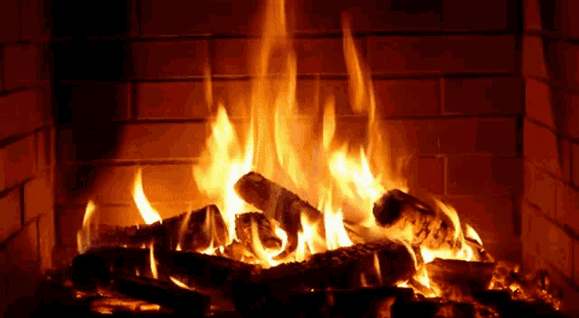
Notes:
temperature is currently

Slide 5
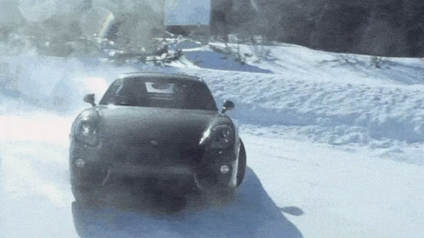
Notes:
let’s use a familiar object

Slide 6
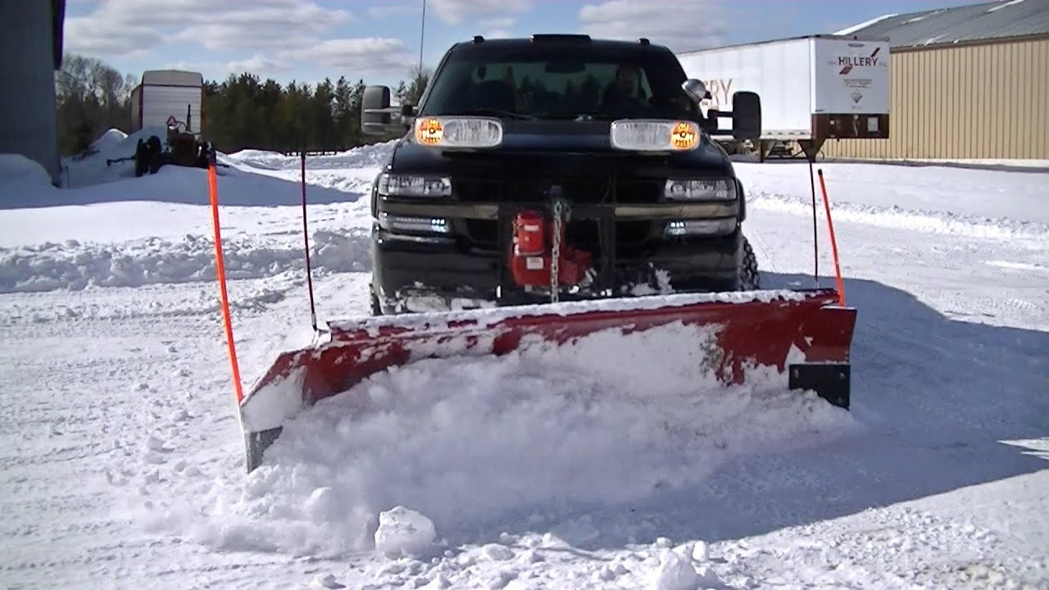
Notes:
my playground varied

Slide 7
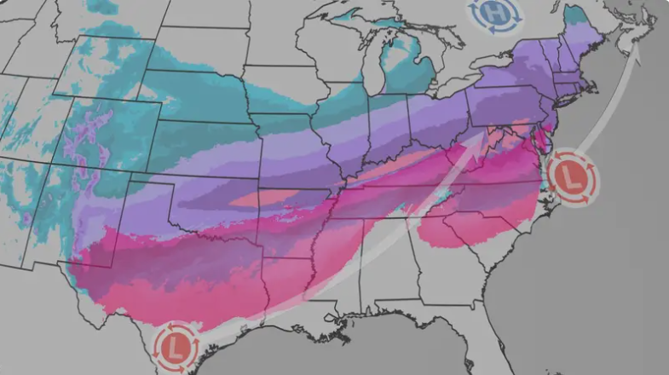
Notes:
the south is blanketed

Slide 8
Matthew 7:13
“Enter ye in at the strait gate: for wide is the gate, and broad is the way, that leadeth to destruction…”

Slide 9
Lk. 9:62
"No man having put his hand to the plow, and looking back, it fit for the kingdom of God…”

Slide 10
Joshua 1:7
“…that thou mayest observe to do according to all the law…turn not from it to the right hand or to the left”

Slide 11
Hebrews 2:1
“Therefore we ought to give the more earnest heed to the things which we have heard, lest at any time we should let them slip.”

Slide 12
Isaiah 40:31
“But they that wait upon the Lord shall renew their strength”

Slide 13
Ezra 7:26
“And whosoever will not do the law of thy God, and the law of the king, let judgment be executed speedily upon him…”

