Slide 1
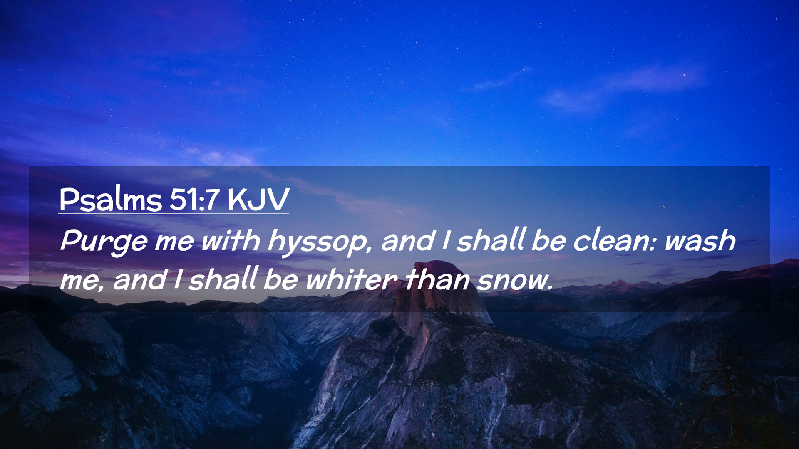
Notes:
music

Slide 2
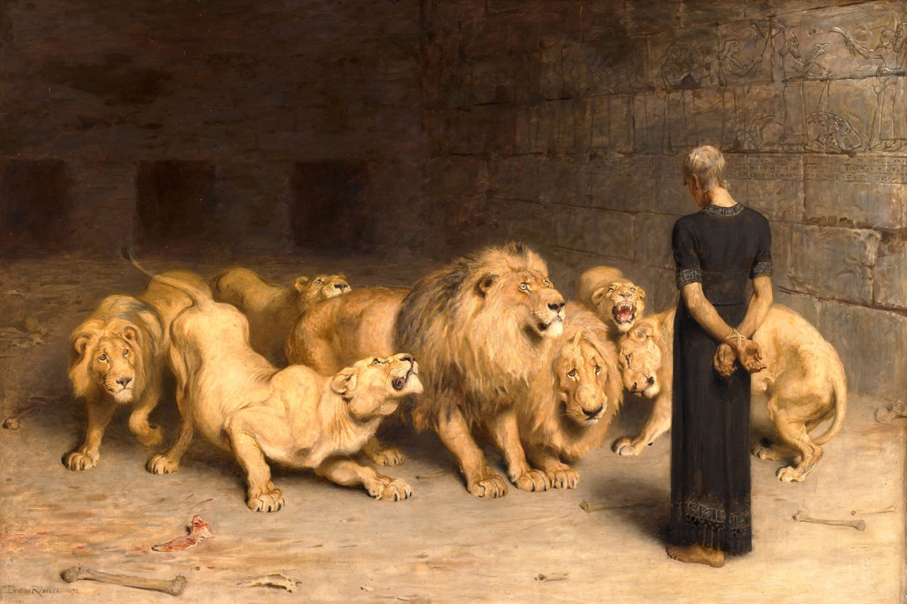
Notes:
beginning

Slide 3
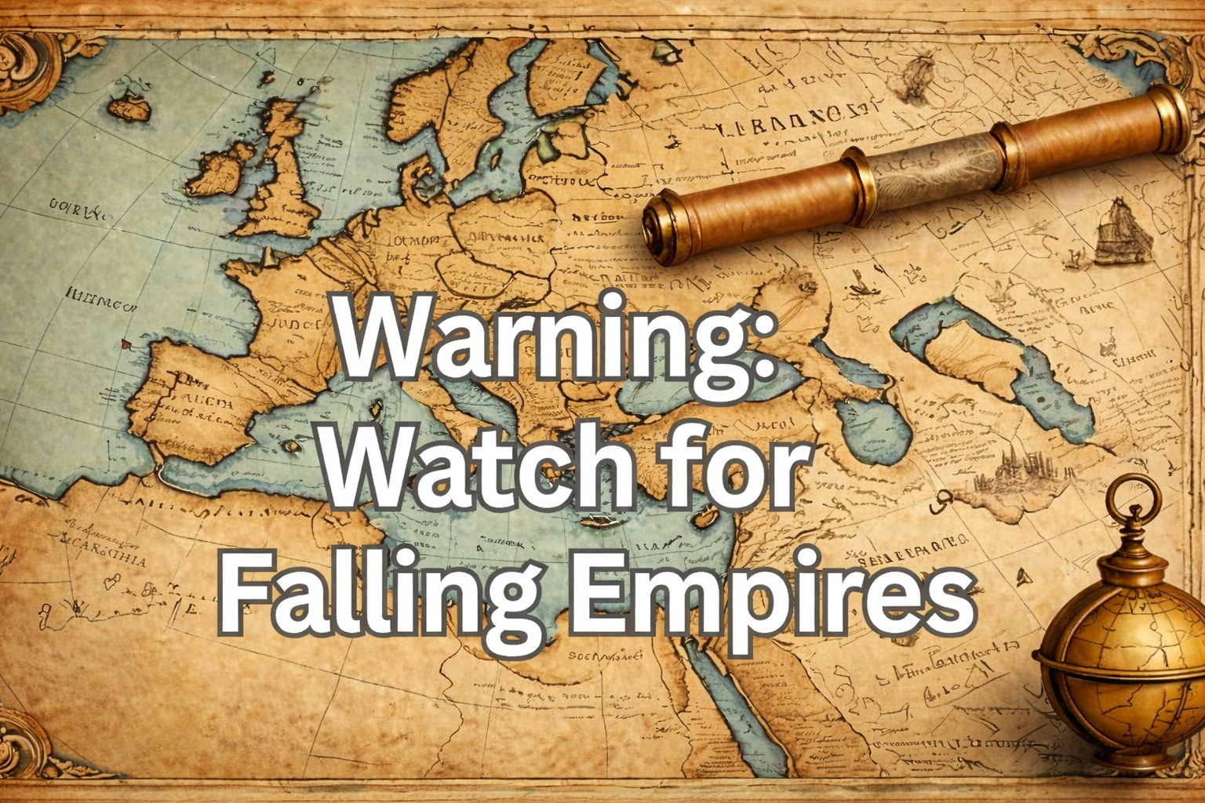
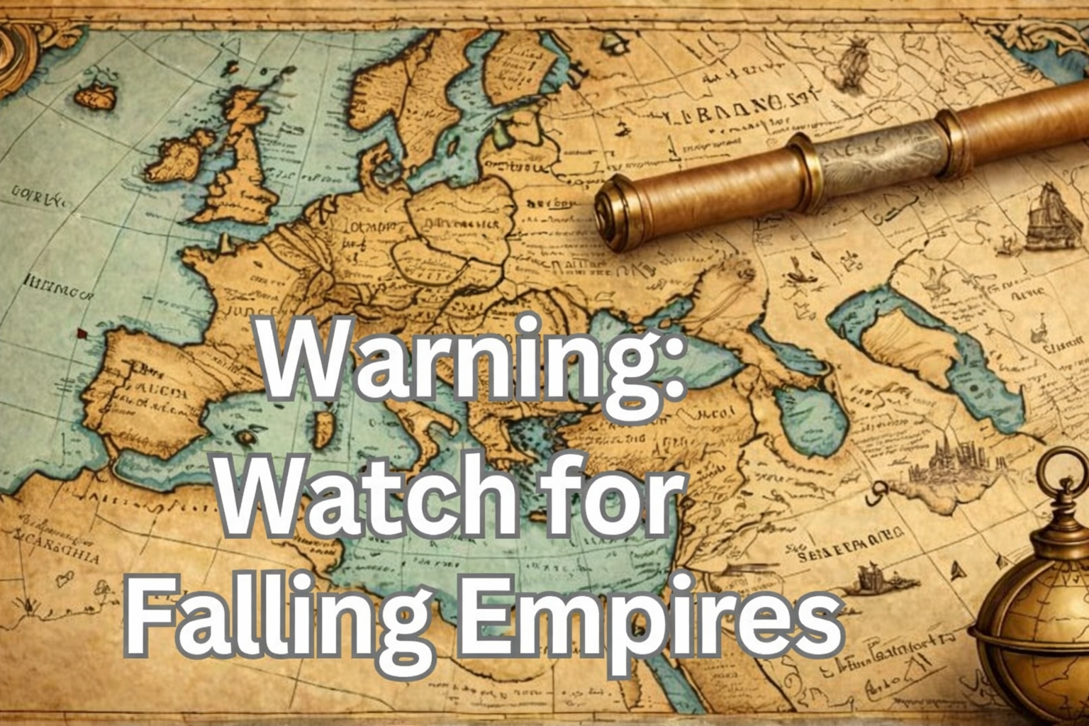

Slide 4
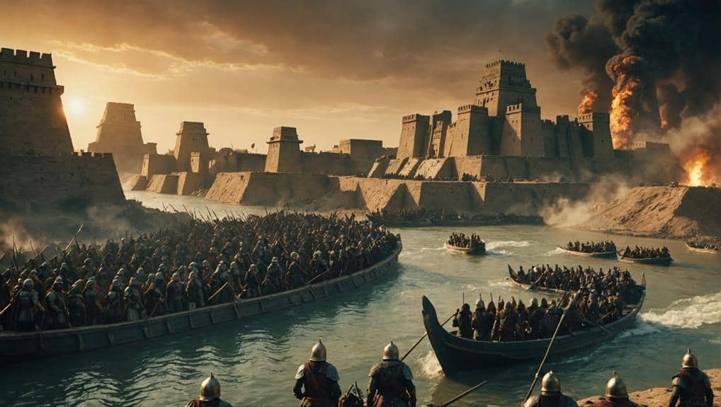
Notes:
more cataclysmic event

Slide 5
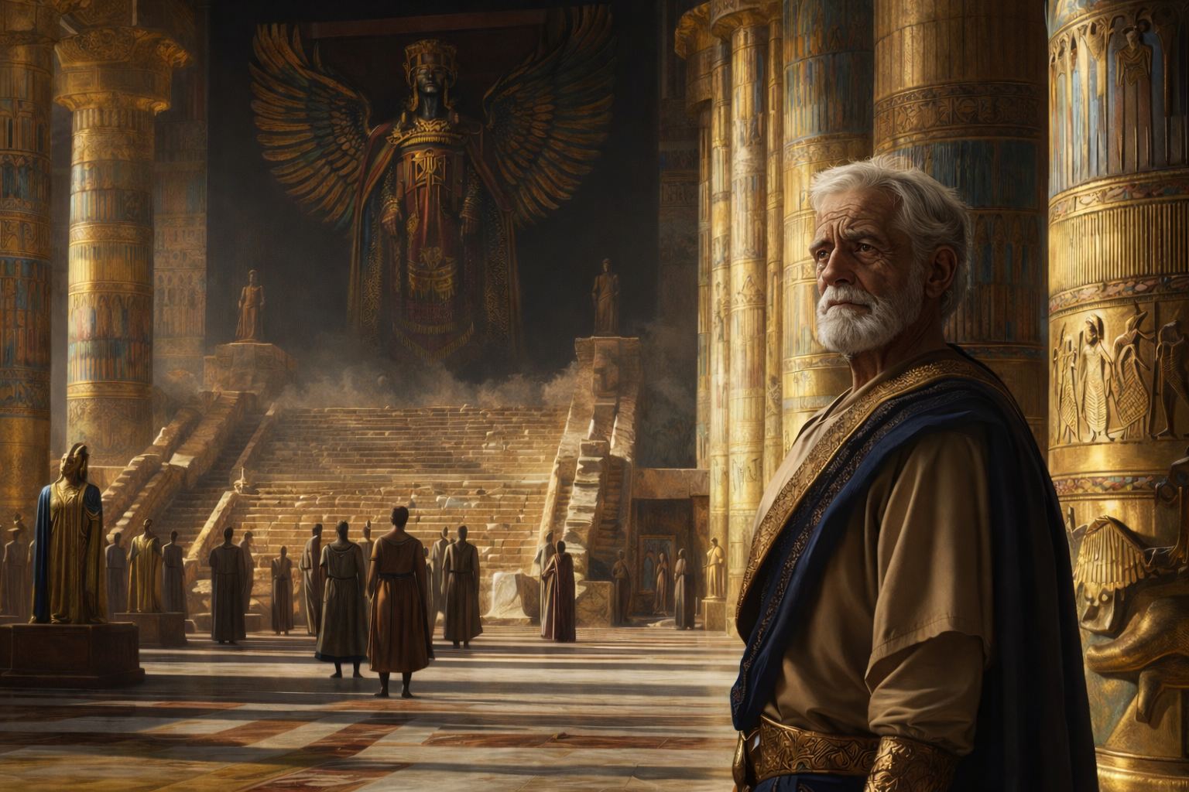
Notes:
Daniel rides high

Slide 6
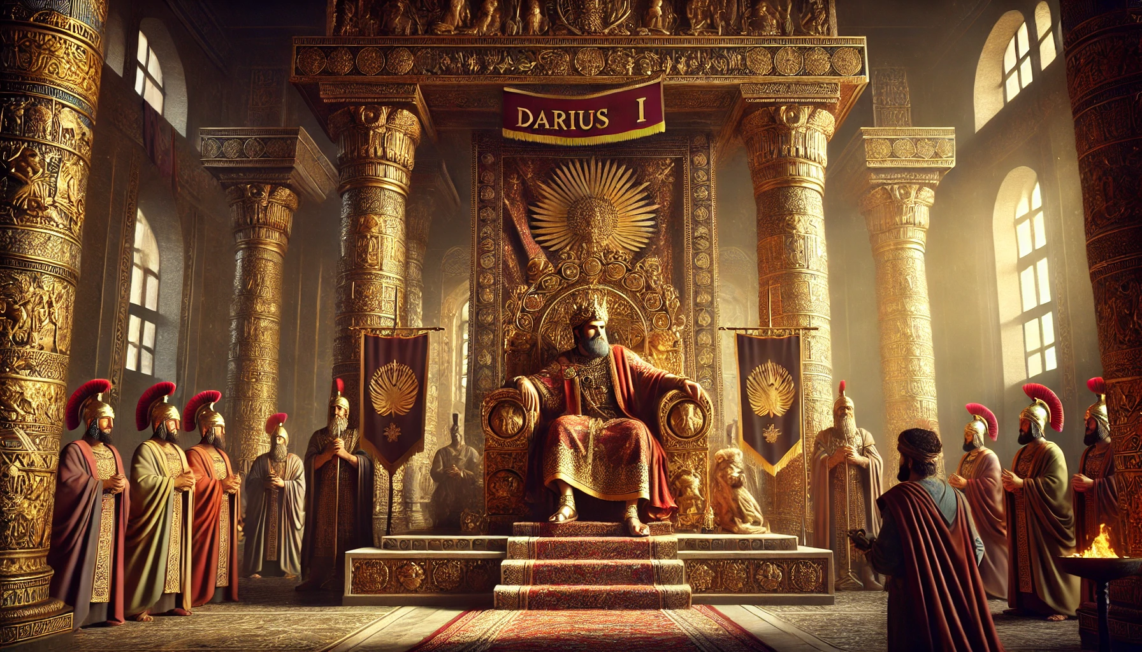
Notes:
There’s a price to pay

Slide 7
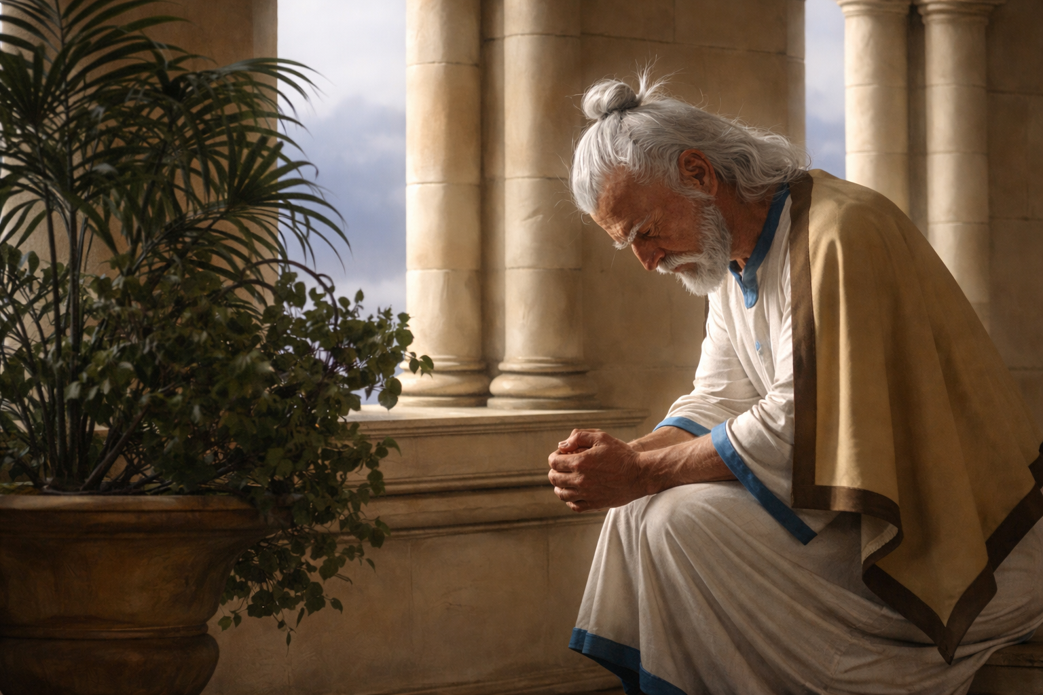
Notes:
Verse 10: Now when Daniel knew…

Slide 8
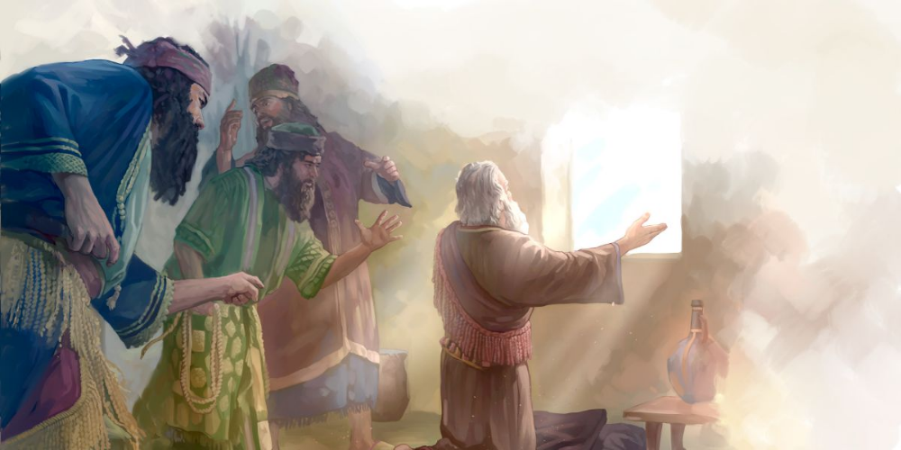
Notes:
They spy him out and rat him out

Slide 9
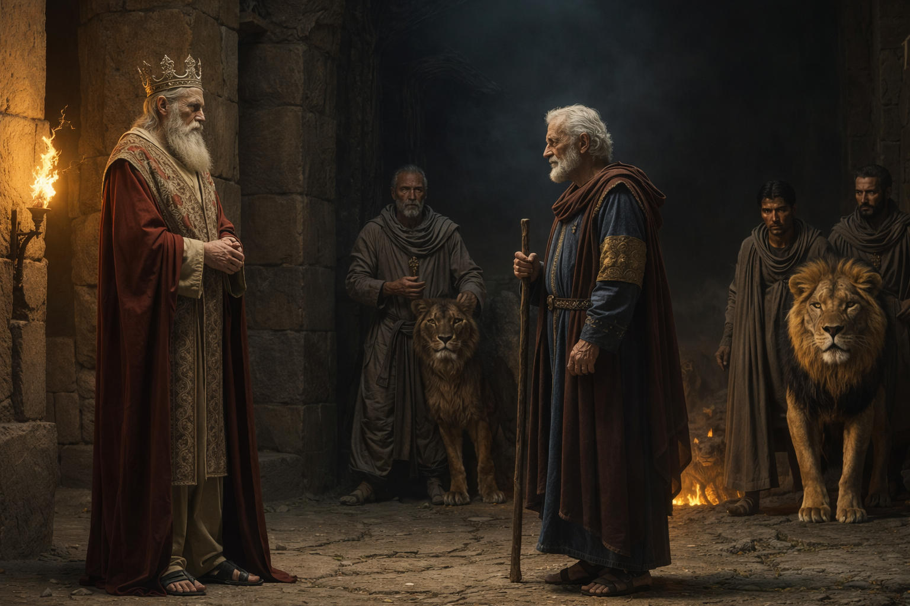
Notes:
Look what happens next

Slide 10
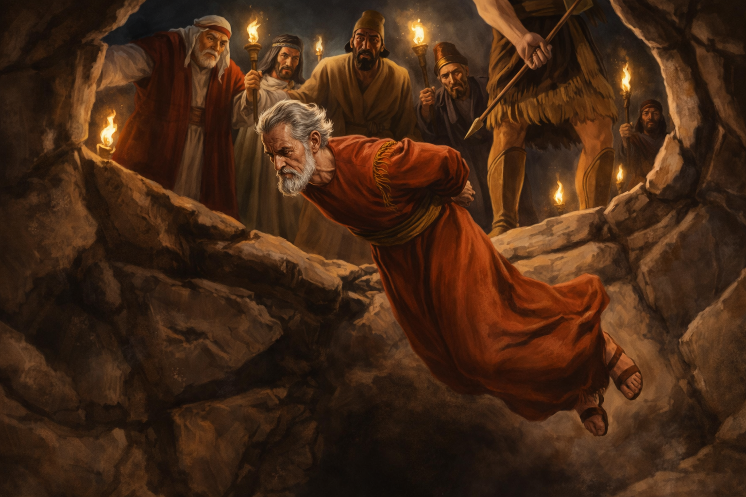
Notes:
Cast him into the den of lions

Slide 11
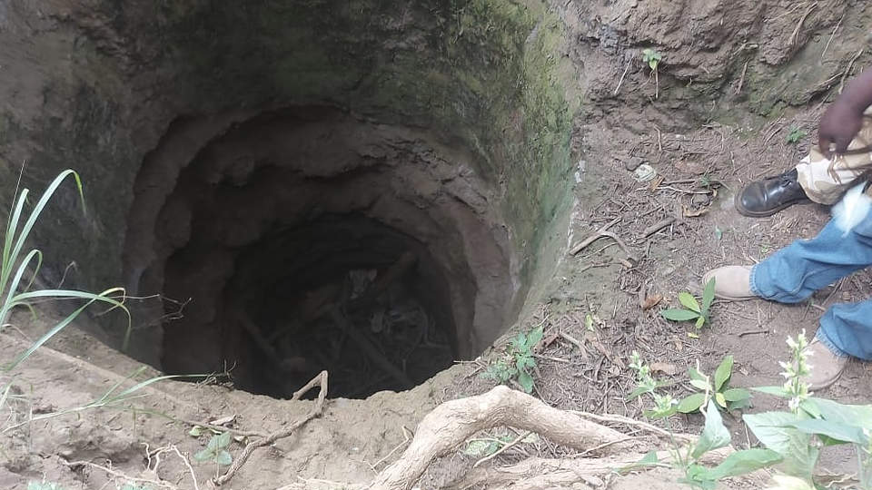
Notes:
they’ve discovered some of these lions’ pits

Slide 12
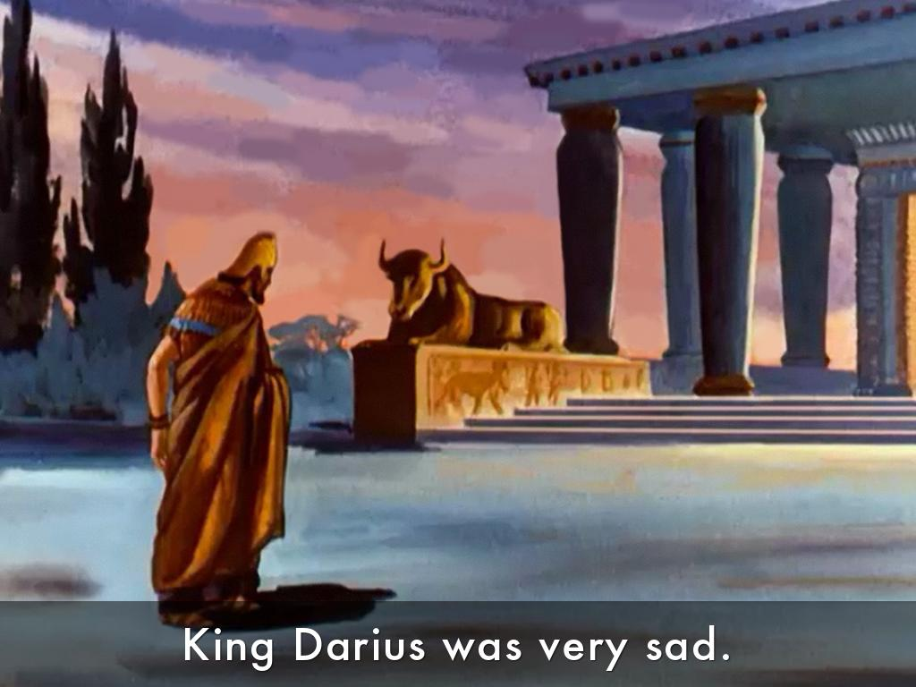
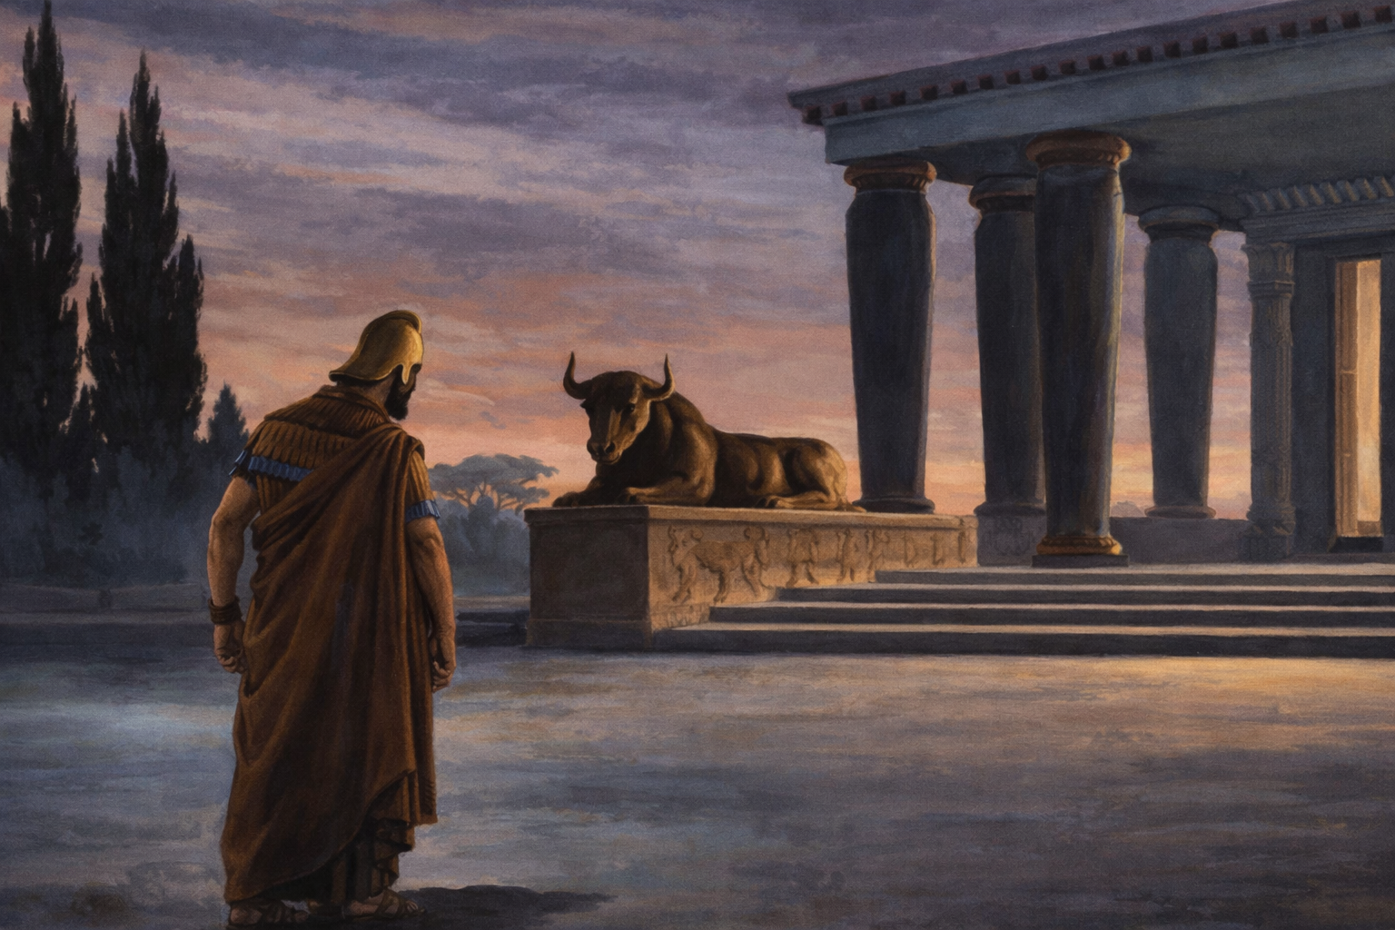
Notes:
His sleep went from him

Slide 13
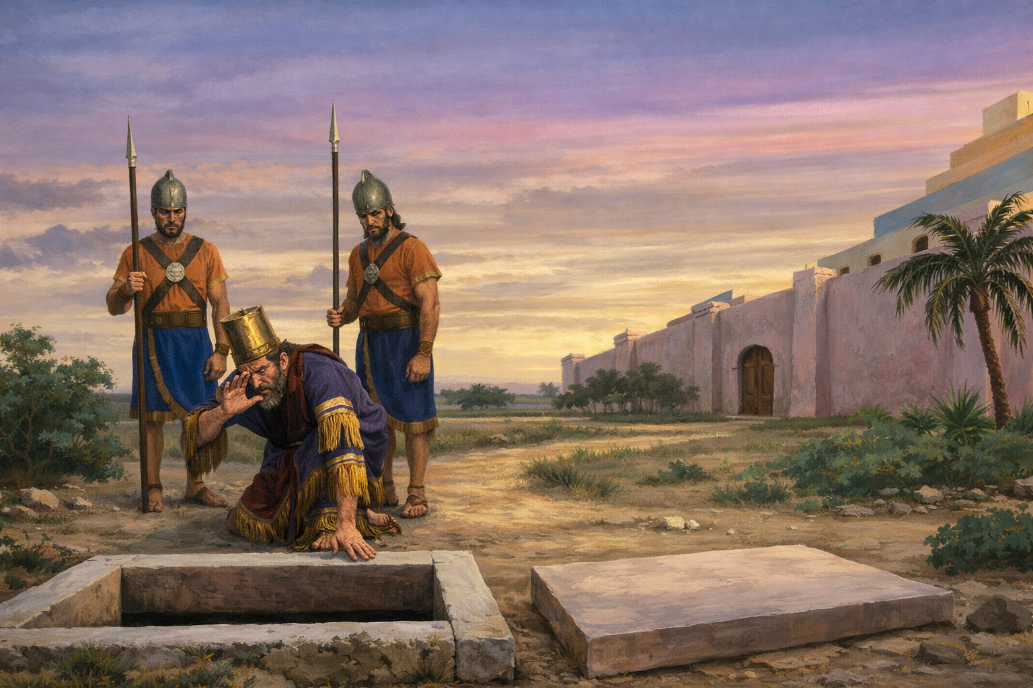
Notes:
hustled back at first light

Slide 14
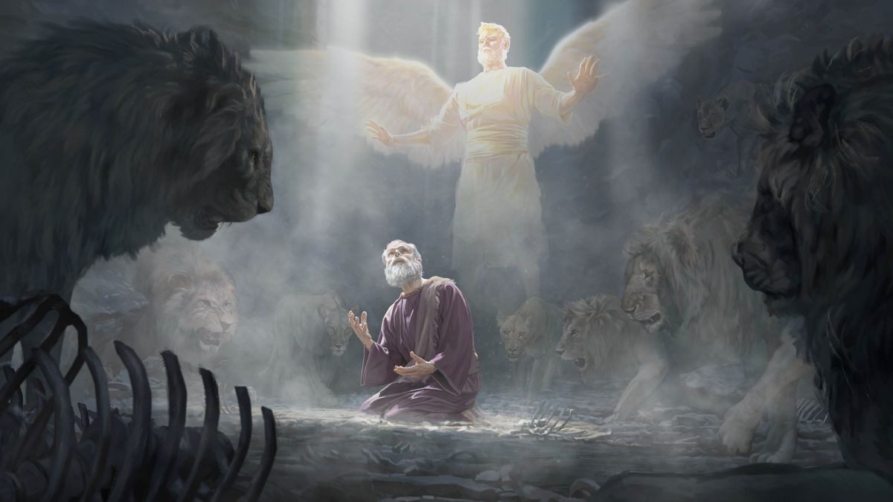
Notes:
My God hath sent his angel…

Slide 15
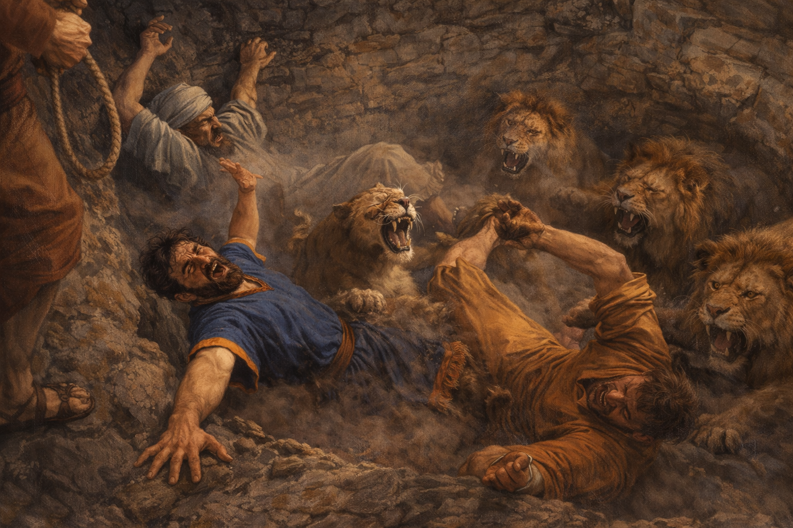
Notes:
they were more eager than ever

Slide 16
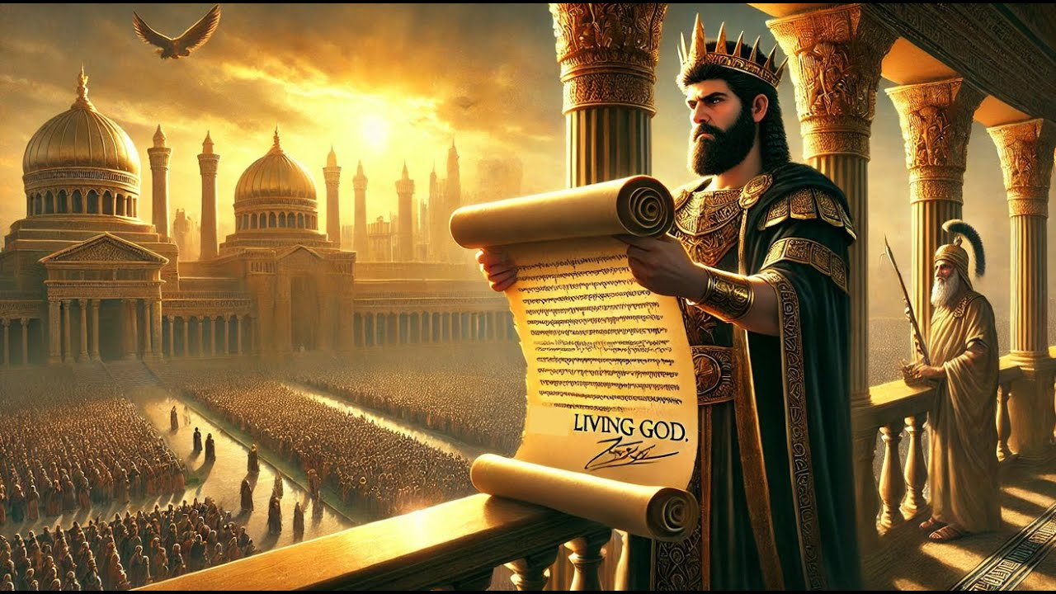
Notes:
Proclamation

Slide 17
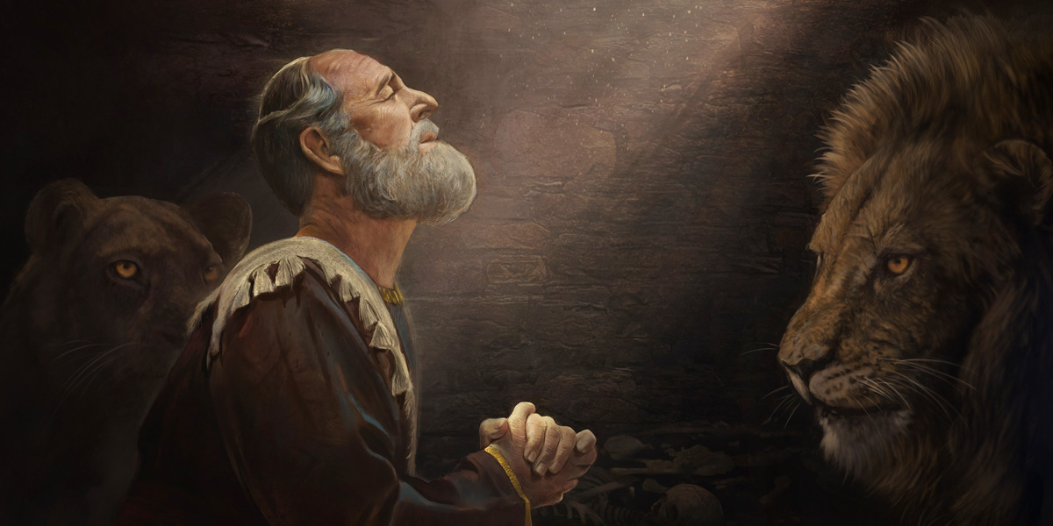
Notes:
Daniel’s character

Slide 18
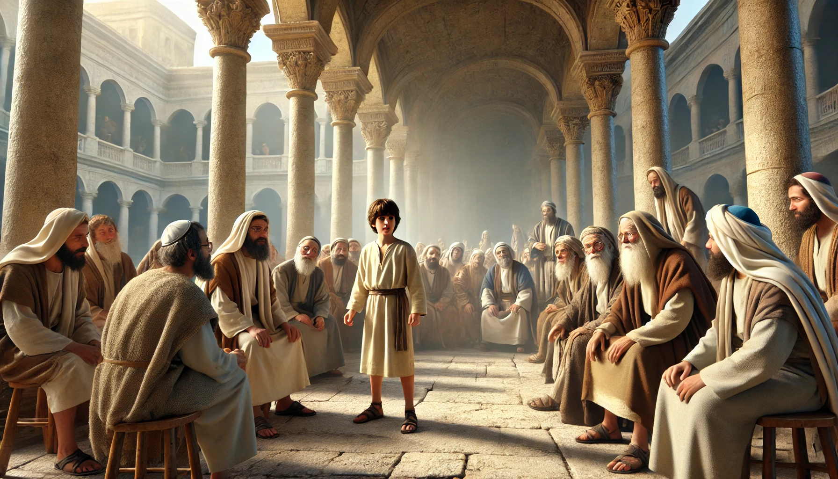
Notes:
PM

