Slide 1
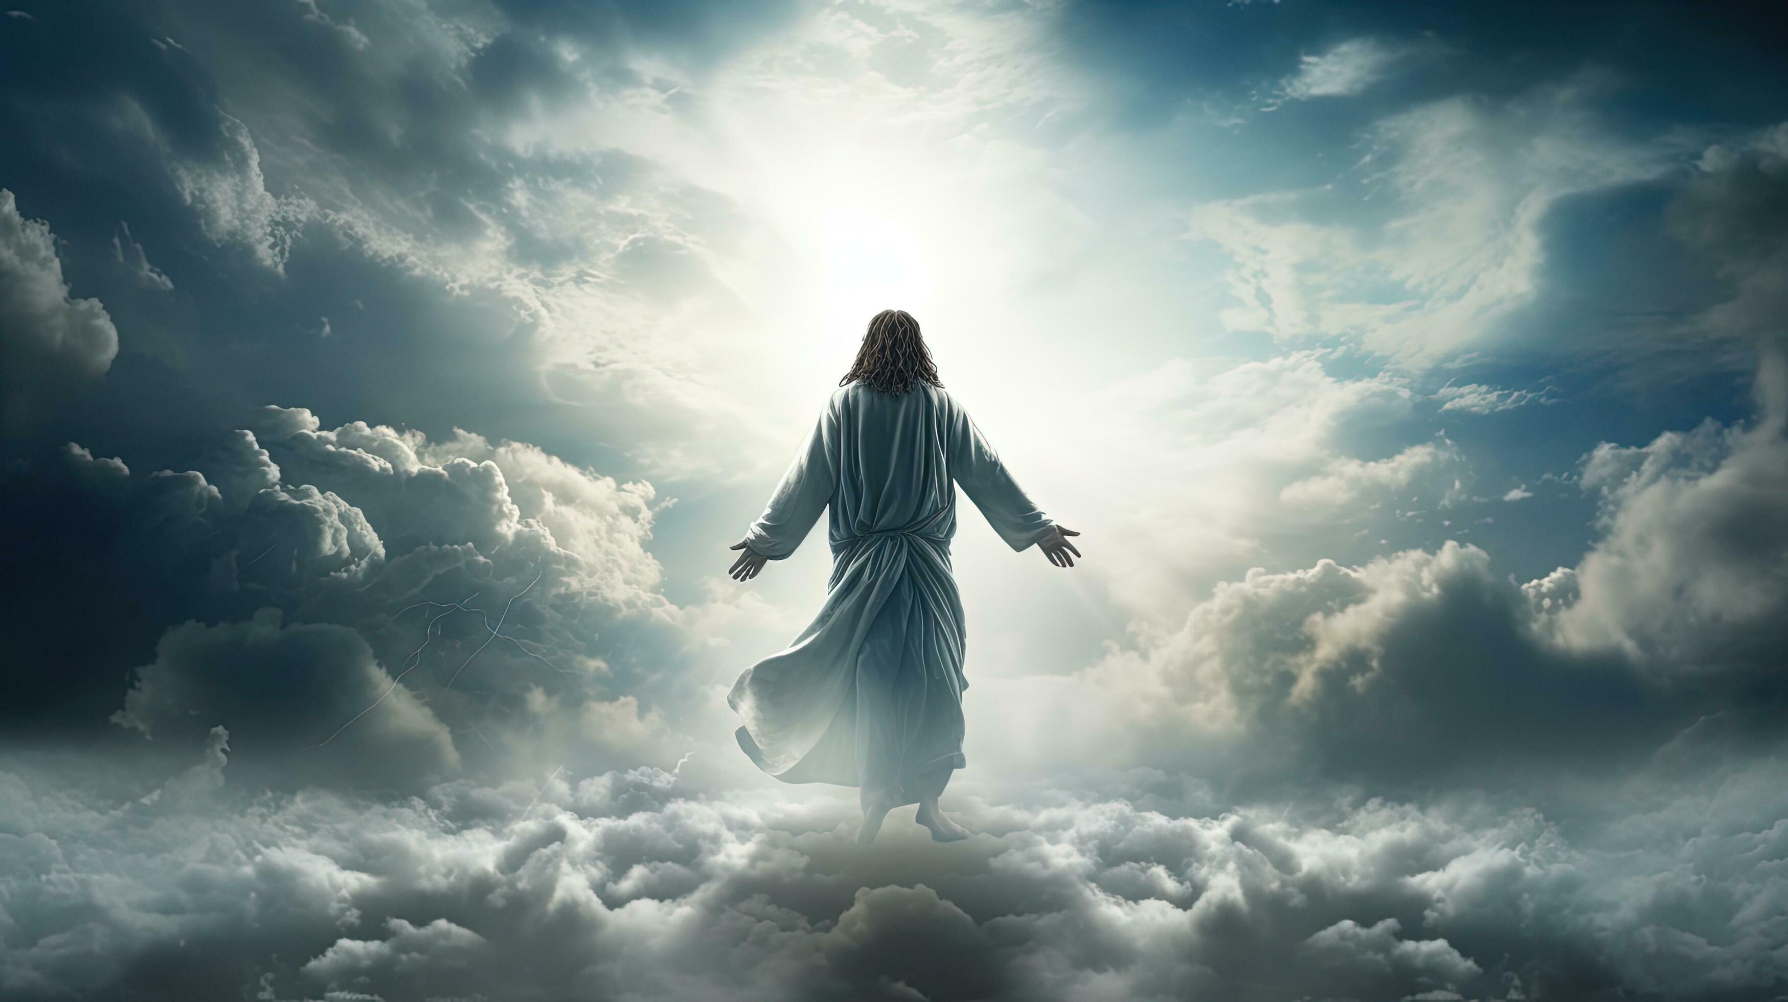
Notes:
music

Slide 2
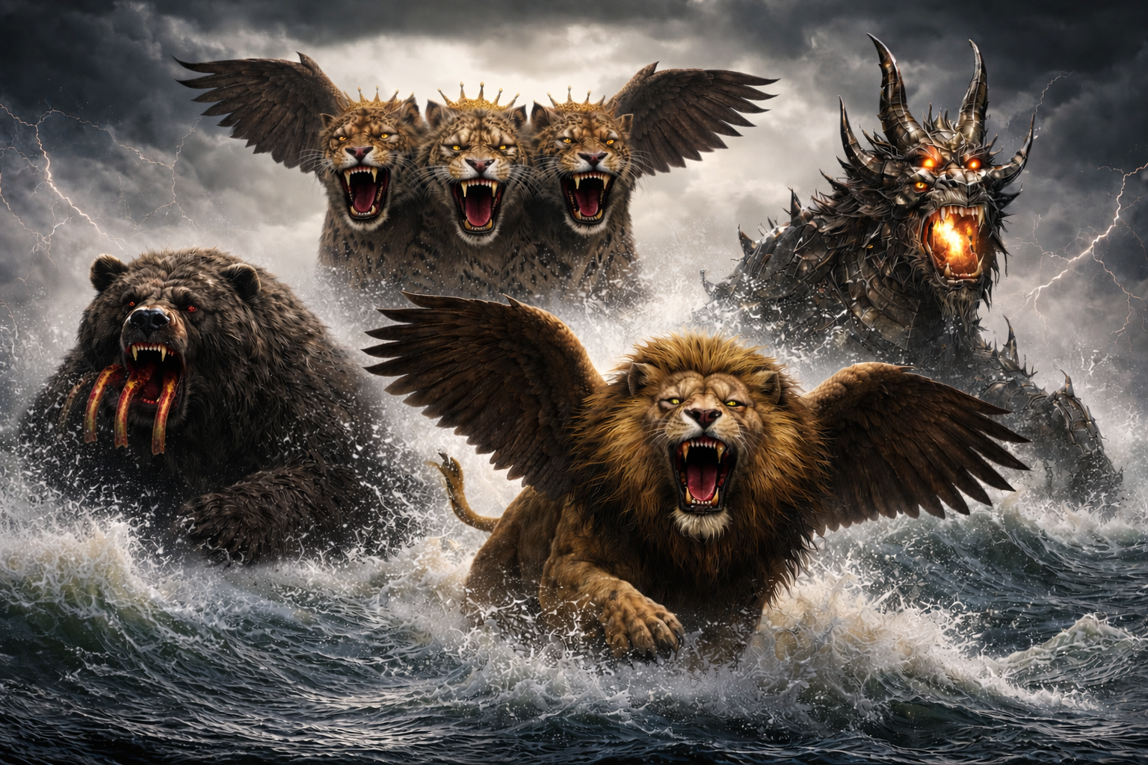
Notes:
message

Slide 3
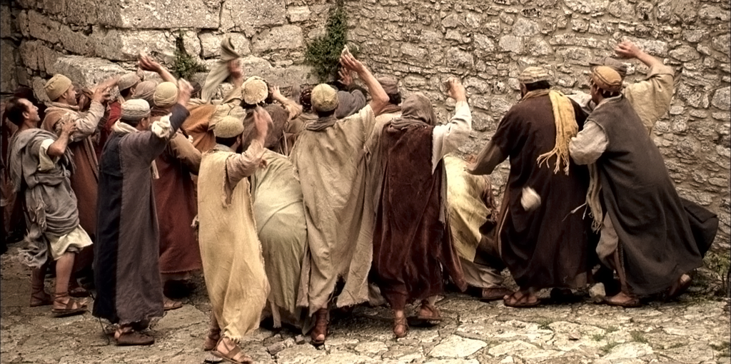
Notes:
Hebrew method of execution

Slide 4
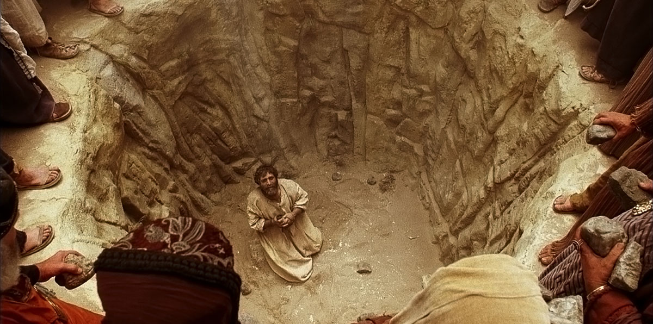
Notes:
if they didn’t have a pit

Slide 5
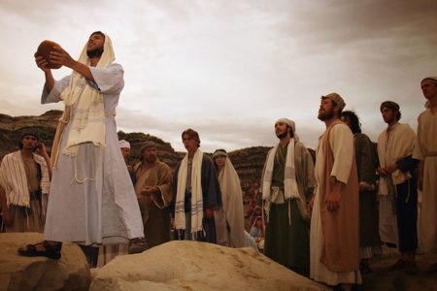
Notes:
then the second witness

Slide 6
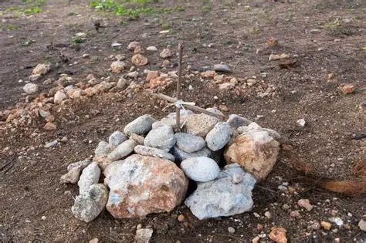
Notes:
infamous place

Slide 7
Deuteronomy 13:5, 10
⁵ And that prophet, or that dreamer of dreams, shall be put to death; because he hath spoken to turn you away from the LORD your God…So shalt thou put the evil away from the midst of thee. ¹⁰ And thou shalt stone him with stones, that he die;

Slide 8
Deuteronomy 13:5, 10
⁵ And that prophet, or that dreamer of dreams, shall be put to death; because he hath spoken to turn you away from the LORD your God…So shalt thou put the evil away from the midst of thee. ¹⁰ And thou shalt stone him with stones, that he die;

Slide 9
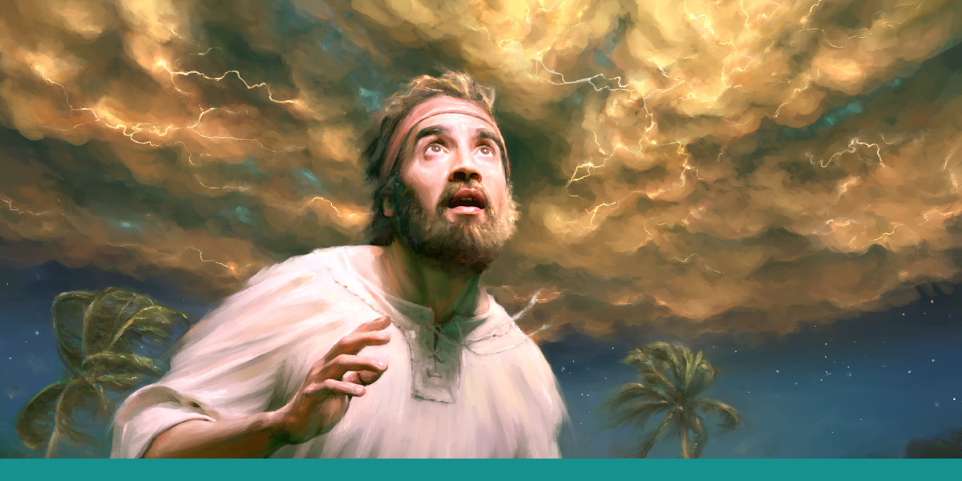
Notes:
there was such a man in ancient times

Slide 10
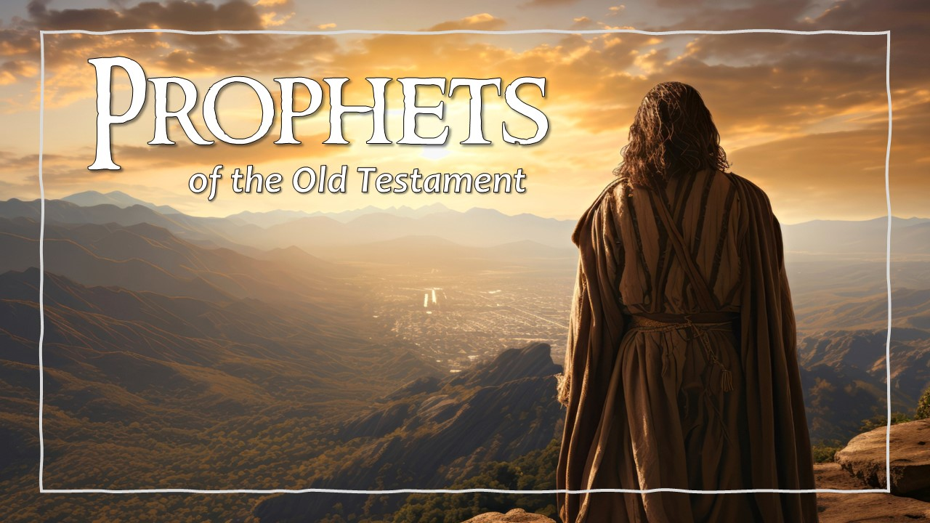
Isaiah 41:22-23
²² Let them bring them forth, and shew us what shall happen… ²³ Shew the things that are to come hereafter, that we may know that ye are gods:

Slide 11
Numbers 23:19
19 God is not a man, that he should lie; neither the son of man, that he should repent: hath he said, and shall he not do it? or hath he spoken, and shall he not make it good?

Slide 12
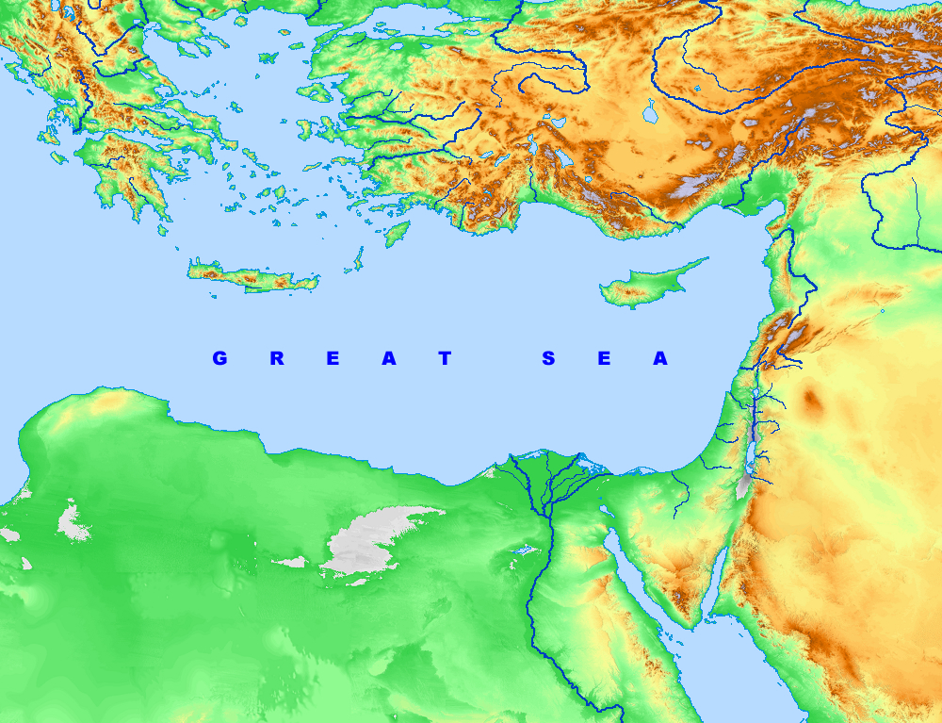
Notes:
what is the great sea

Slide 13
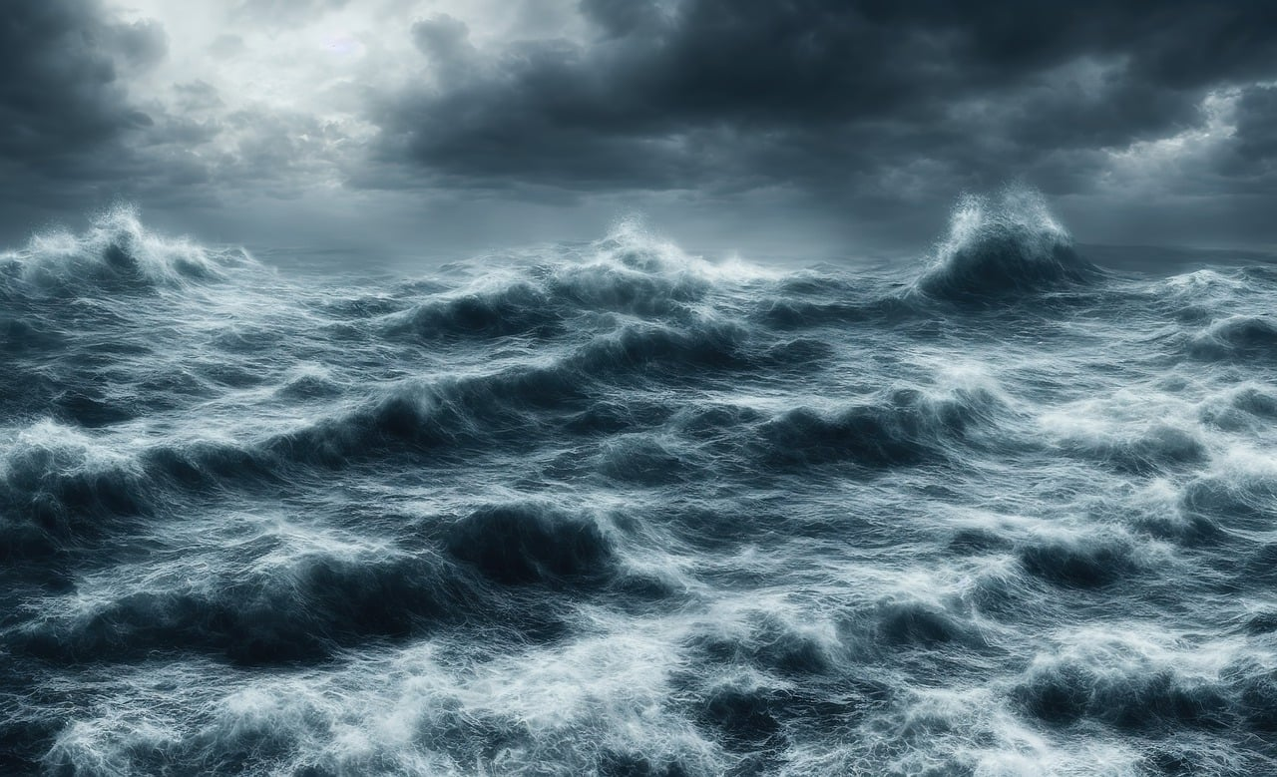
Notes:
he sees the sea in turbulence

Slide 14
Revelation 17:15
¹⁵ And he saith unto me, The waters which thou sawest…are peoples, and multitudes, and nations, and tongues.
Notes:
he sees the sea in turbulence

Slide 15
Notes:
Sea Monsters!

Slide 16
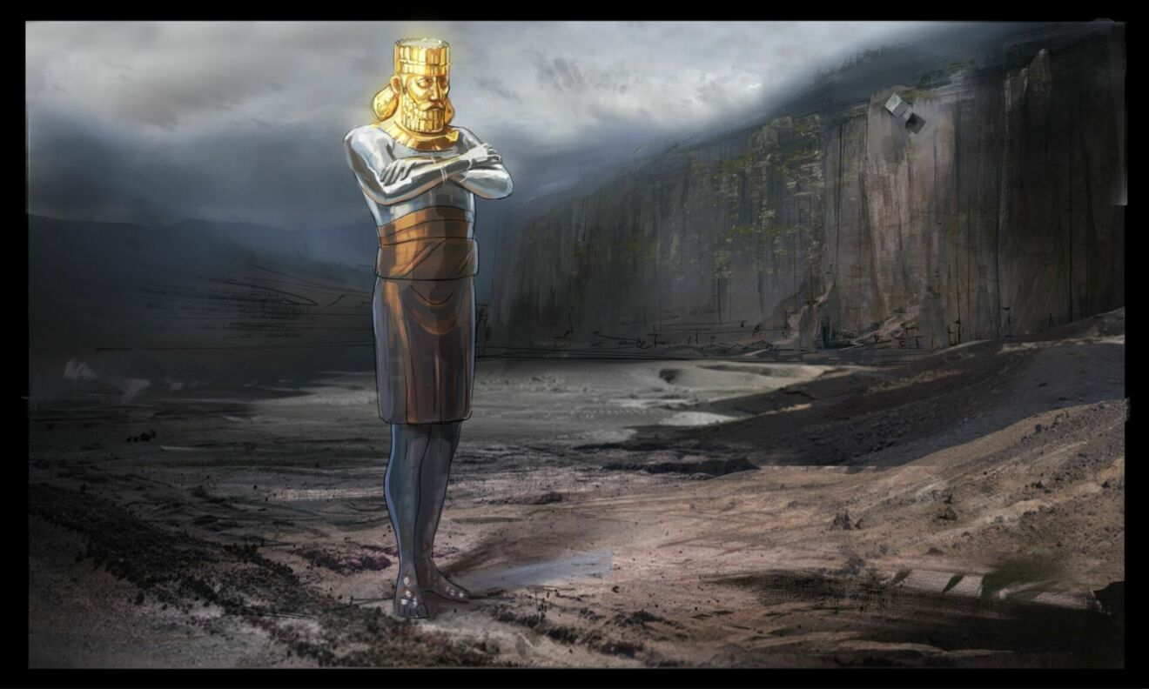
Notes:
Nebuchadnezzar saw this colossal image of gold

Slide 17
Notes:
this is the same thing again

Slide 18
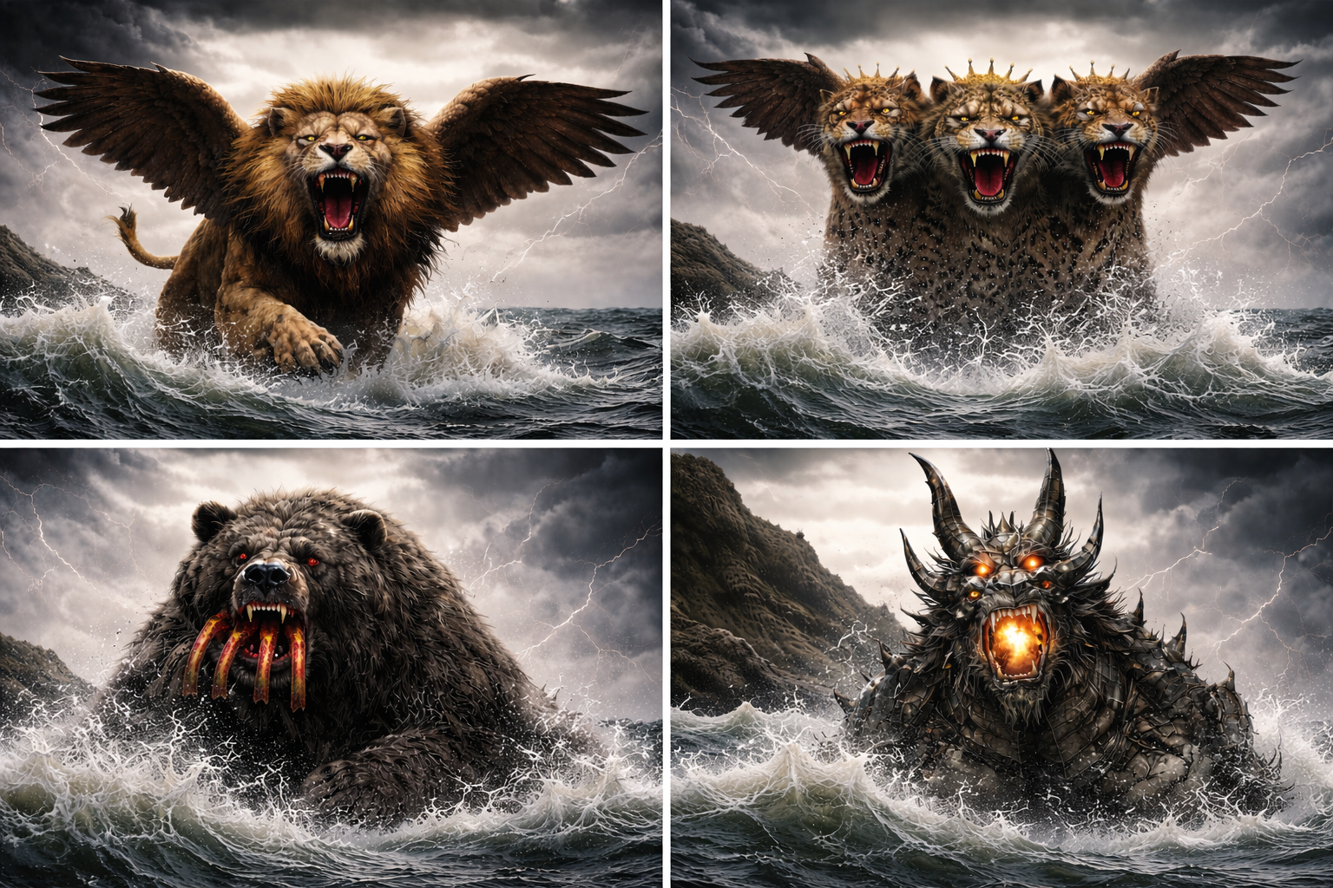

Slide 19
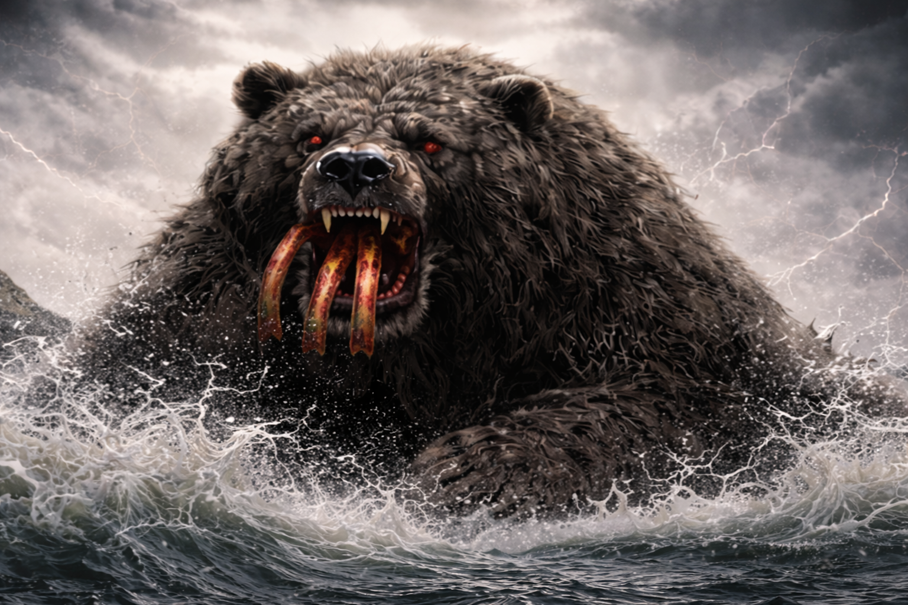
Notes:
let’s look at the second beast in verse 5

Slide 20
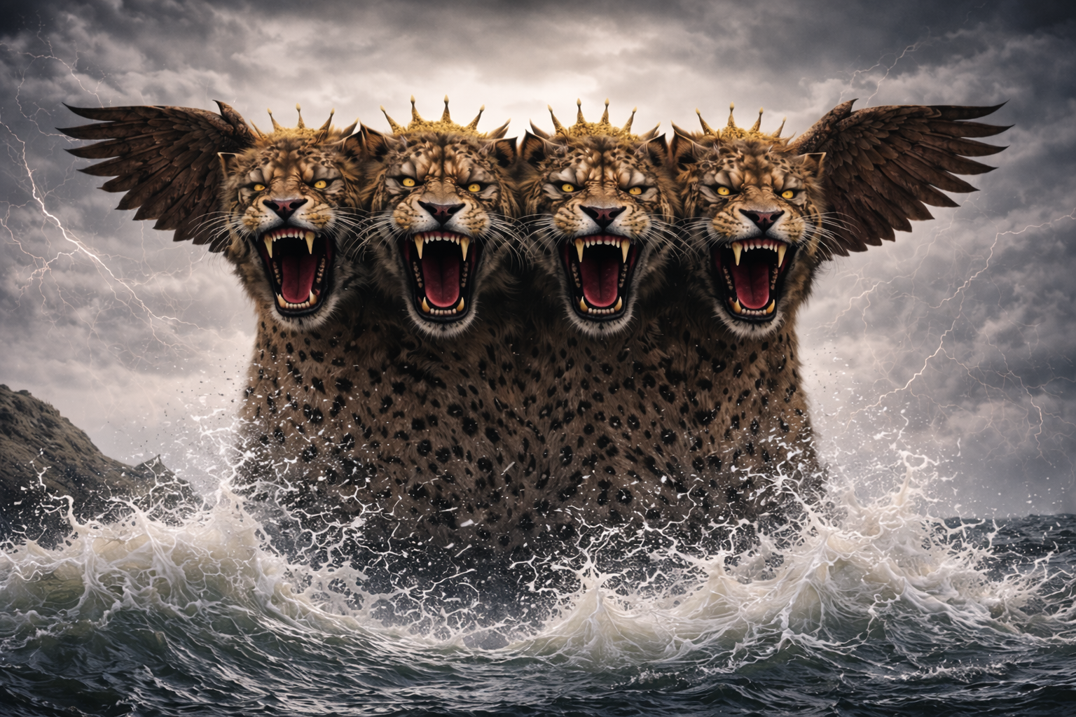
Notes:
Verse 6

Slide 21
Notes:
The fourth beast is in verse 7

Slide 22
Revelation 17:12
¹² And the ten horns which thou sawest are ten kings, which have received no kingdom as yet; but receive power as kings one hour with the beast.

Slide 23
Revelation 13:1-2
1 And I stood upon the sand of the sea, and saw a beast rise up out of the sea, having seven heads and ten horns, and upon his horns ten crowns, and upon his heads the name of blasphemy. 2 And the beast which I saw was like unto a leopard, and his feet were as the feet of a bear, and his mouth as the mouth of a lion: and the dragon gave him his power, and his seat, and great authority.

