Slide 2
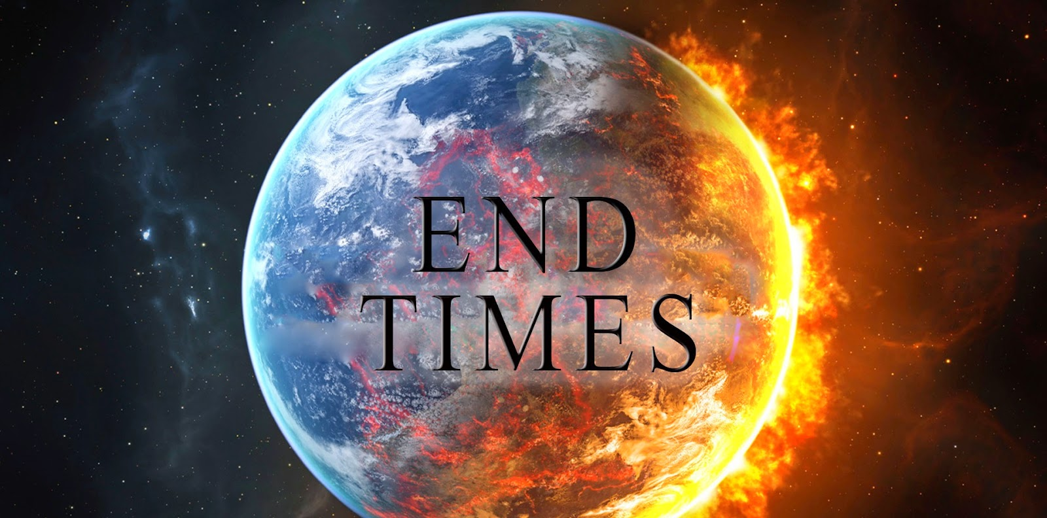
Notes:
beginning

Slide 3
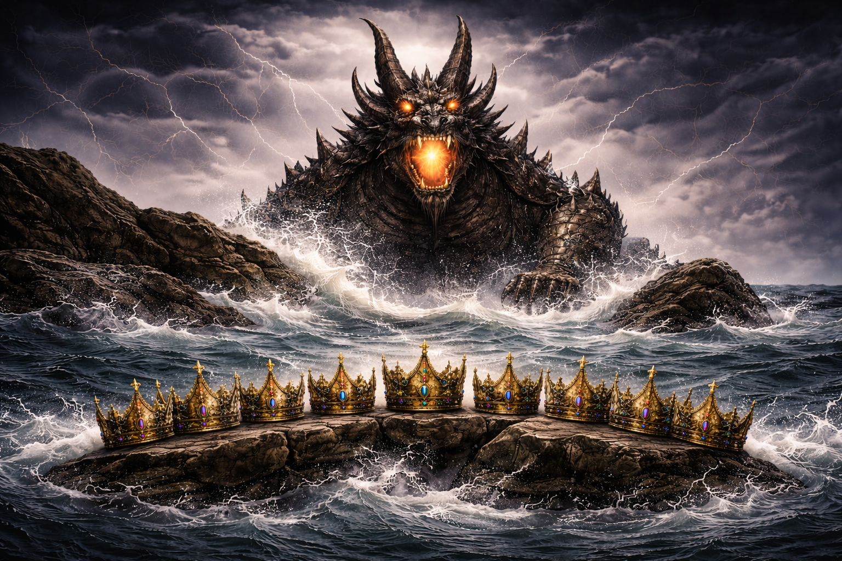
Notes:
the one with ten horns

Slide 4

Revelation 13:1
And I stood upon the sand of the sea, and saw a beast rise up out of the sea, having seven heads and ten horns, and upon his horns ten crowns…

Slide 5

Revelation 13:1
And I stood upon the sand of the sea, and saw a beast rise up out of the sea, having seven heads and ten horns, and upon his horns ten crowns…
Notes:
Daniel started a long countdown

Slide 6
Luke 21:28
And when these things begin to come to pass, then look up, and lift up your heads; for your redemption draweth nigh.
Revelation 13:1
And I stood upon the sand of the sea, and saw a beast rise up out of the sea, having seven heads and ten horns, and upon his horns ten crowns…

Slide 7
Luke 21:31
So likewise ye, when ye see these things come to pass, know ye that the kingdom of God is nigh at hand.
Revelation 13:1
And I stood upon the sand of the sea, and saw a beast rise up out of the sea, having seven heads and ten horns, and upon his horns ten crowns…

Slide 8
Matthew 24:33
So likewise ye, when ye shall see all these things, know that it is near, even at the doors.
Revelation 13:1
And I stood upon the sand of the sea, and saw a beast rise up out of the sea, having seven heads and ten horns, and upon his horns ten crowns…

Slide 9
Revelation 13:1
And I stood upon the sand of the sea, and saw a beast rise up out of the sea, having seven heads and ten horns, and upon his horns ten crowns…
Christ’s Eternal Kingdom
Satan Cast into Hell
Battle of Armageddon
Treaty Broken
Treaty Made
Temple Built
Peace
A Peacemaker
“The Ten”

Slide 10
Daniel 9:27
27 And he shall confirm the covenant with many for one week: and in the midst of the week he shall cause the sacrifice and the oblation to cease, and for the overspreading of abominations he shall make it desolate…

Slide 11
1 Thessalonians 5:3
“For when they shall say, Peace and safety; then sudden destruction cometh upon them…”

Slide 12
Ezekiel 38:11
11 And thou shalt say, I will go up to the land of unwalled villages; I will go to them that are at rest, that dwell safely, all of them dwelling without walls, and having neither bars nor gates,

Slide 13
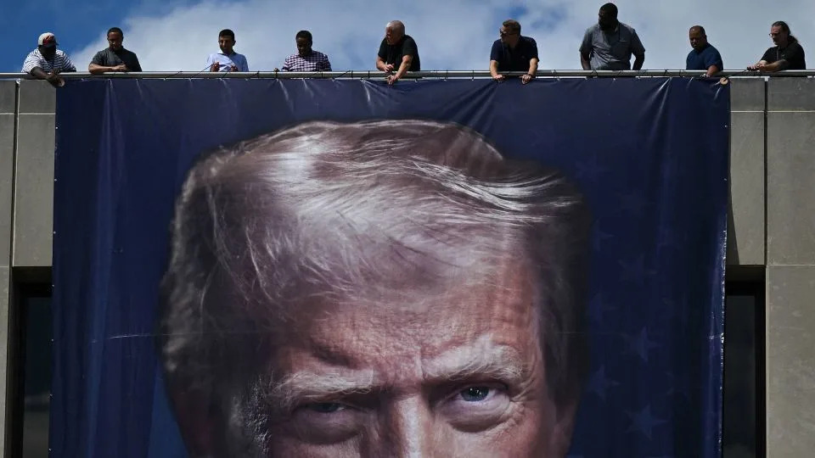
Notes:
Trump is being called the great peacemaker

Slide 14


Slide 15
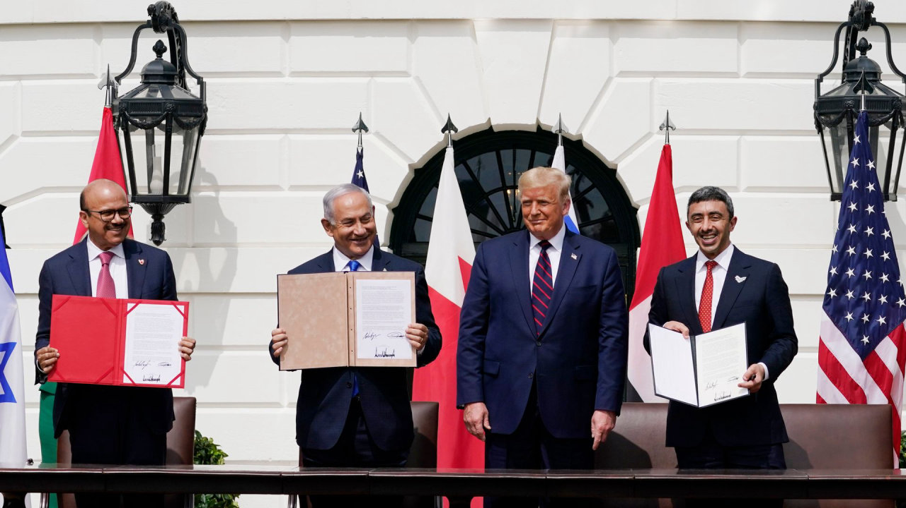
Notes:
Abraham Accords

Slide 16
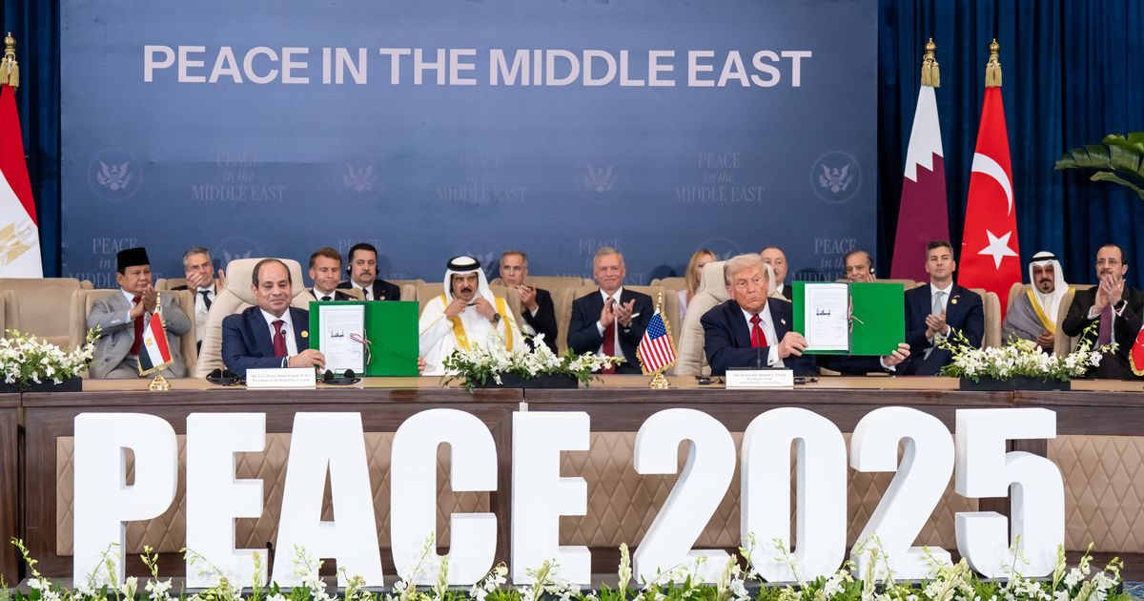
Notes:
Last October

Slide 17
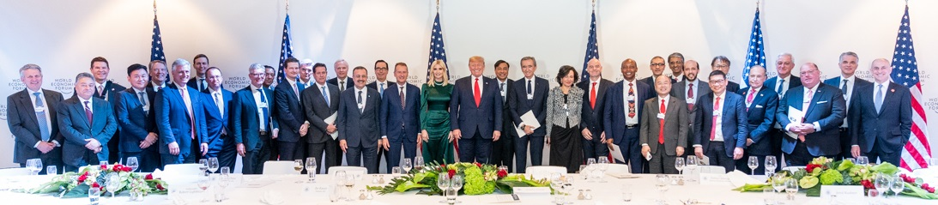
Notes:
last month in Davos, Switzerland

Slide 18
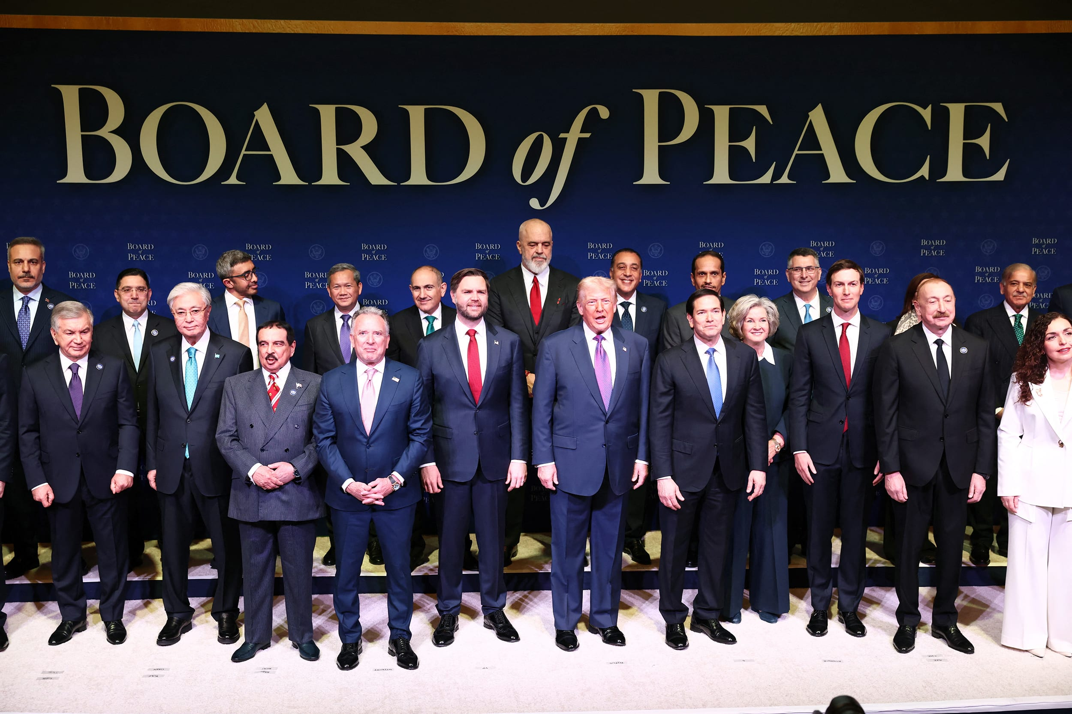

Slide 19
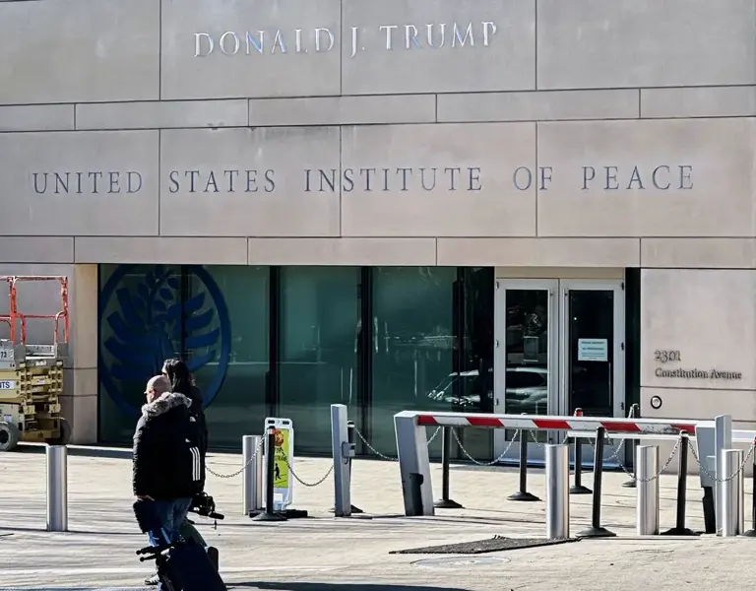

Slide 20
Notes:
Who are “the ten” horns?

Slide 21
Revelation 13:1
And I stood upon the sand of the sea, and saw a beast rise up out of the sea, having seven heads and ten horns, and upon his horns ten crowns…
Christ’s Eternal Kingdom
Satan Cast into Hell
Battle of Armageddon
Treaty Broken
Treaty Made
Temple Built
Peace
A Peacemaker
“The Ten”
The Rapture
Notes:
The rapture can happen at anytime

