Slide 1


Slide 2
Genesis 16:12
¹² And he will be a wild man; his hand will be against every man, and every man's hand against him; and he shall dwell in the presence of all his brethren.

Slide 3
Jeremiah 49:34-39
…Behold, I will break the bow of Elam…upon Elam will I bring the four winds…I will cause Elam to be dismayed before their enemies…I will send the sword after them, till I have consumed them…and will destroy from thence the king and the princes, saith the LORD. But it shall come to pass in the latter days, that I will bring again the captivity of Elam, saith the LORD.

Slide 4
Revelation 13:2
2 And the beast which I saw was like unto a leopard, and his feet were as the feet of a bear, and his mouth as the mouth of a lion: and the dragon gave him his power, and his seat, and great authority.

Slide 5
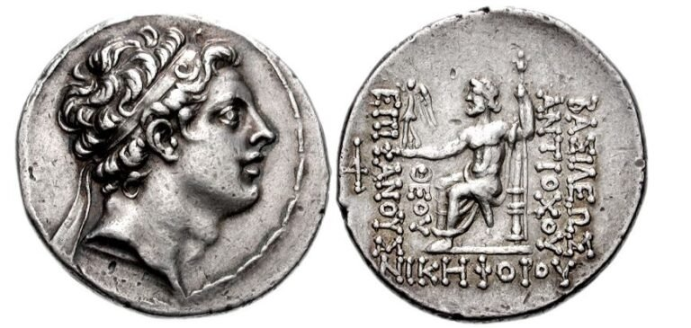

Slide 6


