Slide 1
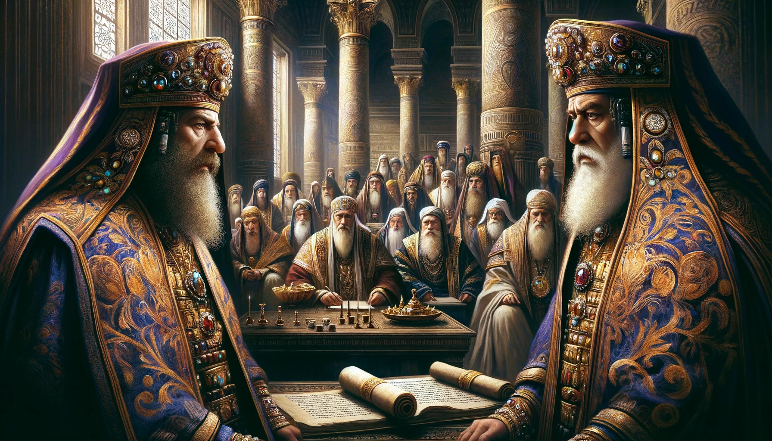
Notes:
message

Slide 2
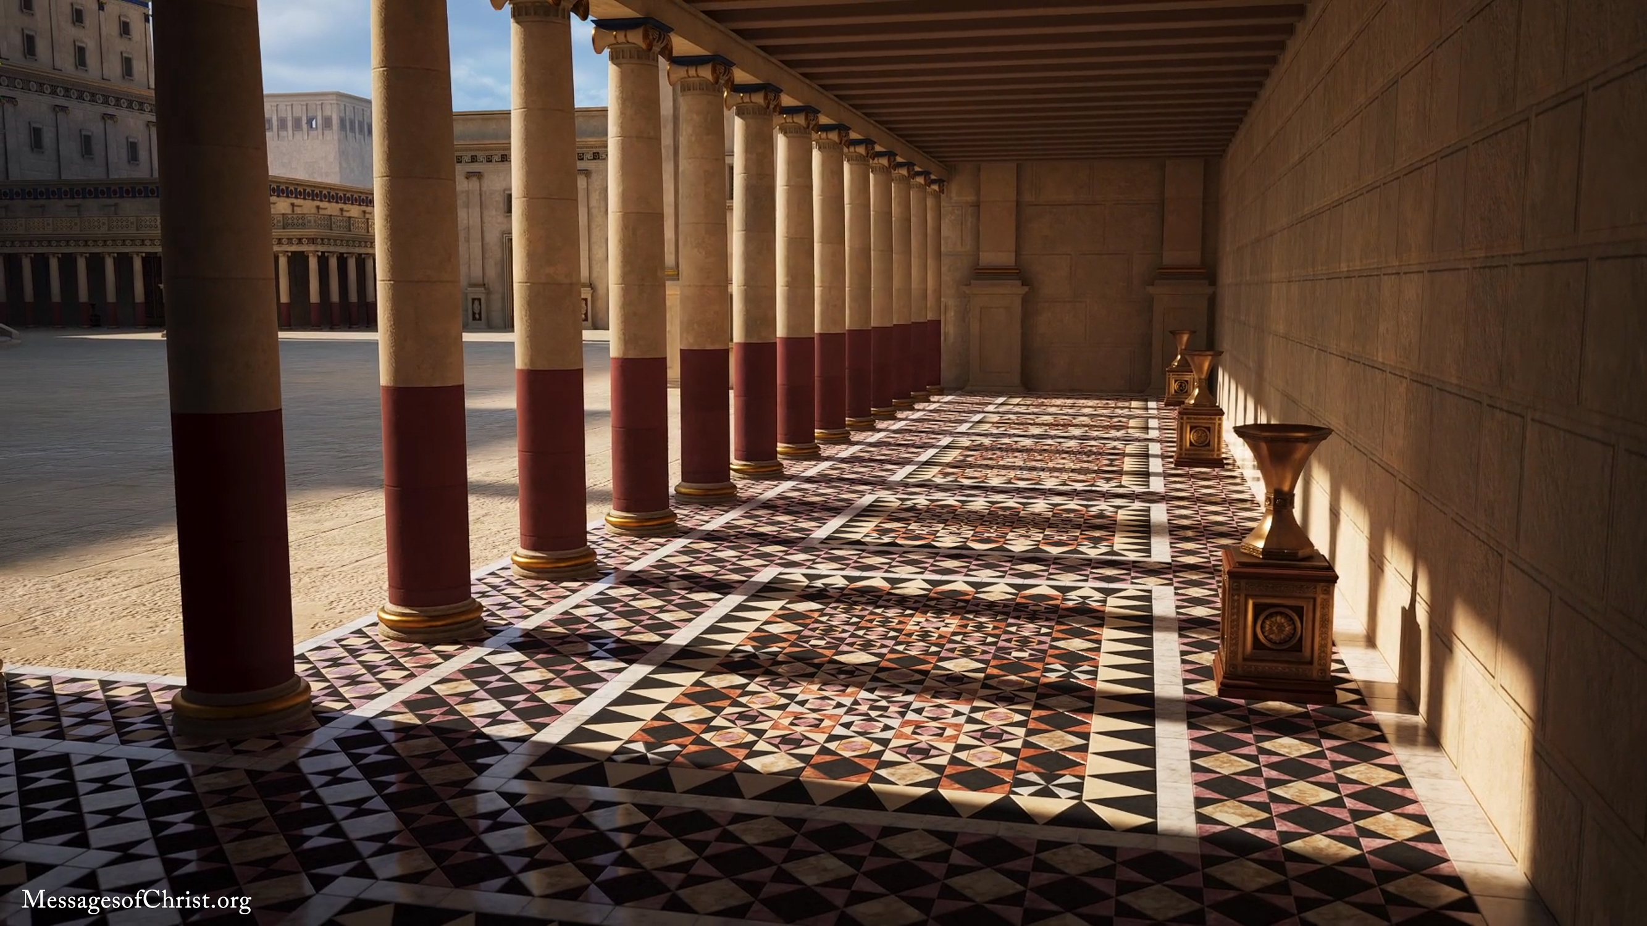
Notes:
thirteen trumpet-shaped

Slide 3
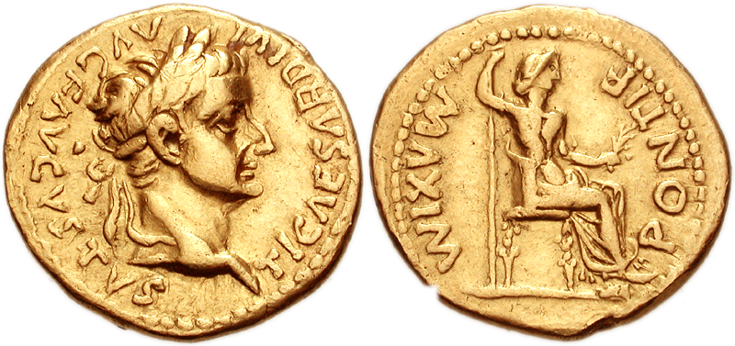
Notes:
On every Roman coin

Slide 4
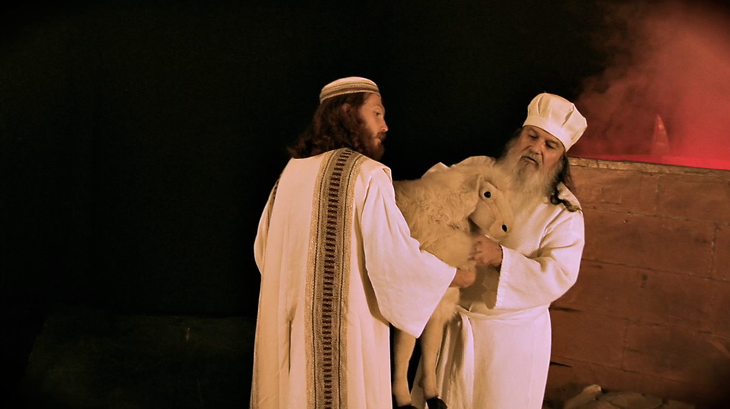
Notes:
You bring your best lamb.

Slide 5
Notes:
The two men were the real power over the people

Slide 6
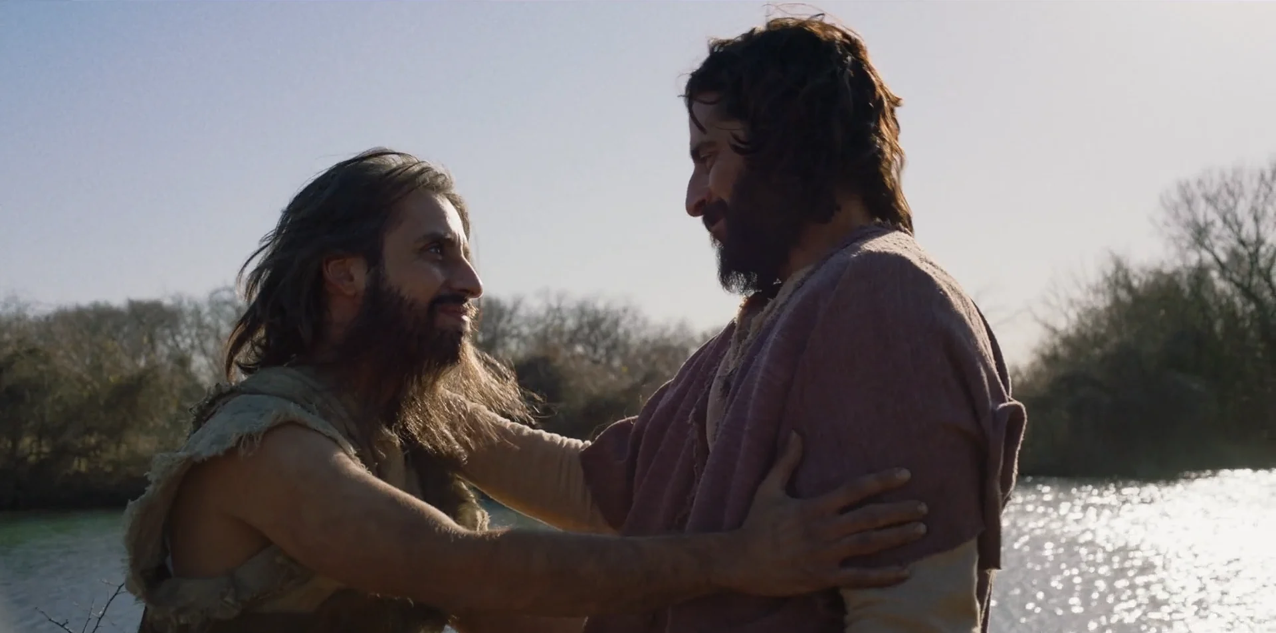
Notes:
cousins

Slide 7
1 Corinthians 1:26-27
²⁶ For ye see your calling, brethren, how that not many wise men after the flesh, not many mighty, not many noble, are called: ²⁷ But God hath chosen the foolish things of the world to confound the wise; and God hath chosen the weak things of the world to confound the things which are mighty;
Notes:
cousins

Slide 8
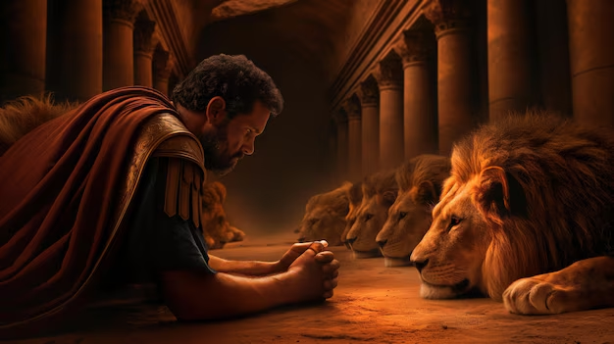
Notes:
PM

