Slide 1
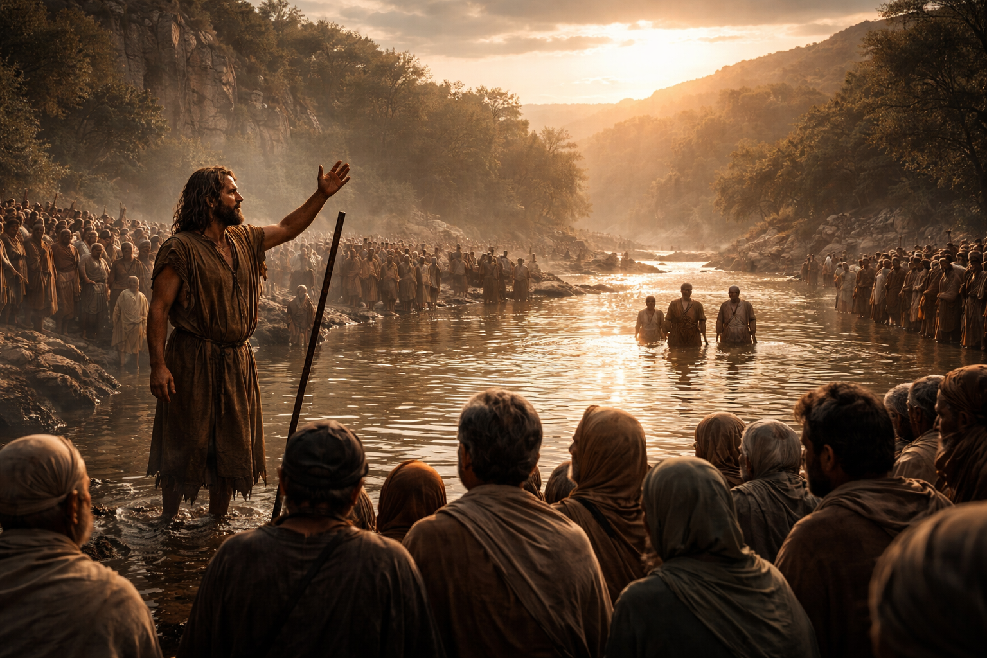

Slide 2
2 Chronicles 7:14
¹⁴ If my people, which are called by my name, shall humble themselves, and pray, and seek my face, and turn from their wicked ways; then will I hear from heaven, and will forgive their sin, and will heal their land.

Slide 3
Isaiah 1:16
¹⁶ Wash you, make you clean; put away the evil of your doings from before mine eyes; cease to do evil;

Slide 4
Isaiah 1:18
18 Come now, and let us reason together, saith the LORD: though your sins be as scarlet, they shall be as white as snow; though they be red like crimson, they shall be as wool.

Slide 5
Ezekiel 33:13
… if he trust to his own righteousness, and commit iniquity, all his righteousnesses shall not be remembered; but for his iniquity that he hath committed, he shall die for it.

Slide 6
Isaiah 55:7
Let the wicked forsake his way, and the unrighteous man his thoughts: and let him return unto the LORD, and he will have mercy upon him; and to our God, for he will abundantly pardon.

Slide 7
Jonah 3:10
¹⁰ And God saw their works, that they turned from their evil way; and God repented of the evil, that he had said that he would do unto them; and he did it not.

Slide 8
2 Corinthians 7:9
9 Now I rejoice, not that ye were made sorry, but that ye sorrowed to repentance: for ye were made sorry after a godly manner…

Slide 9
2 Corinthians 7:10
10 For godly sorrow worketh repentance to salvation not to be repented of: but the sorrow of the world worketh death.

Slide 10
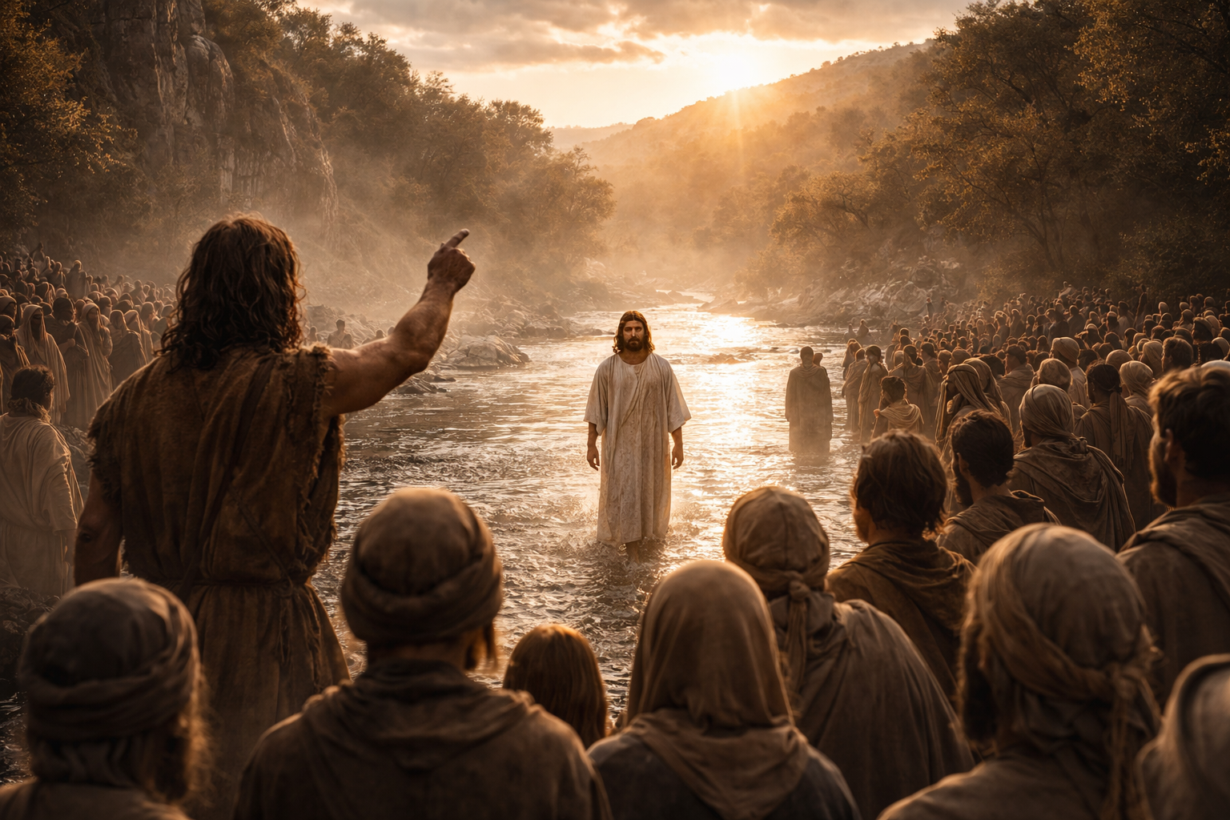
Notes:
then Jesus walked up and John said, Behold the Lamb

Slide 11
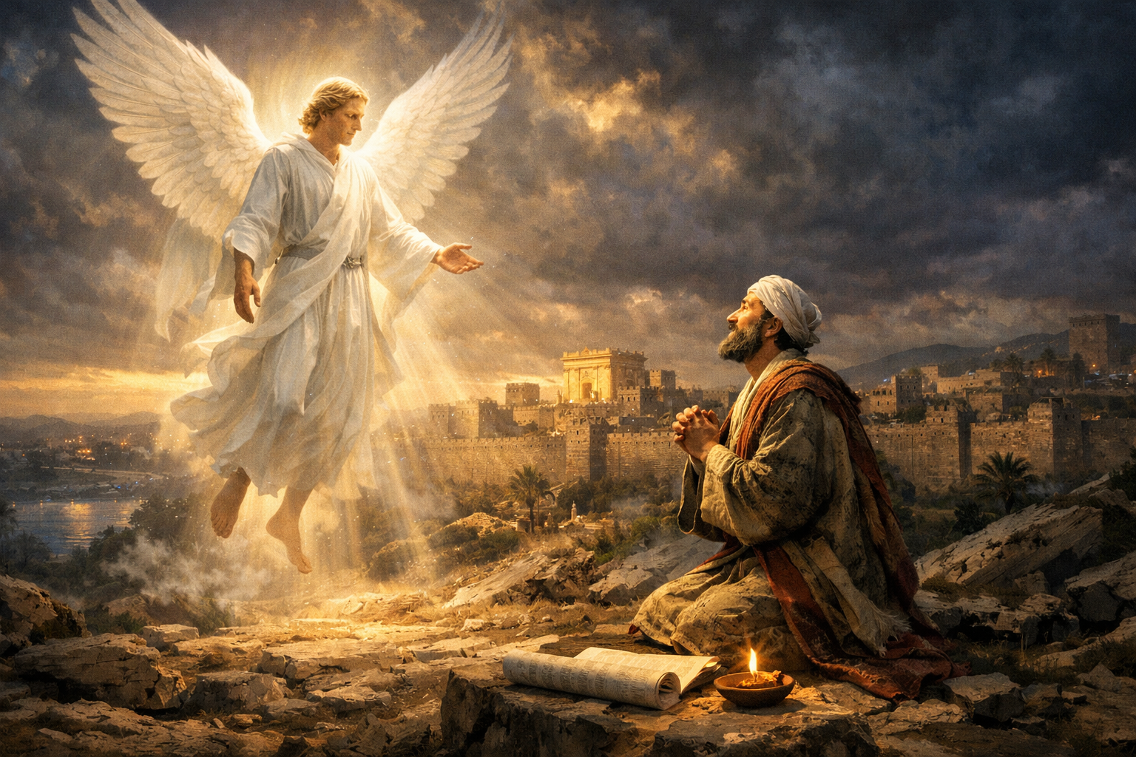
Notes:
PM

