Slide 1
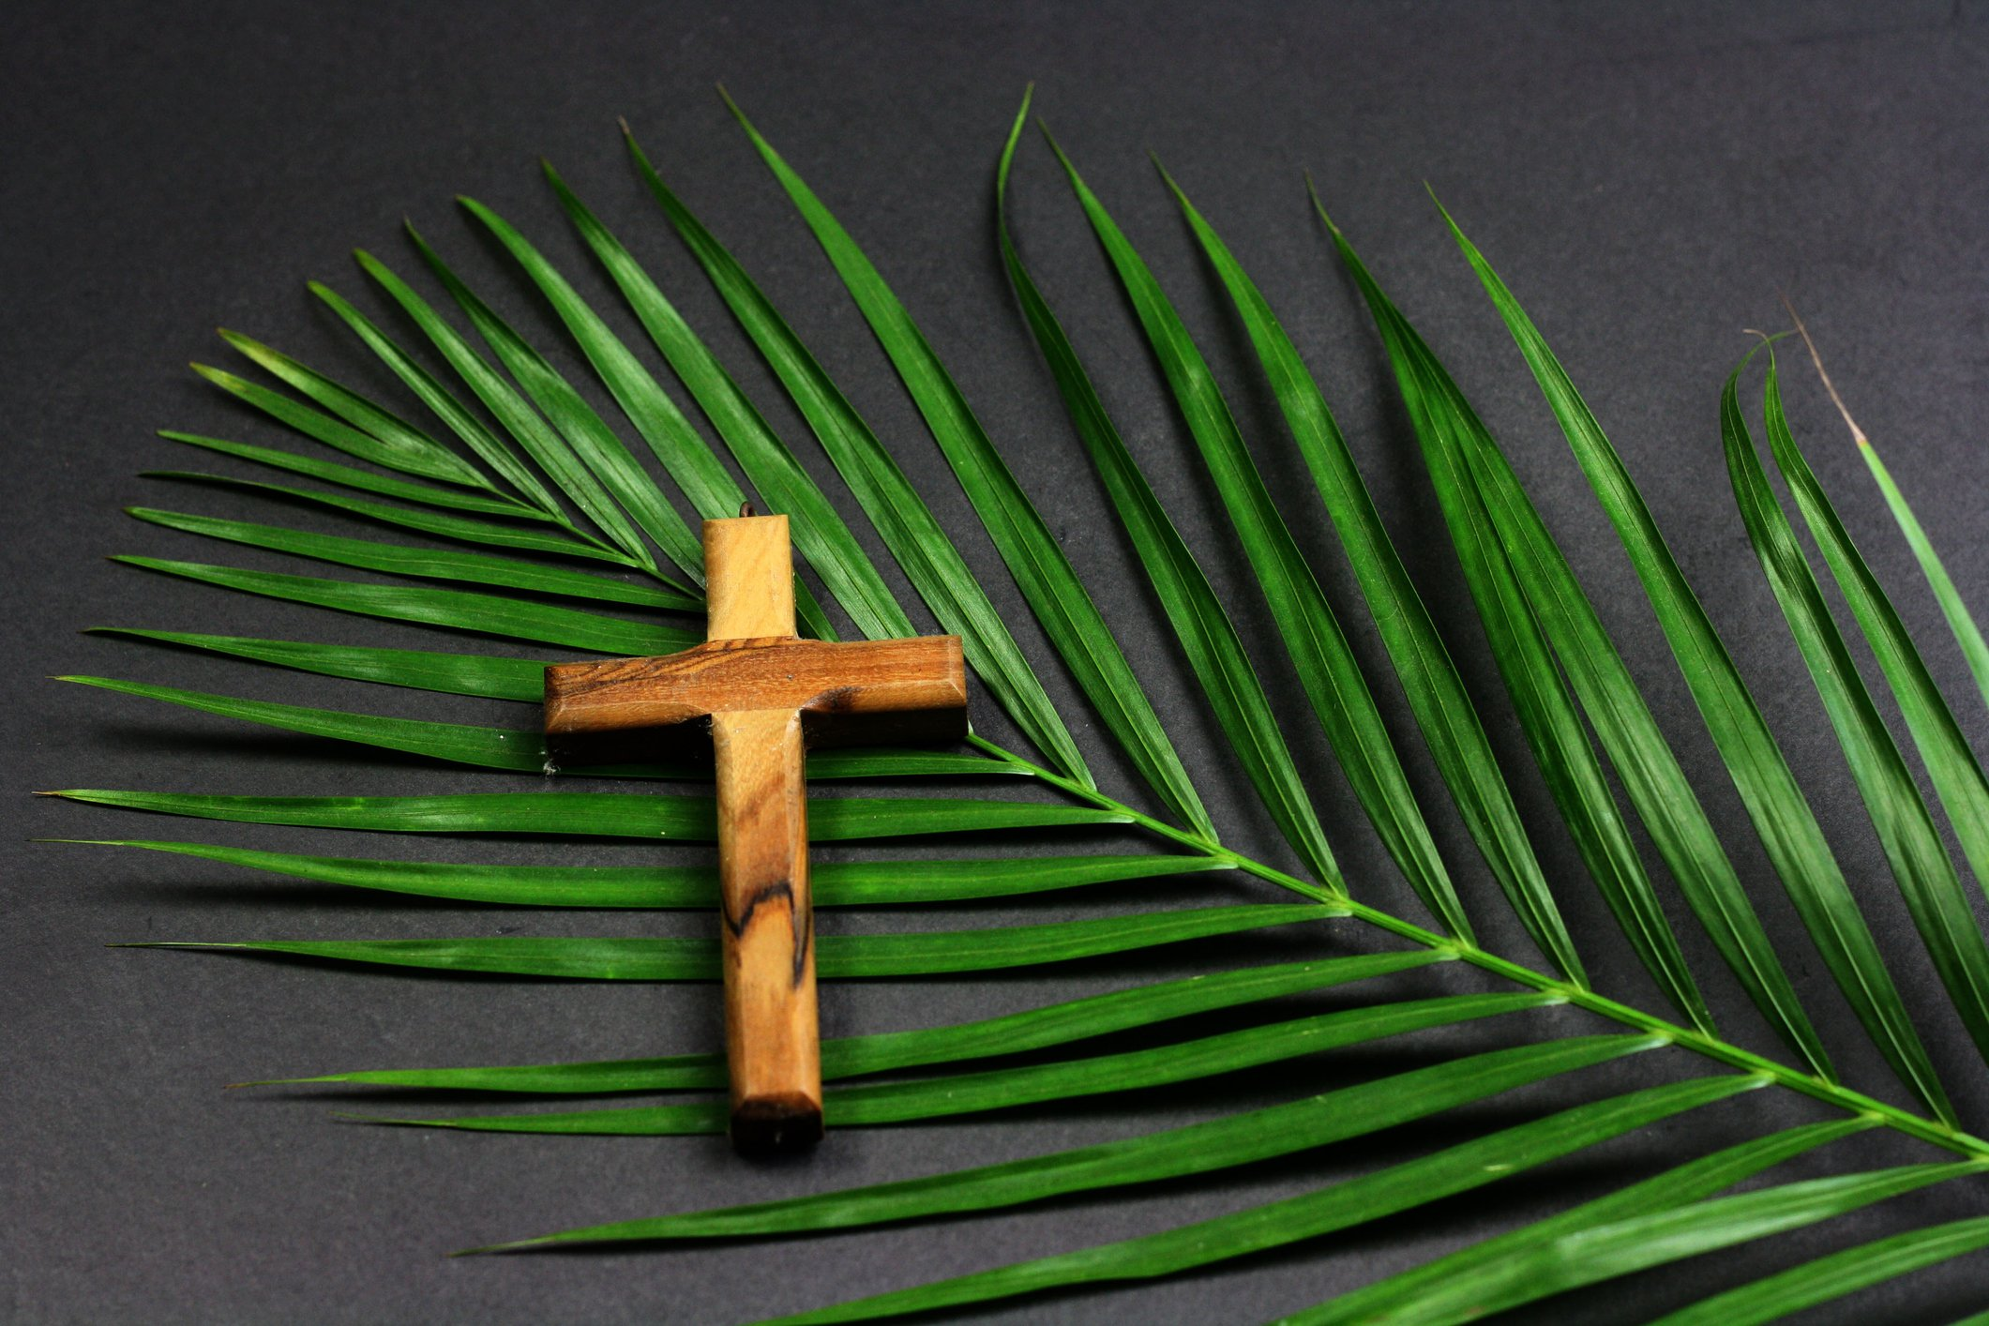
Notes:
Music and beginning of sermon

Slide 2
Zechariah 9:9
⁹ Rejoice greatly, O daughter of Zion; shout, O daughter of Jerusalem: behold, thy King cometh unto thee: he is just, and having salvation; lowly, and riding upon an ass, and upon a colt the foal of an ass.
Notes:
music

Slide 3

Notes:
let’s back up further, to Daniel 9

Slide 4
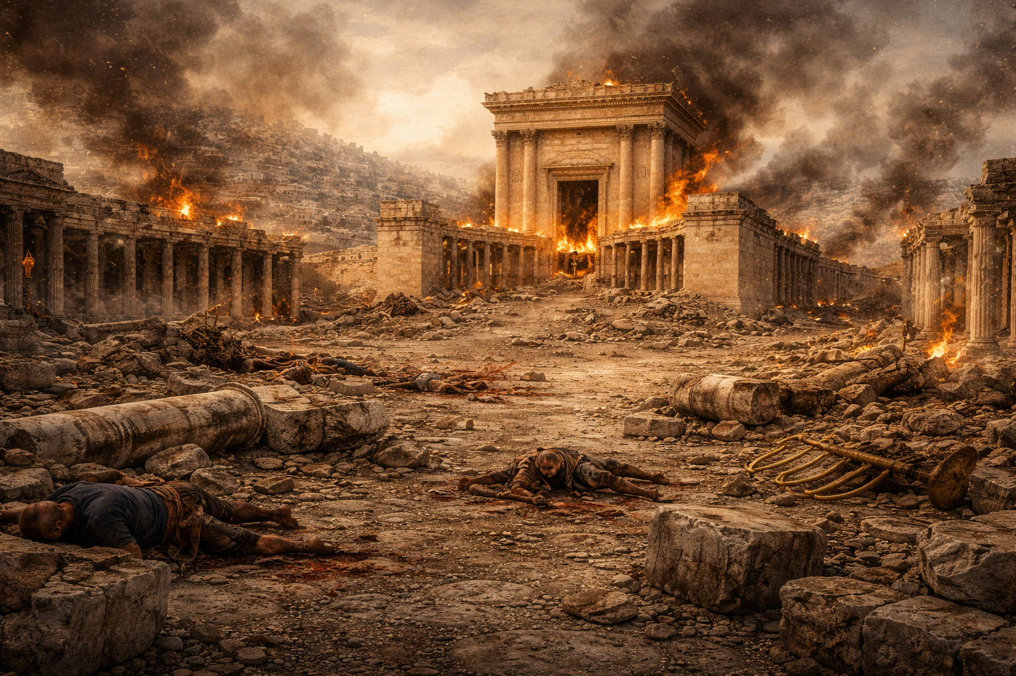
Notes:
they no longer have a temple

Slide 5
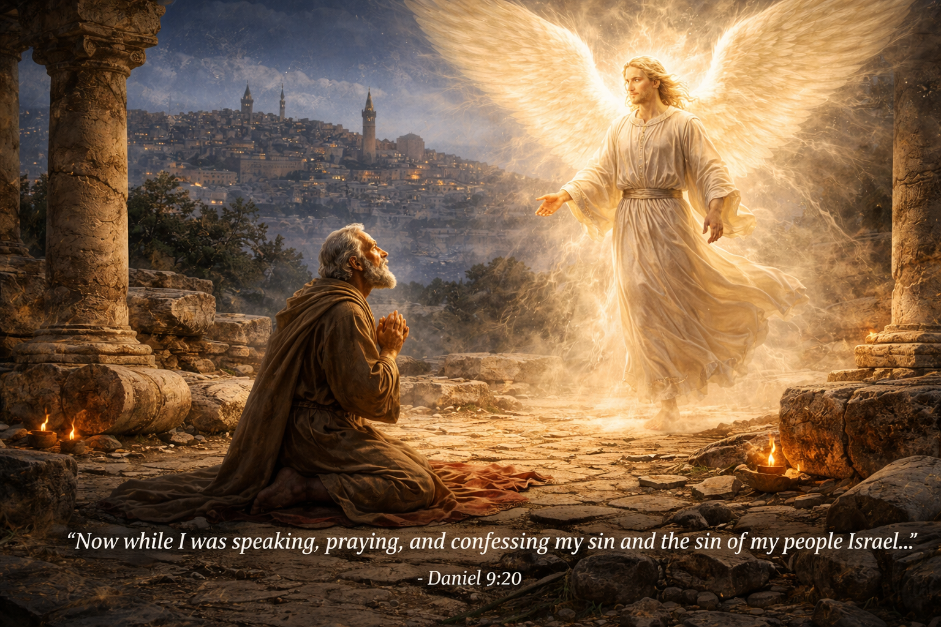
Notes:
he is touched by an angel

Slide 6
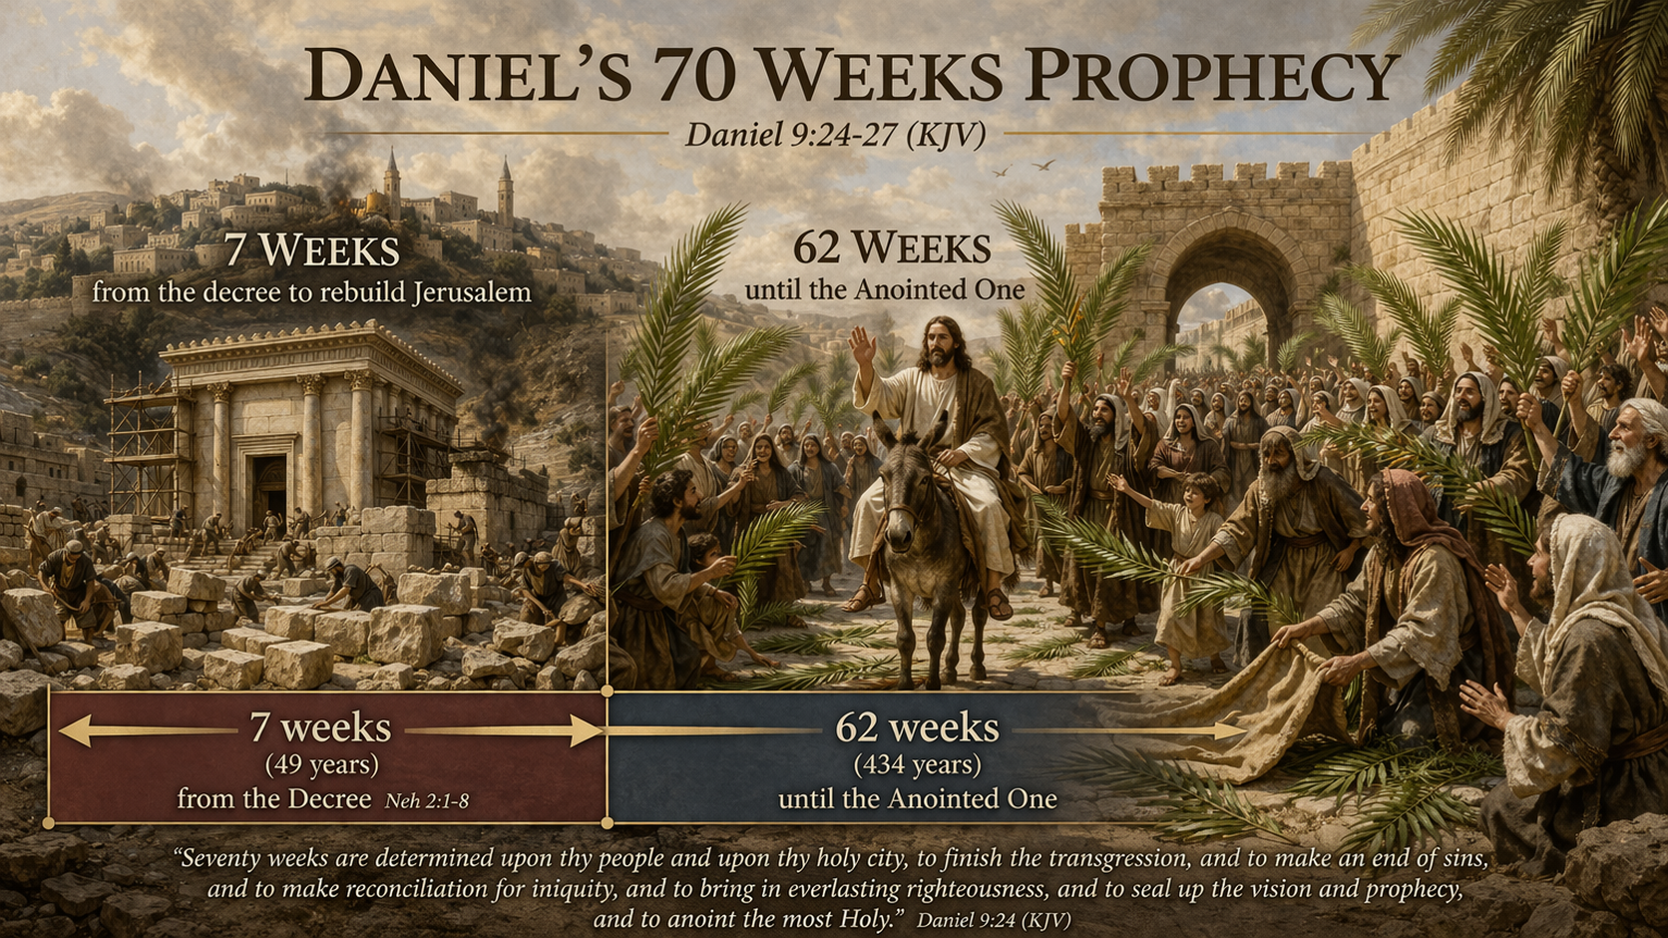
Notes:
this is the triumphal entry

Slide 7
Zechariah 12:10
¹⁰ And I will pour upon the house of David, and upon the inhabitants of Jerusalem…and they shall look upon me whom they have pierced, and they shall mourn for him, as one mourneth for his only son…
Notes:
let’s back up further, to Daniel 9

Slide 8
Zechariah 13:1
1 In that day there shall be a fountain opened to the house of David and to the inhabitants of Jerusalem for sin and for uncleanness.
Notes:
let’s back up further, to Daniel 9

Slide 9
Zechariah 13:9
… they shall call on my name, and I will hear them: I will say, It is my people: and they shall say, The LORD is my God.
Notes:
let’s back up further, to Daniel 9

Slide 10
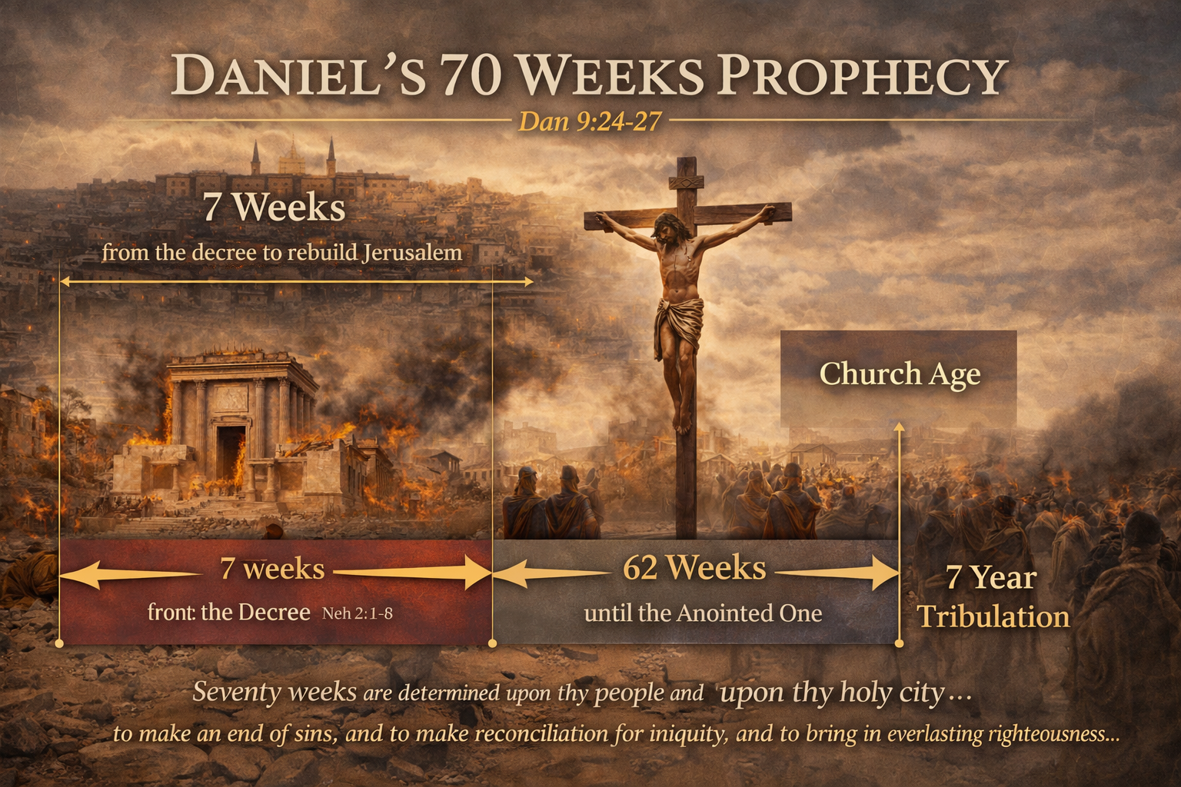
Notes:
There have only been 69 weeks of years.

Slide 11
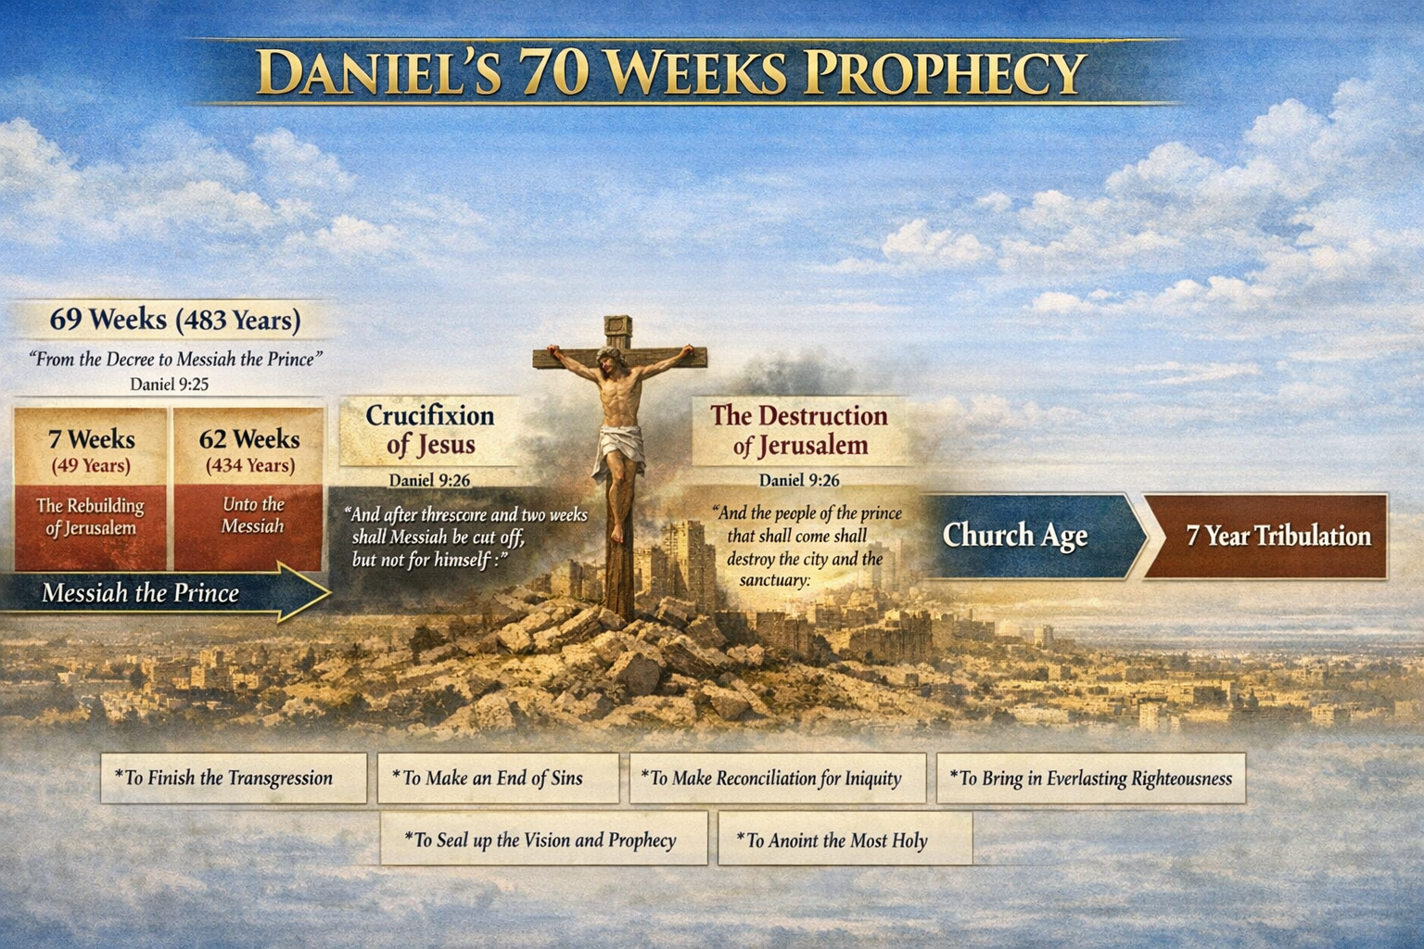
Notes:
This next slide is helpful.

Slide 12
Matthew 24:15
15 When ye therefore shall see the abomination of desolation, spoken of by Daniel the prophet, stand in the holy place, (whoso readeth, let him understand:)
Notes:
let’s back up further, to Daniel 9

Slide 13
Notes:
right on schedule, Jesus died

