Slide 1
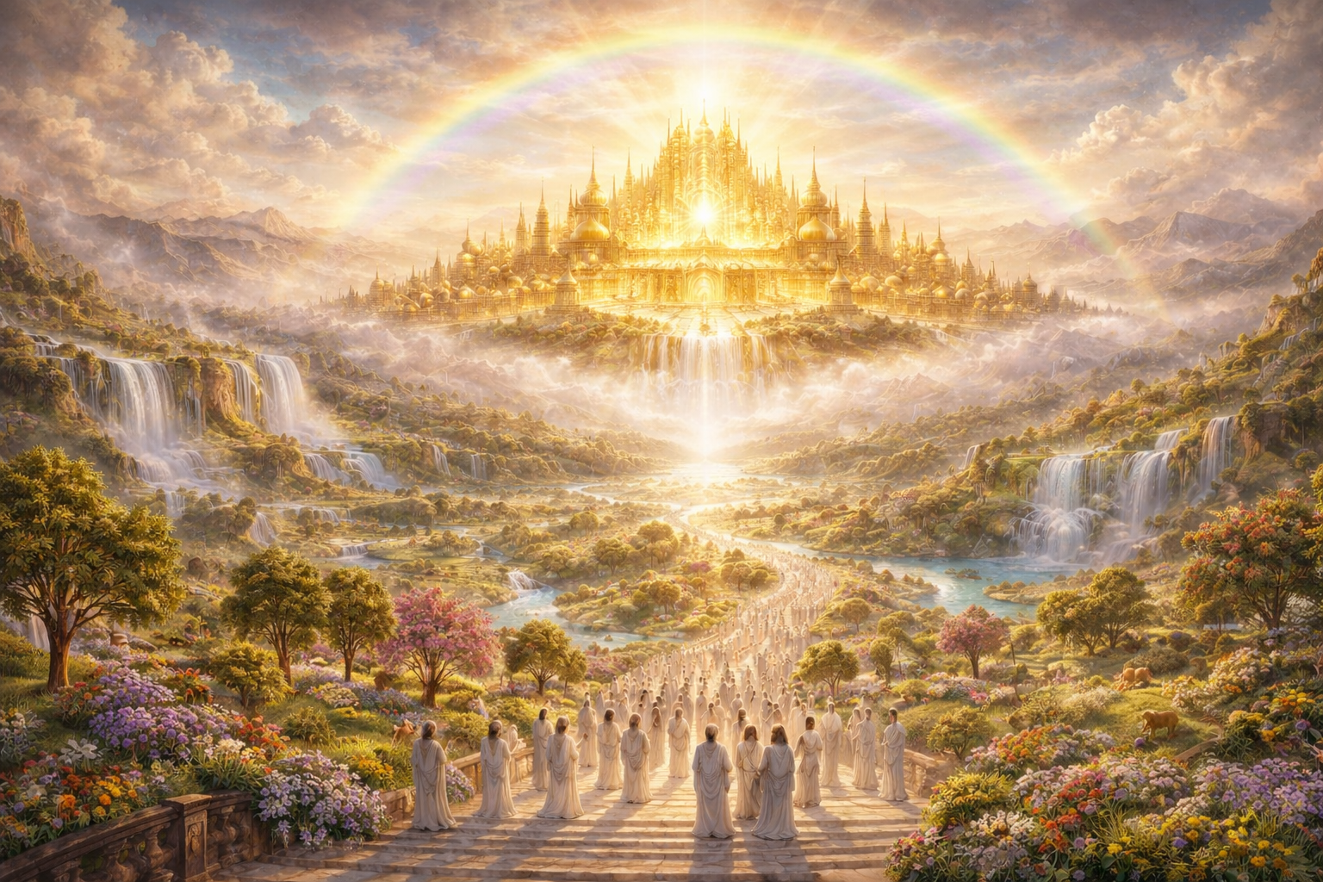

Slide 2
2 Samuel 7:12
¹² And when thy days be fulfilled, and thou shalt sleep with thy fathers, I will set up thy seed after thee, which shall proceed out of thy bowels, and I will establish his kingdom.

Slide 3
Psalms 2:6
6 Yet have I set my king upon my holy hill of Zion.

Slide 4
Psalms 2:6
6 Yet have I set my king upon my holy hill of Zion.
Psalms 2:7
7 I will declare the decree: the LORD hath said unto me, Thou art my Son; this day have I begotten thee.

Slide 5
Psalms 2:6
6 Yet have I set my king upon my holy hill of Zion.
Psalms 2:7
7 I will declare the decree: the LORD hath said unto me, Thou art my Son; this day have I begotten thee.
Psalms 2:8
8 Ask of me, and I shall give thee the heathen for thine inheritance, and the uttermost parts of the earth for thy possession.

Slide 6
Isaiah 2:2-4
2 And it shall come to pass in the last days, that the mountain of the LORD's house shall be established…and he will teach us of his ways, and we will walk in his paths: for out of Zion shall go forth the law, and the word of the LORD from Jerusalem. 4 And he shall judge among the nations, and shall rebuke many people: and they shall beat their swords into plowshares, and their spears into pruninghooks: nation shall not lift up sword against nation, neither shall they learn war any more.

Slide 7
Jeremiah 23:5-6
5 Behold, the days come, saith the LORD, that I will raise unto David a righteous Branch, and a King shall reign and prosper, and shall execute judgment and justice in the earth. 6 In his days Judah shall be saved, and Israel shall dwell safely: and this is his name whereby he shall be called, THE LORD OUR RIGHTEOUSNESS.

Slide 8
Daniel 2:44
44 And in the days of these kings shall the God of heaven set up a kingdom, which shall never be destroyed: and the kingdom shall not be left to other people, but it shall break in pieces and consume all these kingdoms, and it shall stand for ever.

Slide 9
Matthew 4:17
17 From that time Jesus began to preach, and to say, Repent: for the kingdom of heaven is at hand.

