Slide 1
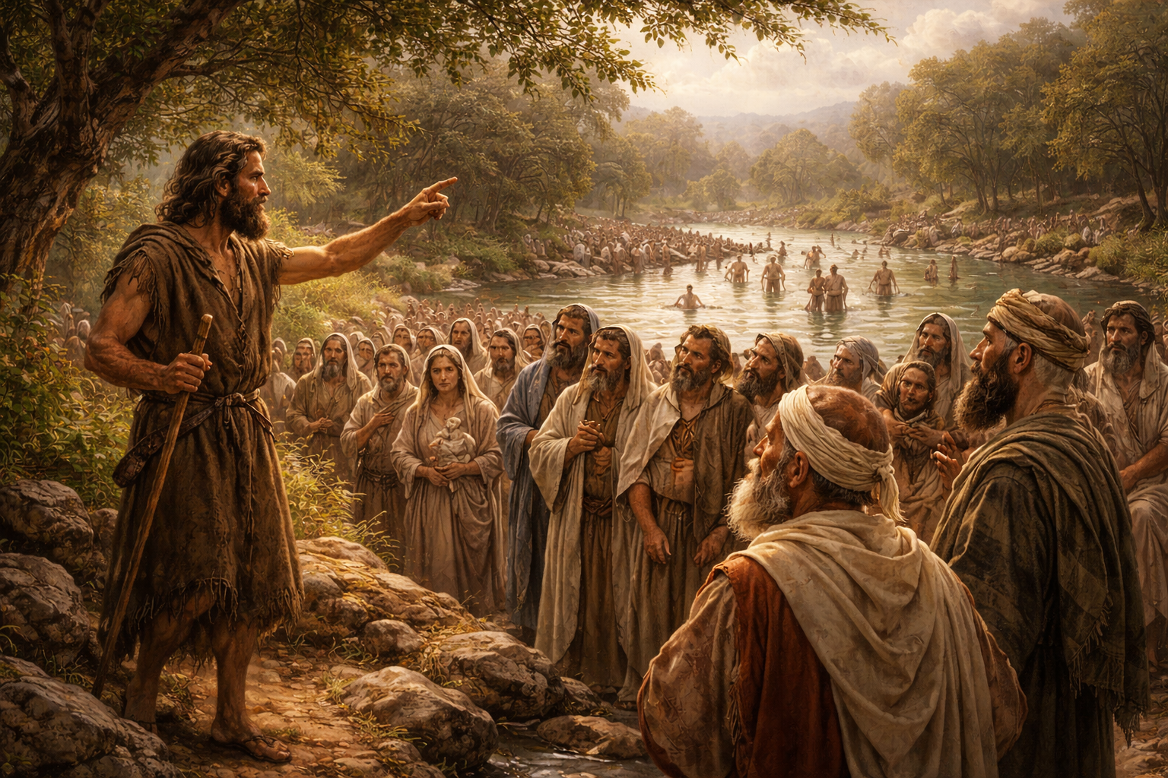

Slide 2


Slide 3
True repenters reflect on personal sin

Slide 4
True repenters reflect on personal sin
True repenters recognize divine wrath

Slide 5
Malachi 3:1-5
¹ Behold, I will send my messenger, and he shall prepare the way before me: and the LORD, whom ye seek, shall suddenly come to his temple…² But who may abide the day of his coming? and who shall stand when he appeareth? for he is like a refiner's fire, and like fullers' soap: ³ And he shall sit as a refiner and purifier of silver… ⁵ And I will come near to you to judgment;

Slide 6
Malachi 4:1
1 For, behold, the day cometh, that shall burn as an oven; and all the proud, yea, and all that do wickedly, shall be stubble: and the day that cometh shall burn them up, saith the LORD of hosts, that it shall leave them neither root nor branch.

Slide 7
Isaiah 2:10-12
10 Enter into the rock, and hide thee in the dust, for fear of the LORD…12 For the day of the LORD of hosts shall be upon every one that is proud and lofty, and upon every one that is lifted up; and he shall be brought low:

Slide 8
Isaiah 2:19
19 And they shall go into the holes of the rocks, and into the caves of the earth, for fear of the LORD, and for the glory of his majesty, when he ariseth to shake terribly the earth.

Slide 9
Isaiah 30:27
27 Behold, the name of the LORD cometh from far, burning with his anger, and the burden thereof is heavy: his lips are full of indignation, and his tongue as a devouring fire:

Slide 10
Zephaniah 1:14, 15, 18
14 The great day of the LORD is near, it is near, and hasteth greatly, even the voice of the day of the LORD: the mighty man shall cry there bitterly. 15 That day is a day of wrath, a day of trouble and distress, a day of wasteness and desolation, a day of darkness and gloominess, a day of clouds and thick darkness, 18 Neither their silver nor their gold shall be able to deliver them in the day of the LORD's wrath; but the whole land shall be devoured by the fire of his jealousy: for he shall make even a speedy riddance of all them that dwell in the land.

Slide 11
True repenters reflect on personal sin
True repenters recognize divine wrath
True repenters reject religious ritual

Slide 12
True repenters reflect on personal sin
True repenters recognize divine wrath
True repenters reject religious ritual
True repenters renounce ancestry

Slide 13
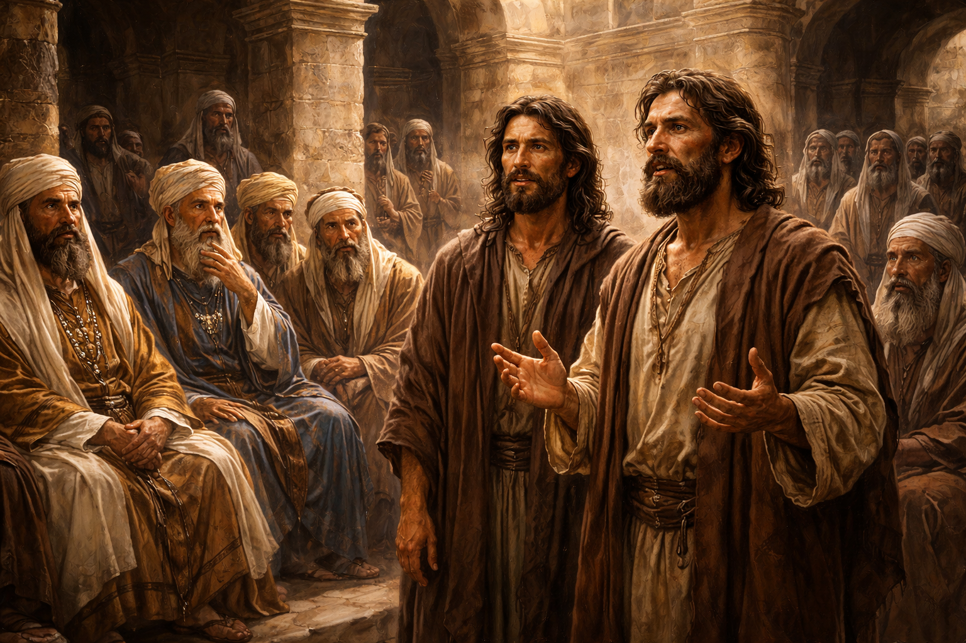
Notes:
PM

