Slide 1
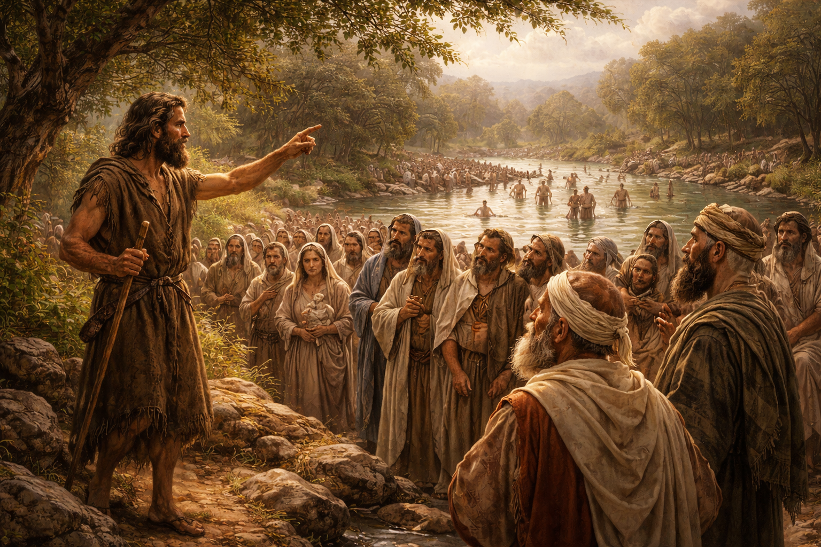
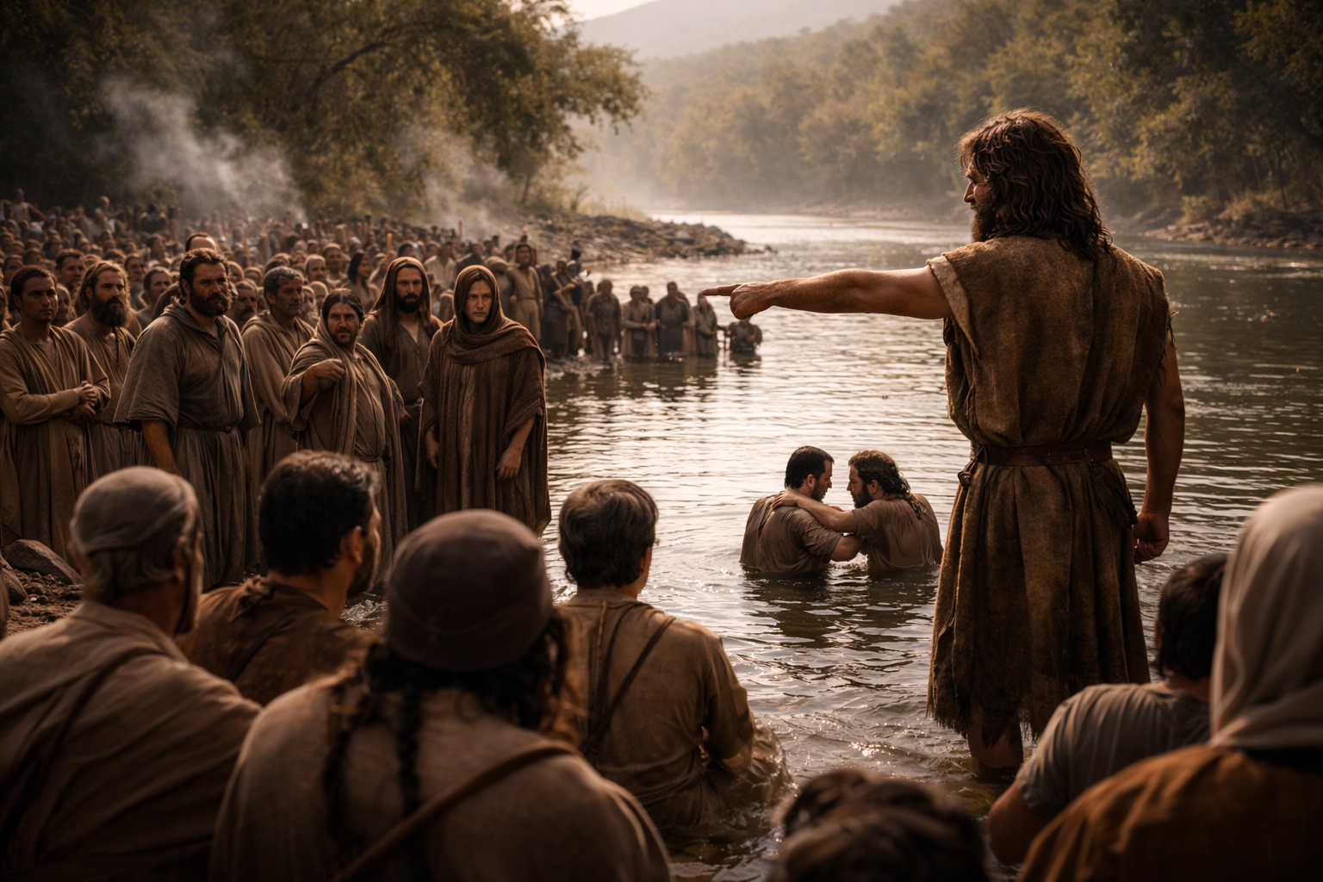
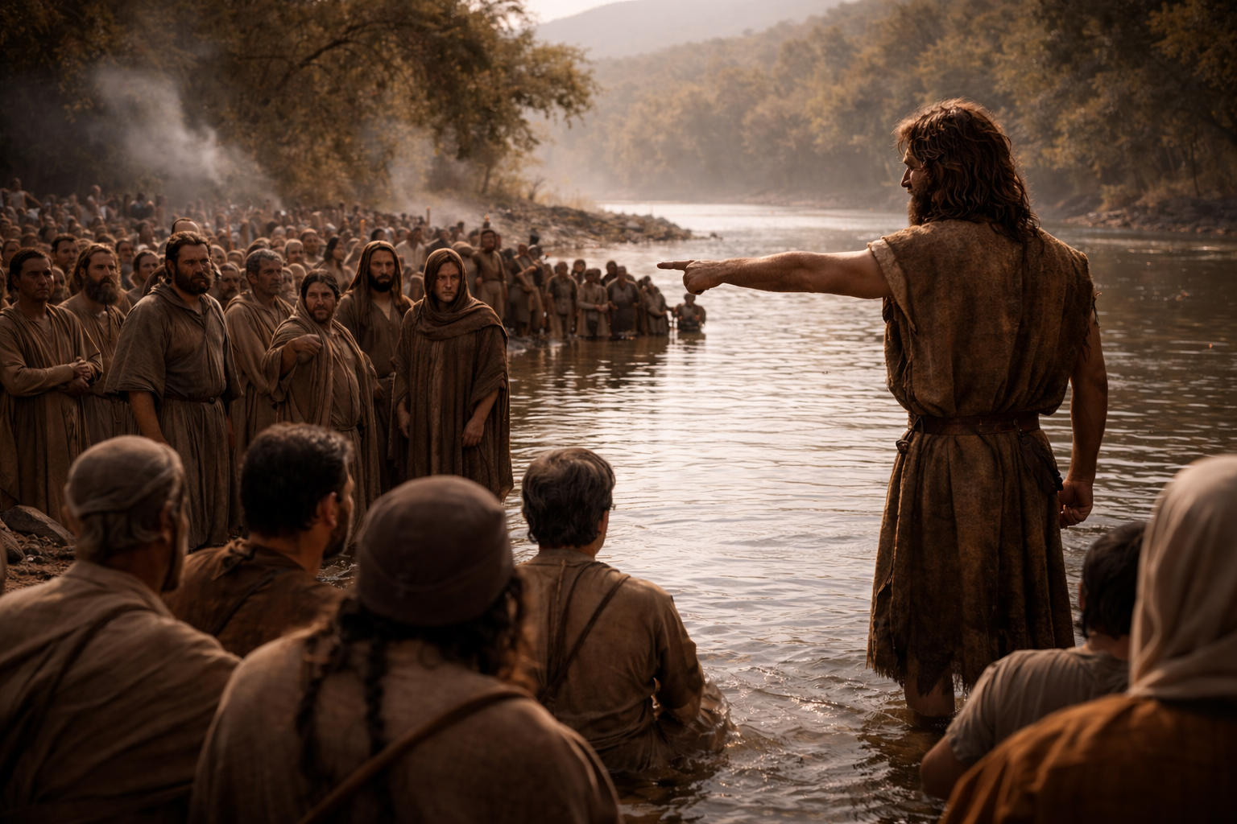
Notes:
it sounded like this

Slide 2
True repenters reflect on personal sin

Slide 3
True repenters reflect on personal sin
True repenters recognize divine wrath

Slide 4
True repenters reflect on personal sin
True repenters recognize divine wrath
True repenters reject religious ritual

Slide 5
True repenters reflect on personal sin
True repenters recognize divine wrath
True repenters reject religious ritual
True repenters renounce ancestry

Slide 6
True repenters reflect on personal sin
True repenters recognize divine wrath
True repenters reject religious ritual
True repenters renounce ancestry
True repenters reveal true transformation

Slide 7

Notes:
counterfeit Christians

Slide 8
Acts 26:20
But shewed first unto them…that they should repent and turn to God, and do works meet for repentance.

Slide 9
Isaiah 1:16
Wash you, make you clean; put away the evil of your doings from before mine eyes; cease to do evil;

Slide 10
Ezekiel 33:19
But if the wicked turn from his wickedness, and do that which is lawful and right, he shall live thereby.

Slide 11
Ezekiel 36:25-27
Then will I sprinkle clean water upon you, and ye shall be clean: from all your filthiness... 26 A new heart also will I give you… 27 And I will put my spirit within you, and cause you to walk in my statutes, and ye shall keep my judgments, and do them.

Slide 12
Ephesians 2:8-10
For by grace are ye saved through faith; and that not of yourselves: it is the gift of God: 9 Not of works, lest any man should boast. 10 For we are his workmanship, created in Christ Jesus unto good works, which God hath before ordained that we should walk in them.

Slide 13
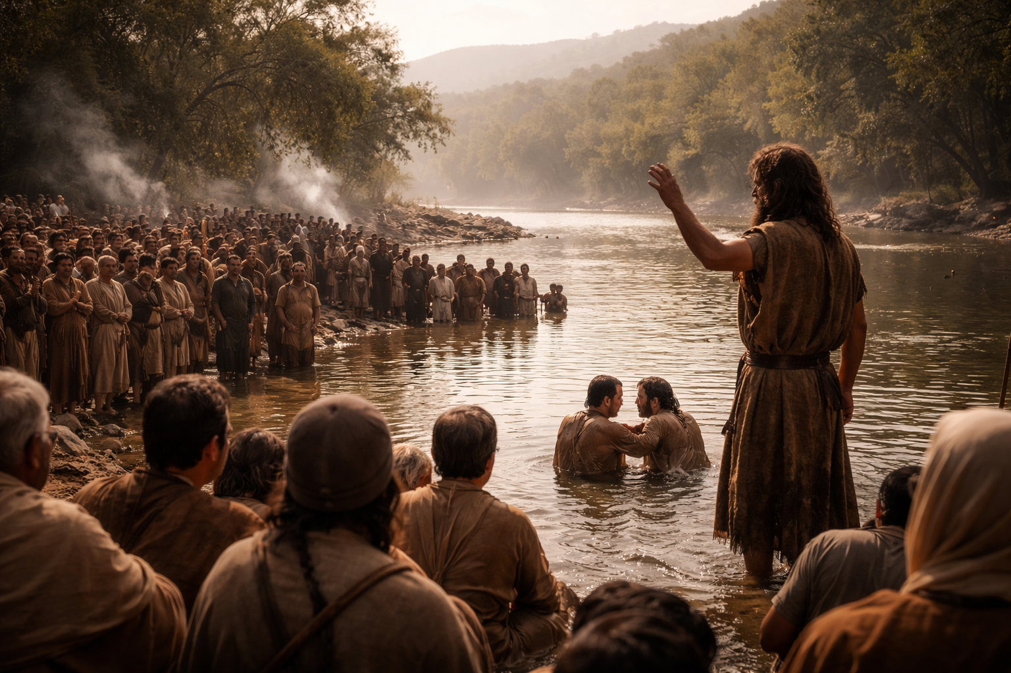
Notes:
they had some questions

Slide 14
True repenters reflect on personal sin
True repenters recognize divine wrath
True repenters reject religious ritual
True repenters renounce ancestry
True repenters reveal true transformation
True repenters receive the Messiah

Slide 15
John 3:30
He must increase, but I must decrease.

Slide 16
Acts 4:12
Neither is there salvation in any other: for there is none other name under heaven given among men, whereby we must be saved.

Slide 17
John 14:6
Jesus saith unto him, I am the way, the truth, and the life: no man cometh unto the Father, but by me.

Slide 18
Romans 10:13
For whosoever shall call upon the name of the Lord shall be saved.

Slide 19
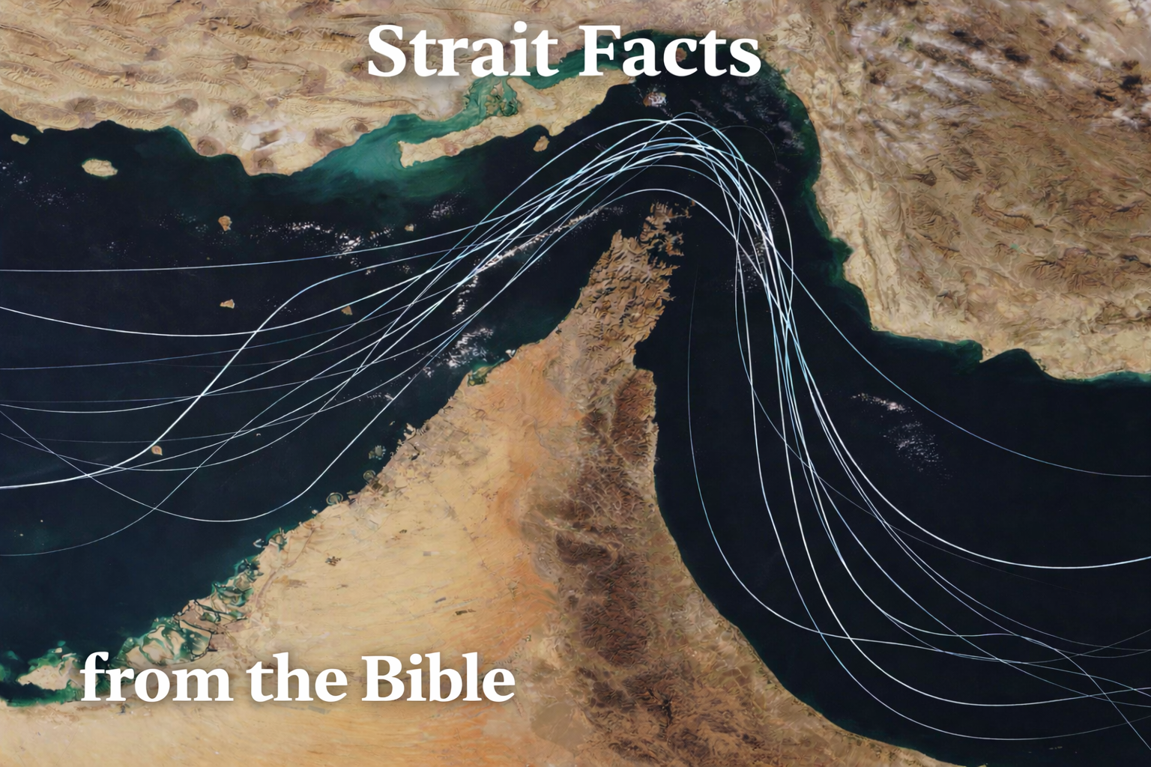
Notes:
PM

