Slide 1
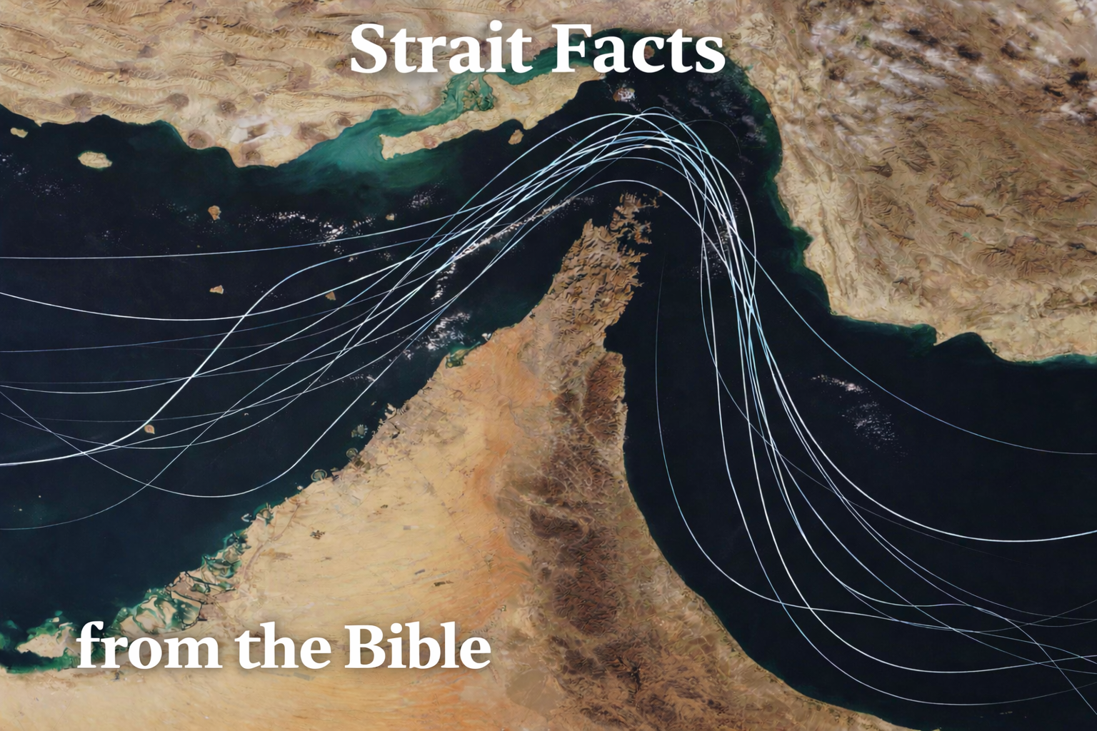

Slide 2
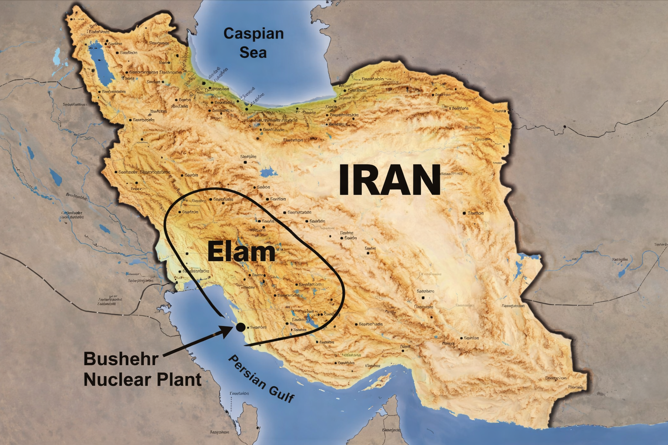
K
Notes:
a specific region of Iran’s southwest coastline

Slide 3
Jeremiah 49:35-39
Thus saith the LORD of hosts; Behold, I will break the bow of Elam, the chief of their might. ³⁶ And upon Elam will I bring the four winds from the four quarters of heaven, and will scatter them…³⁷ For I will cause Elam to be dismayed before their enemies, and before them that seek their life: and I will bring evil upon them, even my fierce anger, saith the LORD; and I will send the sword after them, till I have consumed them: ³⁸ And I will set my throne in Elam, and will destroy from thence the king and the princes, saith the LORD. ³⁹ But it shall come to pass in the latter days, that I will bring again the captivity of Elam, saith the LORD.

