Slide 1
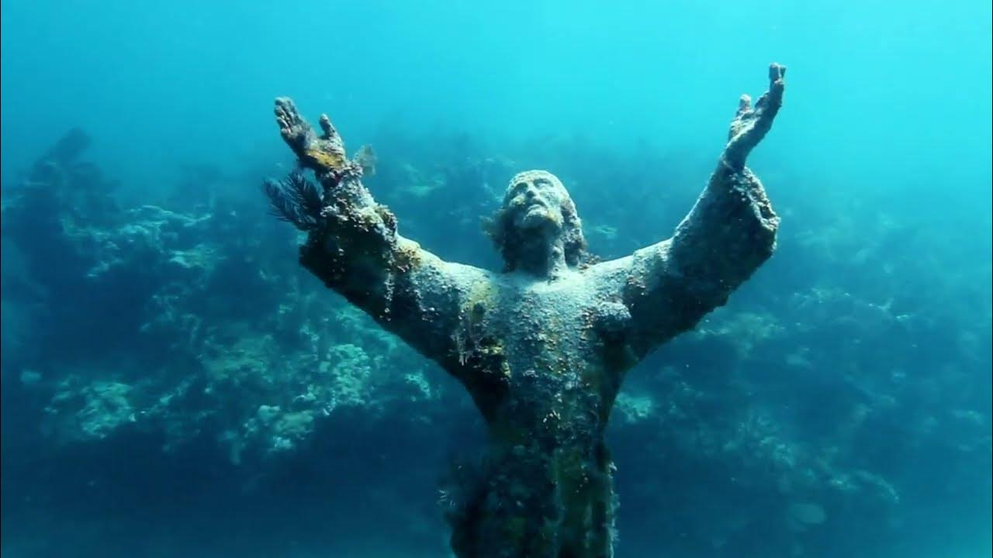

Slide 2
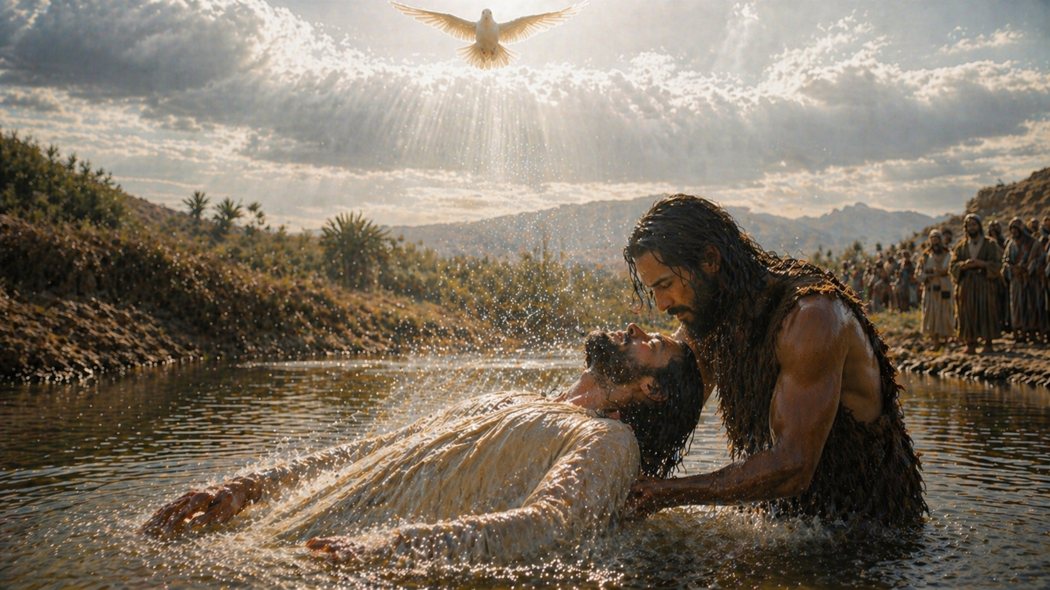
Notes:
Jesus did go underwater

Slide 3
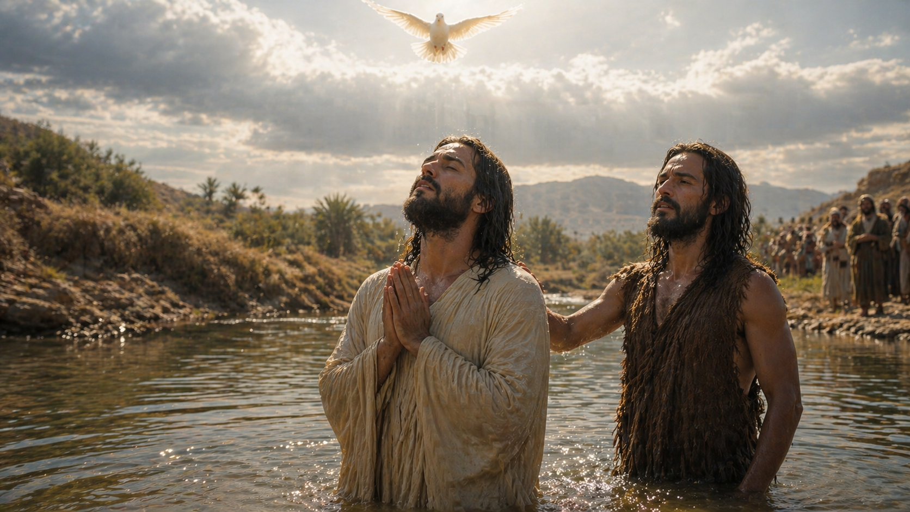
Matthew 3:15
And Jesus answering said unto him, Suffer it to be so now: for thus it becometh us to fulfil all righteousness. Then he suffered him.

Slide 4
Philippians 3:9
And be found in him, not having mine own righteousness, which is of the law, but that which is through the faith of Christ, the righteousness which is of God by faith:

Slide 5
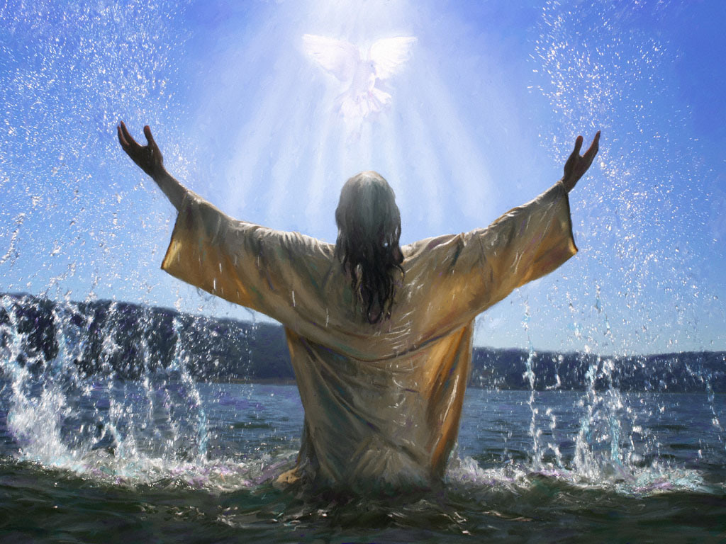
Notes:
at the very time that Jesus is coming up out of the water

Slide 6
Isaiah 64:1
Oh that thou wouldest rend the heavens, that thou wouldest come down…

