Slide 1


Slide 2
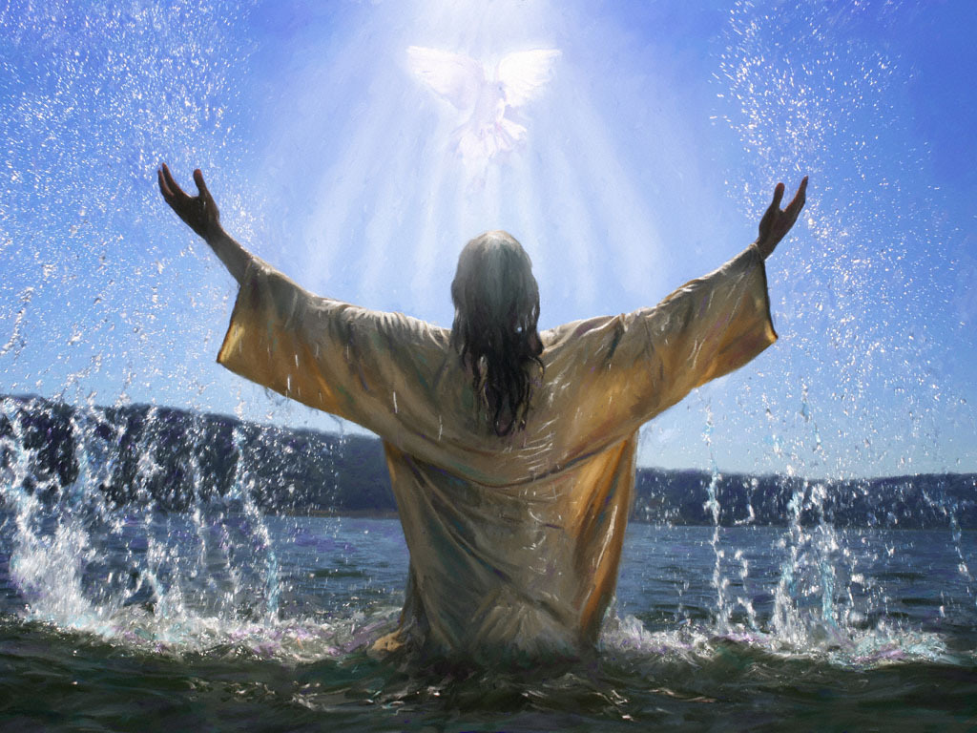
Notes:
This is one of those great portions of Scripture

Slide 3
Romans 8:9
But ye are not in the flesh, but in the Spirit, if so be that the Spirit of God dwell in you. Now if any man have not the Spirit of Christ, he is none of his.

Slide 4
John 3:34
For he whom God hath sent speaketh the words of God: for God giveth not the Spirit by measure unto him.

Slide 5
Isaiah 42:1
Behold my servant, whom I uphold; mine elect, in whom my soul delighteth; I have put my spirit upon him:

Slide 6
Isaiah 61:1
The Spirit of the Lord GOD is upon me; because the LORD hath anointed me to preach good tidings unto the meek; he hath sent me to bind up the brokenhearted, to proclaim liberty to the captives, and the opening of the prison to them that are bound;

Slide 7
Luke 4:1
And Jesus being full of the Holy Ghost returned from Jordan, and was led by the Spirit into the wilderness,

Slide 8
Luke 4:14
And Jesus returned in the power of the Spirit into Galilee: and there went out a fame of him through all the region round about.

Slide 9
Acts 10:38
How God anointed Jesus of Nazareth with the Holy Ghost and with power.

Slide 10
Matthew 12:32
And whosoever speaketh a word against the Son of man, it shall be forgiven him: but whosoever speaketh against the Holy Ghost, it shall not be forgiven him, neither in this world, neither in the world to come.

Slide 11
Hebrews 9:14
How much more shall the blood of Christ, who through the eternal Spirit offered himself without spot to God, purge your conscience from dead works to serve the living God?

Slide 12
Luke 23:46
And when Jesus had cried with a loud voice, he said, Father, into thy hands I commend my spirit: and having said thus, he gave up the ghost.

Slide 13
Romans 8:11
But if the Spirit of him that raised up Jesus from the dead dwell in you, he that raised up Christ from the dead shall also quicken your mortal bodies by his Spirit that dwelleth in you.

