Slide 1

Notes:
message

Slide 2
Notes:
her husband was quite a man

Slide 3
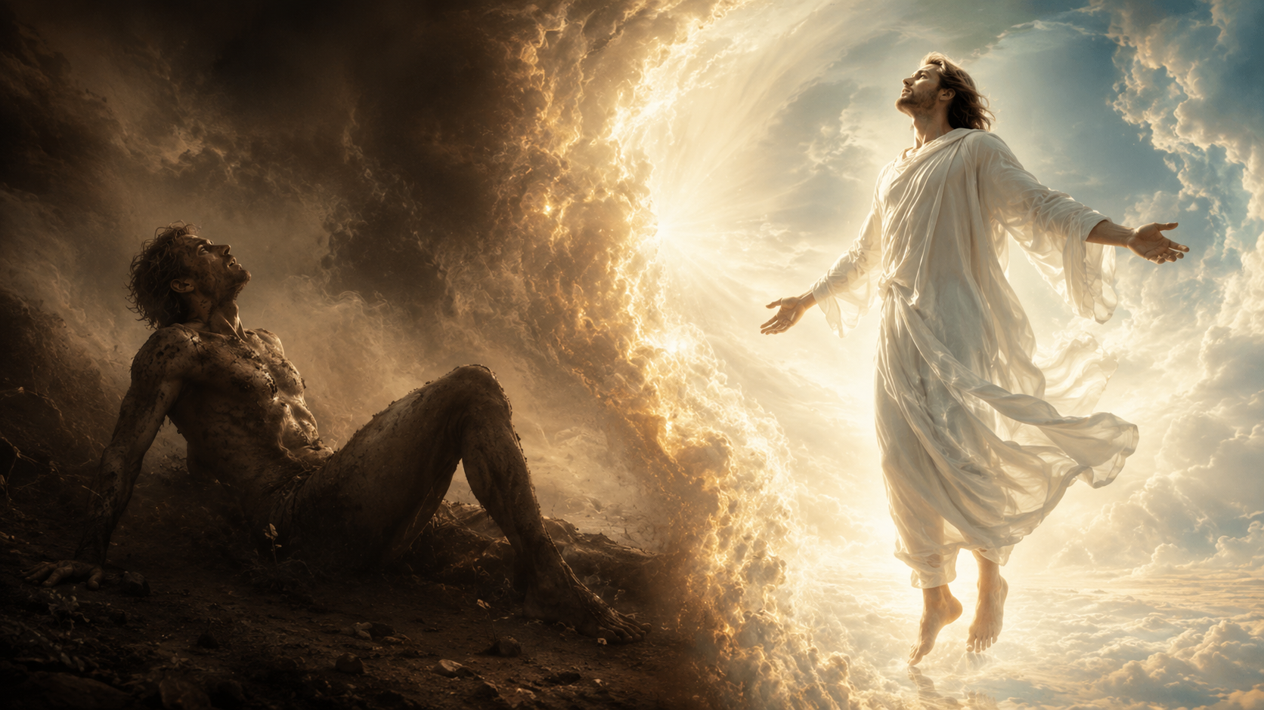
Notes:
Is Jesus like Adam?

Slide 4
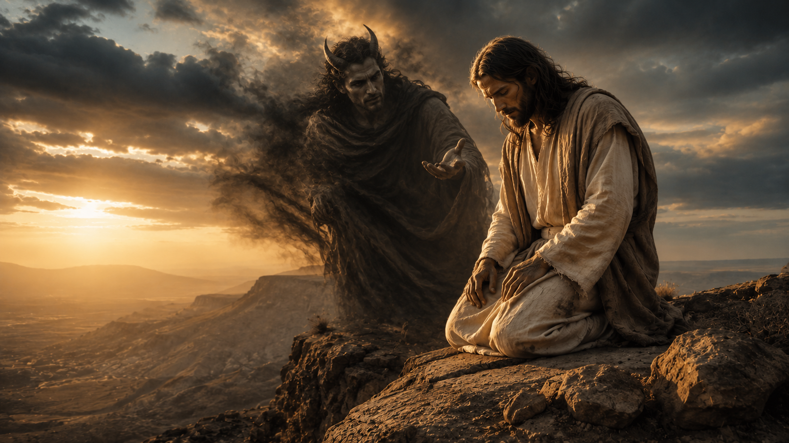
Notes:
Christ was victorious over that snake

Slide 5
1 Corinthians 15:45
The first man Adam was made a living soul; the last Adam was made a quickening spirit.

Slide 6

Notes:
Think about the distinction between Jesus and Adam

Slide 7
Notes:
Into mortal combat with the devil

