Slide 1

Notes:
music

Slide 2
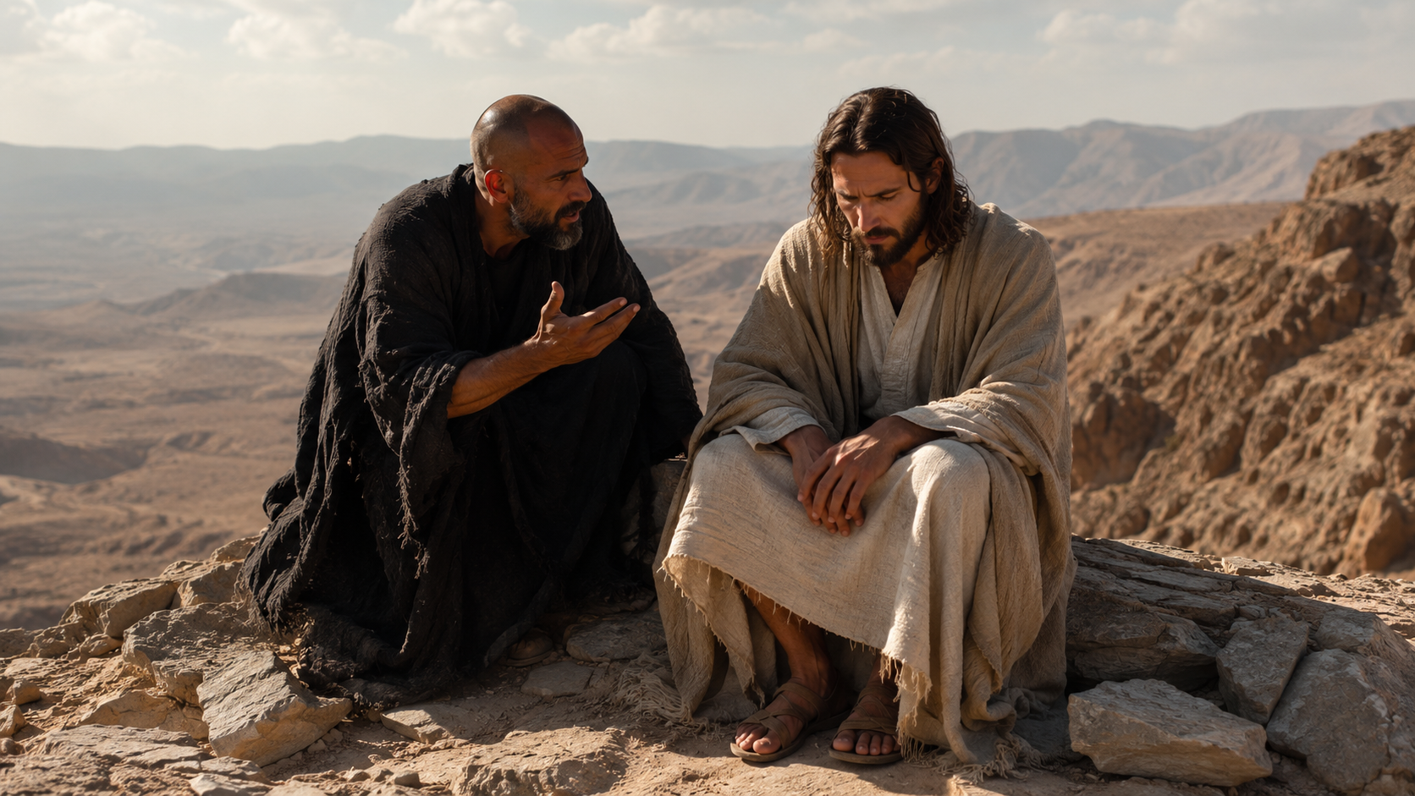
Notes:
message

Slide 3
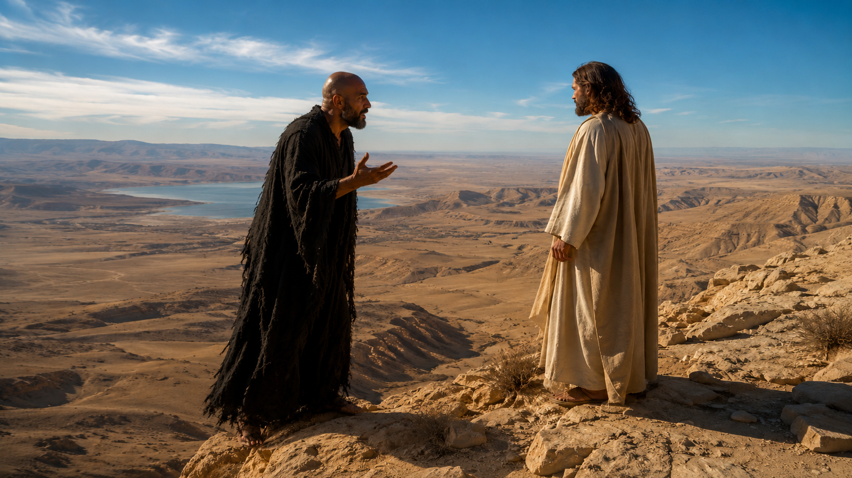
Notes:
The devil transported himself and Jesus

Slide 4


