Slide 1


Slide 2
Titus 2:13
Looking for that blessed
and the glorious appearing…

Slide 3
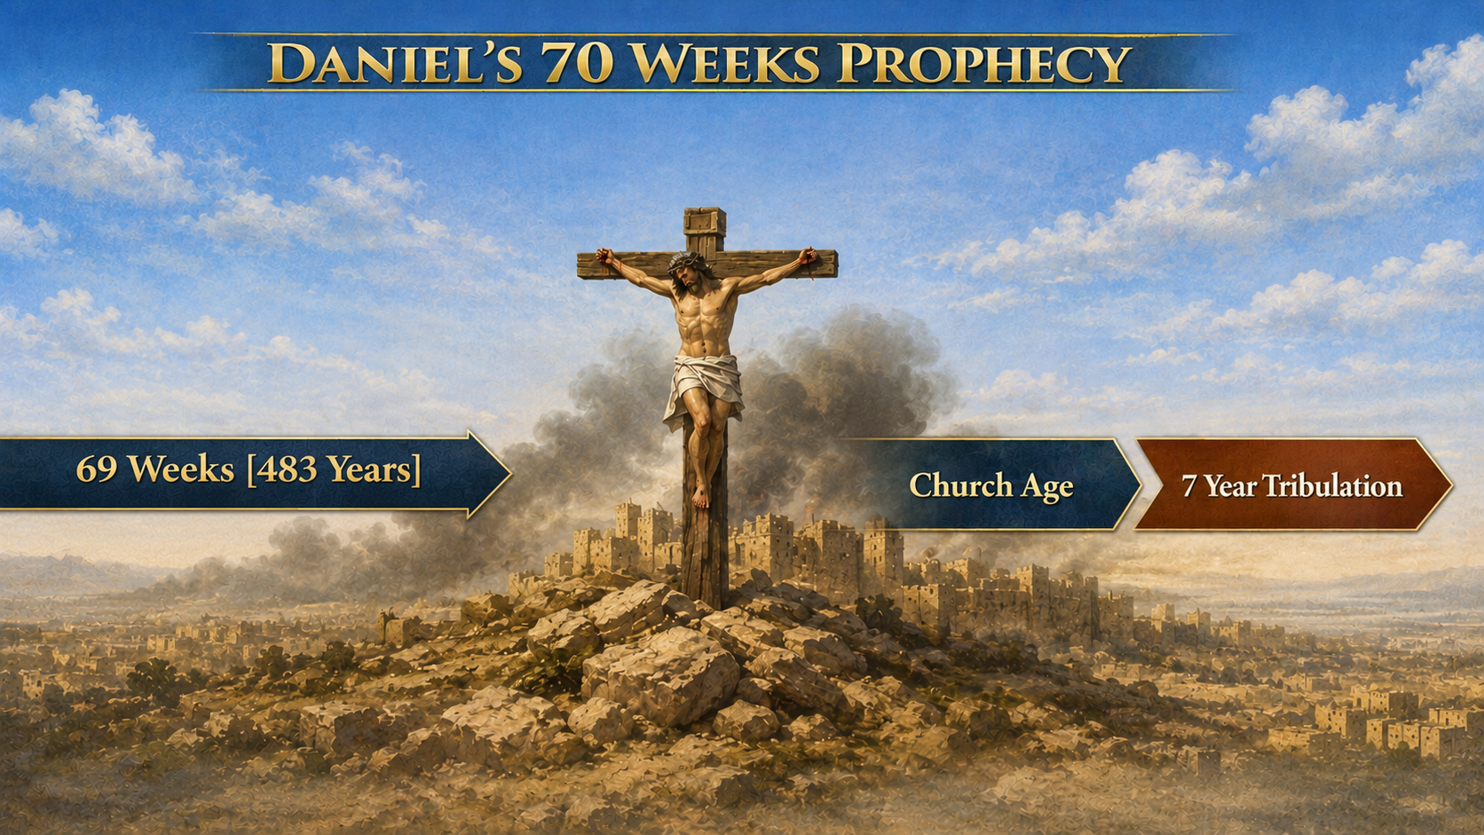
Notes:
All of the 490 years

Slide 4
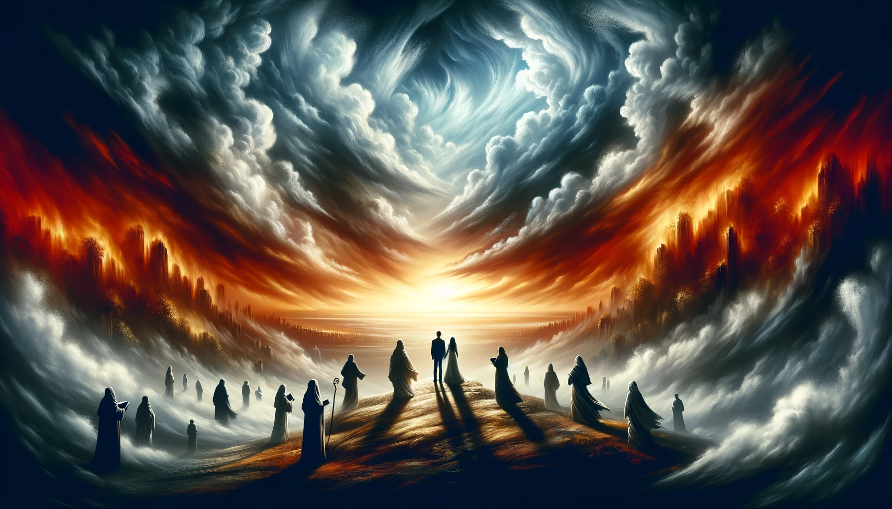
Notes:
Especially in the literal tribulation

Slide 5
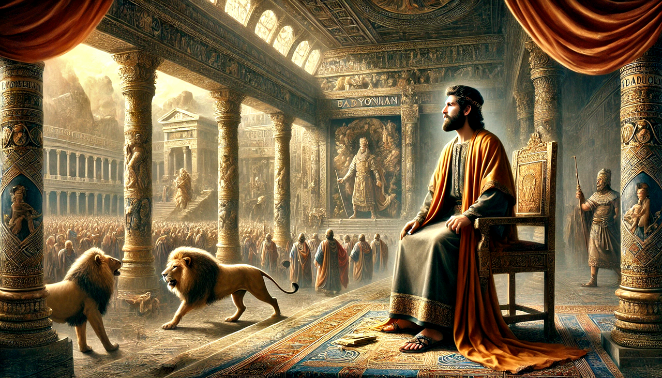
Notes:
Daniel was shocked

Slide 6
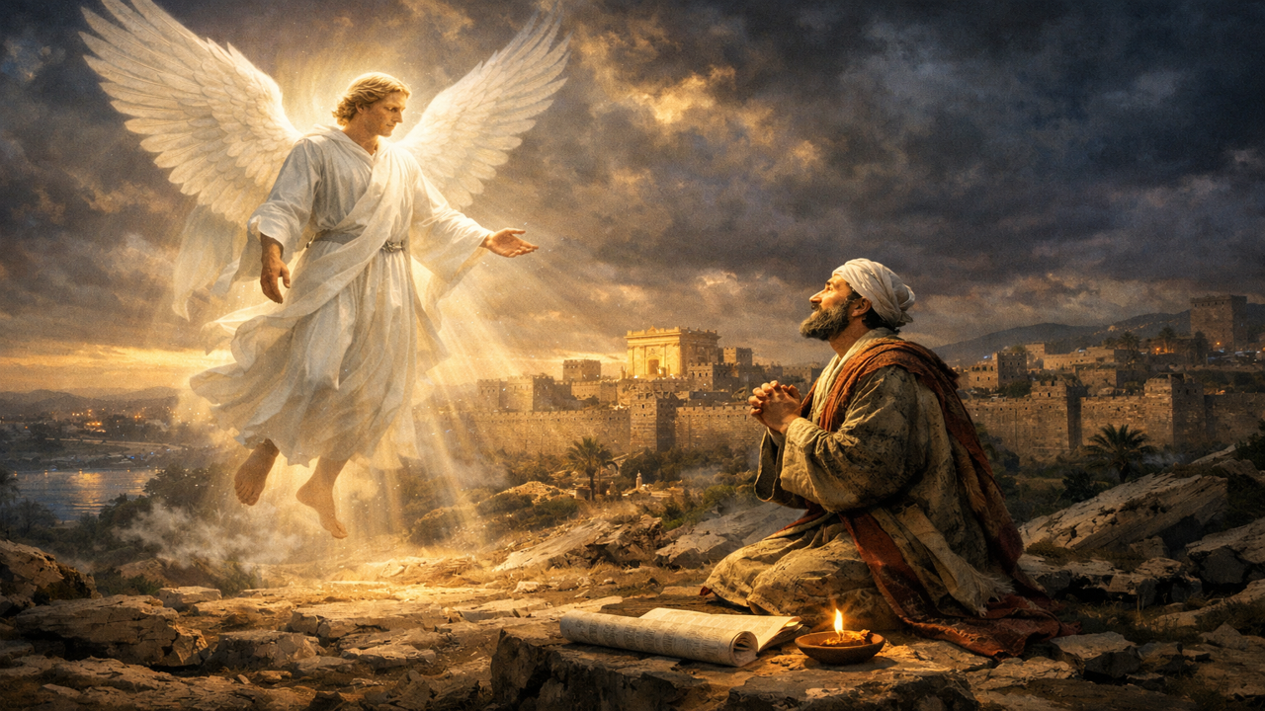
Notes:
a very special angel

Slide 7
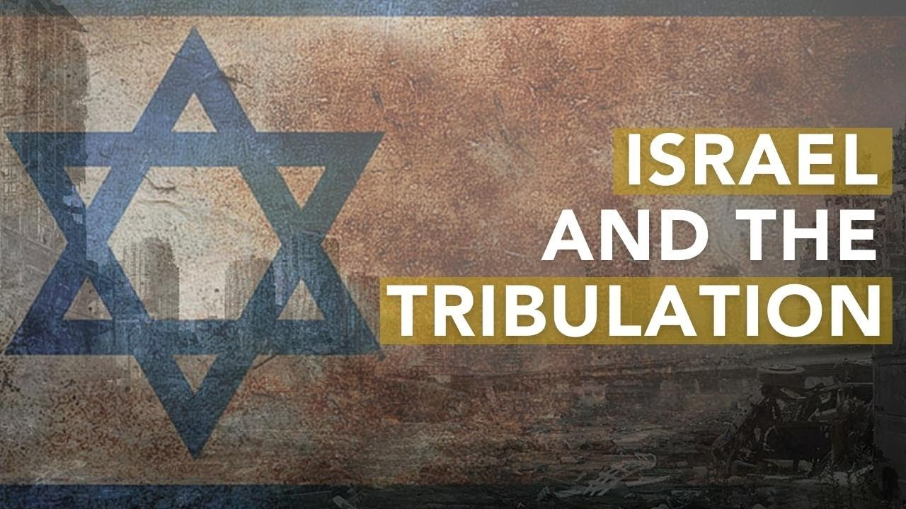
Notes:
This is the 7 year tribulation

Slide 8

Deuteronomy 4:30
When thou art in tribulation, and all these things are come upon thee, even in the latter days…

Slide 9
Jeremiah 30:4-6
And these are the words that the LORD spake concerning Israel and concerning Judah. 5 For thus saith the LORD; We have heard a voice of trembling, of fear, and not of peace. 6 Ask ye now, and see whether a man doth travail with child? wherefore do I see every man with his hands on his loins, as a woman in travail, and all faces are turned into paleness?

Slide 10
Zechariah 12:2-3
Behold, I will make Jerusalem a cup of trembling unto all the people round about, when they shall be in the siege both against Judah and against Jerusalem. 3 And in that day will I make Jerusalem a burdensome stone for all people: all that burden themselves with it shall be cut in pieces, though all the people of the earth be gathered together against it.

Slide 11
Zechariah 13:8-9
And it shall come to pass, that in all the land, saith the LORD, two parts therein shall be cut off and die; but the third shall be left therein. 9 And I will bring the third part through the fire, and will refine them as silver is refined, and will try them as gold is tried: they shall call on my name, and I will hear them: I will say, It is my people: and they shall say, The LORD is my God.

Slide 12
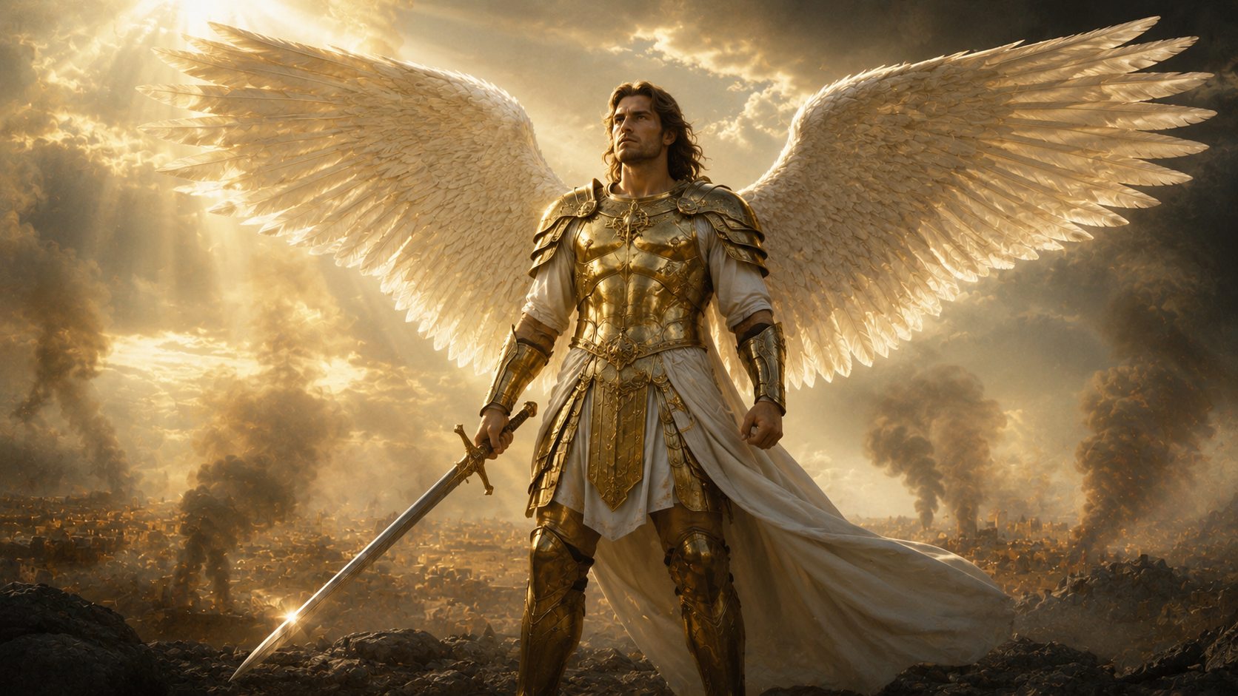
Notes:
here comes the hope

Slide 13
Jude 1:9
Yet Michael the archangel, when contending with the devil he disputed about the body of Moses, durst not bring against him a railing accusation, but said, The Lord rebuke thee.
Notes:
here comes the hope

Slide 14
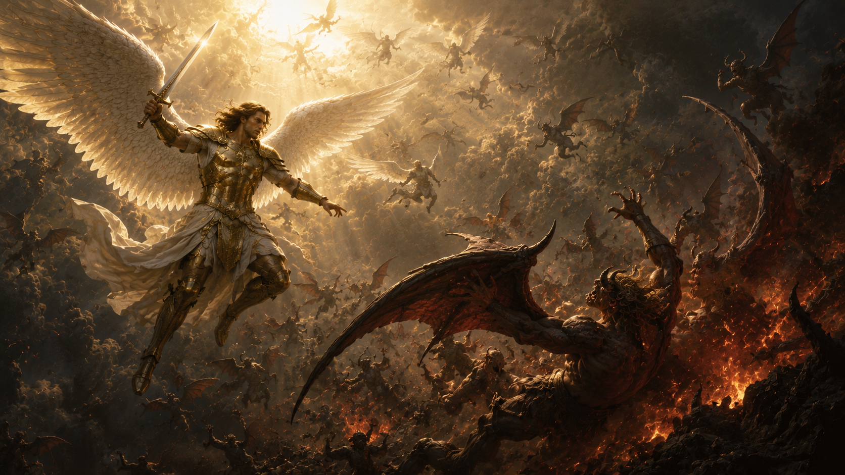
Revelation 12:7
And there was war in heaven: Michael and his angels fought against the dragon; and the dragon fought and his angels,

Slide 15
Revelation 12:8-9
And prevailed not; neither was their place found any more in heaven. 9 And the great dragon was cast out, that old serpent, called the Devil, and Satan, which deceiveth the whole world: he was cast out into the earth, and his angels were cast out with him.

Slide 16
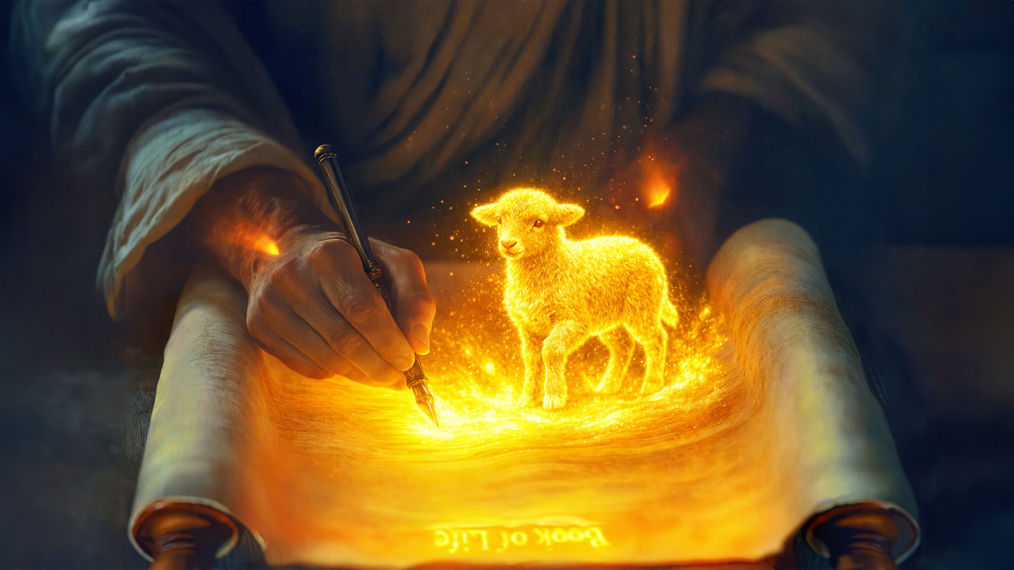
Notes:
A special deliverance

Slide 17
Jeremiah 30:7,11
Alas! for that day is great, so that none is like it: it is even the time of Jacob's trouble, but he shall be saved out of it. ¹¹ For I am with thee, saith the LORD, to save thee: though I make a full end of all nations whither I have scattered thee, yet I will not make a full end of thee: but I will correct thee in measure...
Notes:
A special deliverance

Slide 18
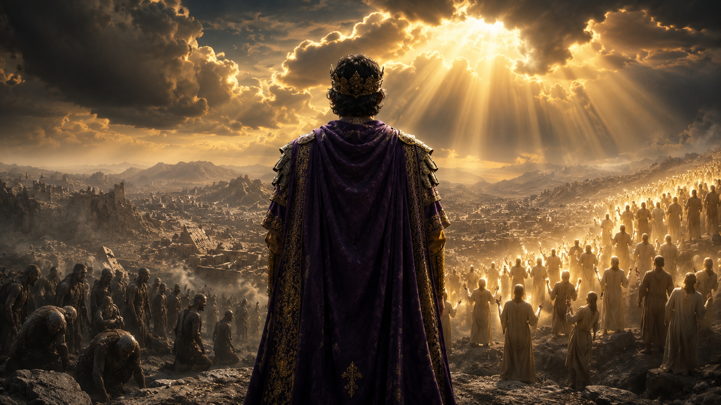
Notes:
the climax to the tribulation is resurrection

Slide 19
Isaiah 26:19
Thy dead men shall live, together with my dead body shall they arise. Awake and sing, ye that dwell in dust: for thy dew is as the dew of herbs, and the earth shall cast out the dead.

Slide 20
Hosea 13:14
I will ransom them from the power of the grave; I will redeem them from death: O death, I will be thy plagues; O grave, I will be thy destruction:

Slide 21
John 5:28-29
… the hour is coming, in the which all that are in the graves shall hear his voice, 29 And shall come forth…unto the resurrection of life; [or] …unto the resurrection of damnation.

Slide 22
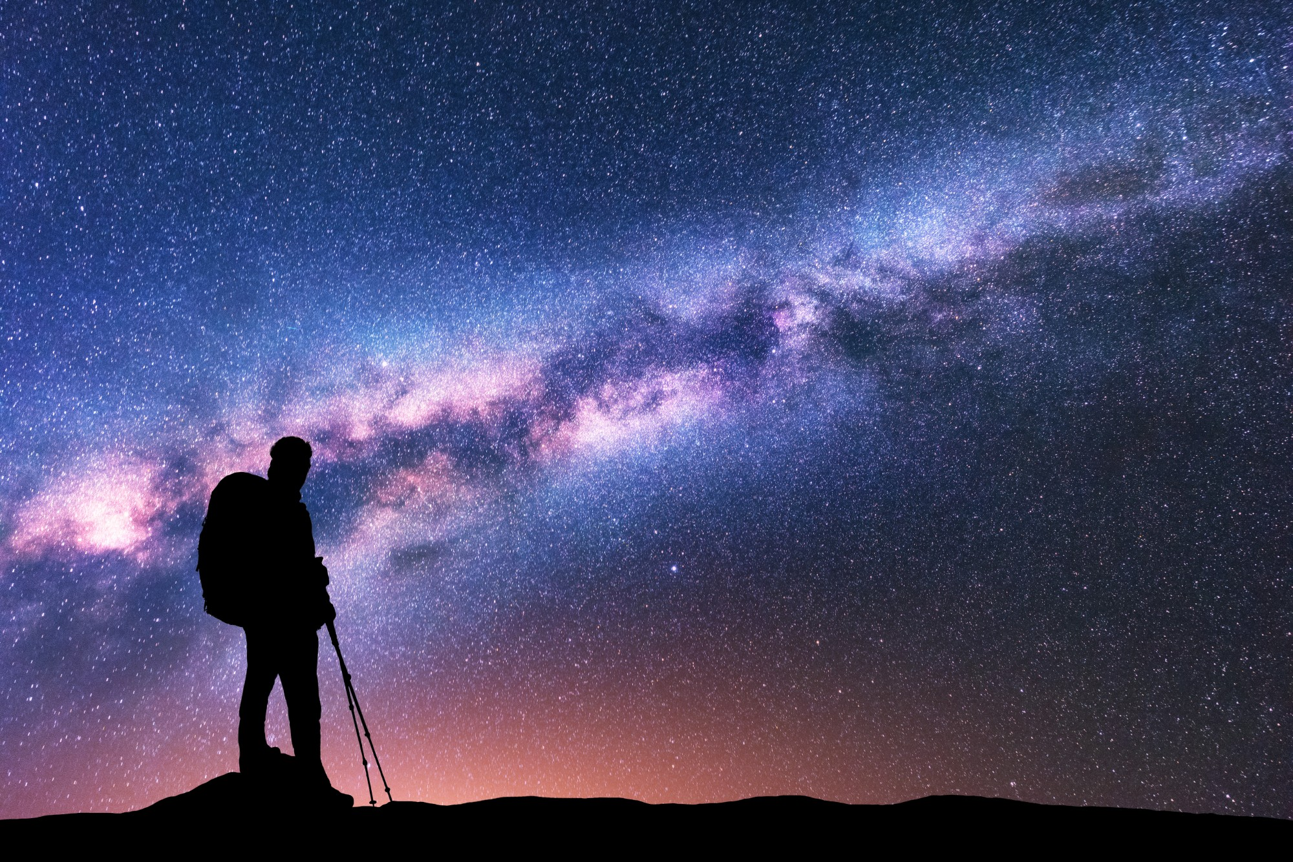
Notes:
A special dividend

Slide 23
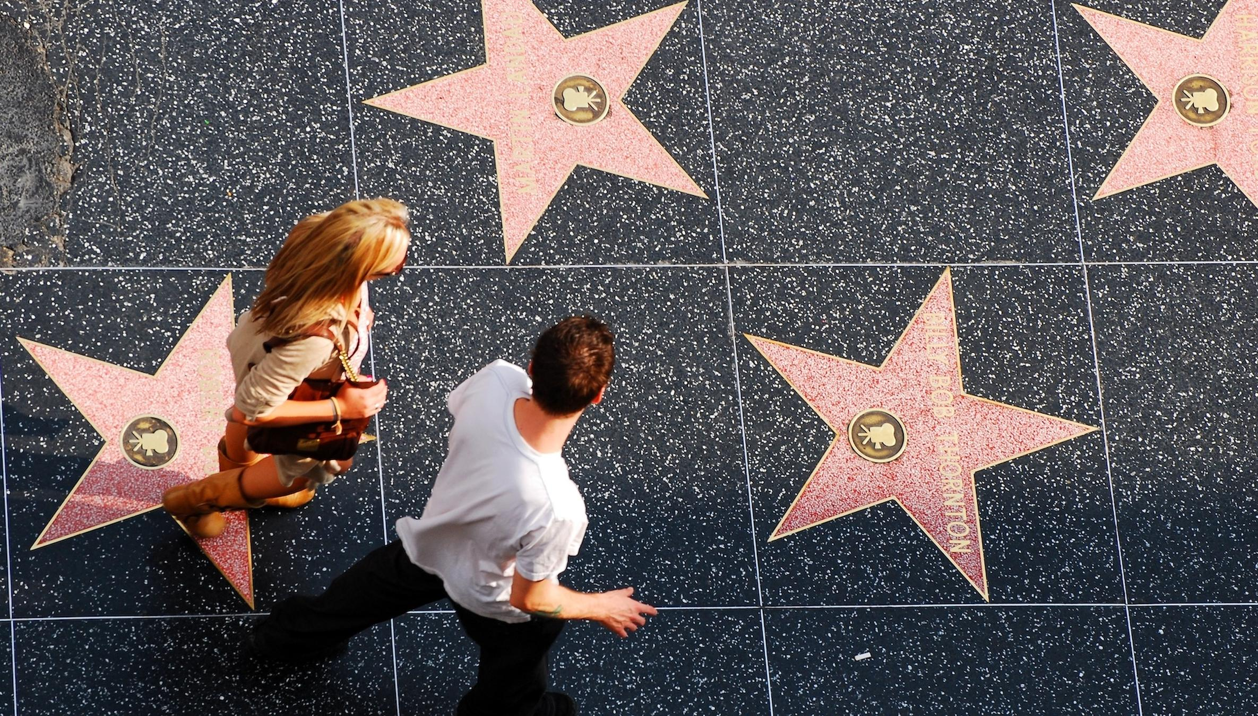
Notes:
Walk down Hollywood Boulevard

Slide 24
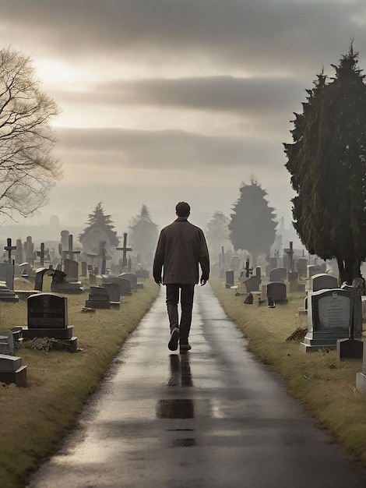
Notes:
walk through cemeteries

Slide 25

Notes:
Who are the greatest lights in God’s sky

Slide 26
Philippians 2:15
That ye may be blameless and harmless, the sons of God, without rebuke, in the midst of a crooked and perverse nation, among whom ye shine as lights in the world;

