Slide 1

Notes:
beginning

Slide 2
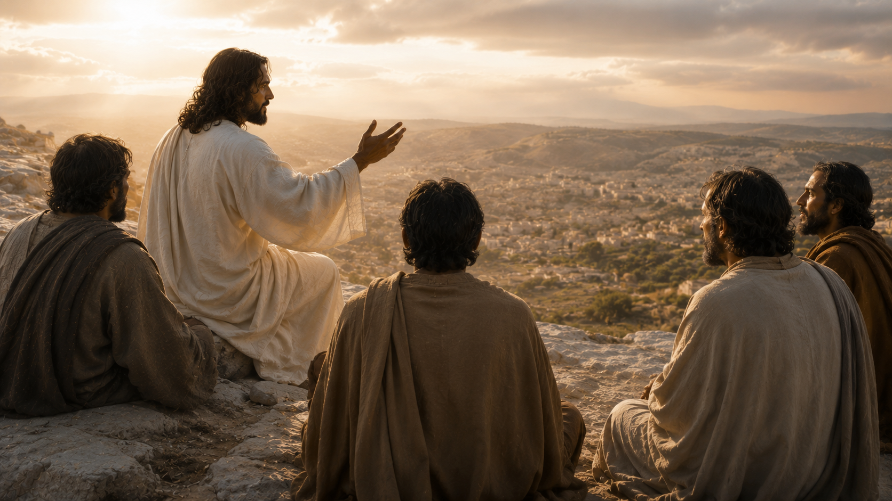
John 14:1
"Let not your heart be troubled..."
Notes:
It reminds me of what Jesus said to His disciples

Slide 3

Notes:
Paul echoes it in II Thessalonians

Slide 4
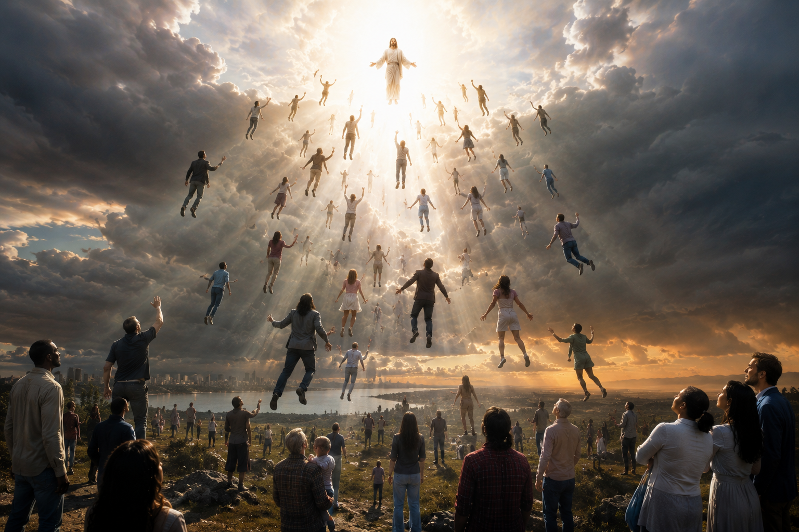
1 Thessalonians 1:10
And to wait for his Son from heaven, whom he raised from the dead, even Jesus, which delivered us from the wrath to come.

Slide 5
1 Thessalonians 5:9
For God hath not appointed us to wrath, but to obtain salvation by our Lord Jesus Christ

Slide 6
Revelation 2:7
He that hath an ear, let him hear what the Spirit saith unto the churches;

Slide 7
Revelation 4:1
After this I looked, and, behold, a door was opened in heaven: and the first voice which I heard was as it were of a trumpet talking with me; which said, Come up hither…

Slide 8
Revelation 2:7
He that hath an ear, let him hear what the Spirit saith unto the churches;
Revelation 13:9
If any man have an ear, let him hear.

Slide 9
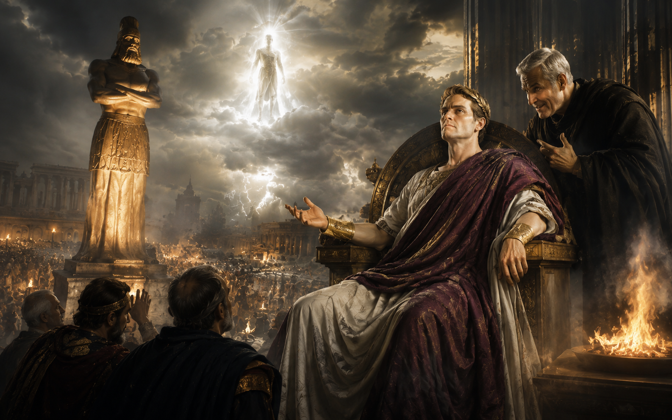
Notes:
2. The Deceptive Man.

Slide 10
Acts 2:22
Jesus of Nazareth, a man approved of God among you by miracles and wonders and signs, which God did by him in the midst of you…
Hebrews 2:4
God also bearing them [the apostles] witness, both with signs and wonders, and with divers miracles, and gifts of the Holy Ghost…

Slide 11
1 Thessalonians 1:10
And to wait for his Son from heaven, whom he raised from the dead, even Jesus, which delivered us from the wrath to come.

Slide 12
John 14:1
"Let not your heart be troubled..."
Notes:
The antichrist will be destroyed

