Slide 1
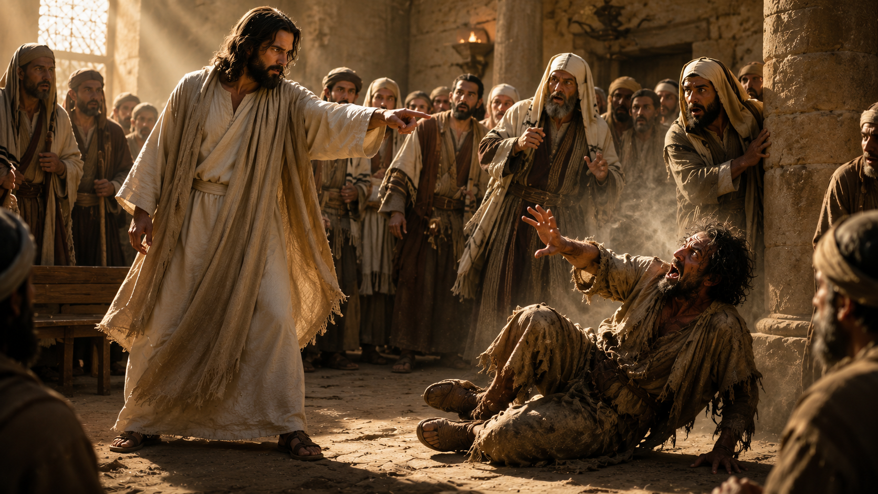

Slide 2
James 2:19
Thou believest that there is one God; thou doest well: the devils also believe, and tremble.

Slide 3
1 John 3:8
…For this purpose the Son of God was manifested, that he might destroy the works of the devil

Slide 4
2 Corinthians 10:4-5
(For the weapons of our warfare are not carnal, but mighty through God to the pulling down of strong holds;) 5 Casting down imaginations, and every high thing that exalteth itself against the knowledge of God,

Slide 5
Colossians 1:13
Who hath delivered us from the power of darkness, and hath translated us into the kingdom of his dear Son:

Slide 6
Luke 8:28
When he saw Jesus, he cried out, and fell down before him, and with a loud voice said, What have I to do with thee, Jesus, thou Son of God most high? I beseech thee, torment me not.

Slide 7
Mark 1:34
And he healed many that were sick of divers diseases, and cast out many devils; and suffered not the devils to speak, because they knew him.

Slide 8
Luke 11:20
But if I with the finger of God cast out devils, no doubt the kingdom of God is come upon you.

Slide 9
Galatians 2:20
"I am crucified with Christ, nevertheless I live, yet not I but Christ liveth in me."

Slide 10
Matthew 9:33
And when the devil was cast out, the dumb spake: and the multitudes marvelled, saying, It was never so seen in Israel.

