Slide 1
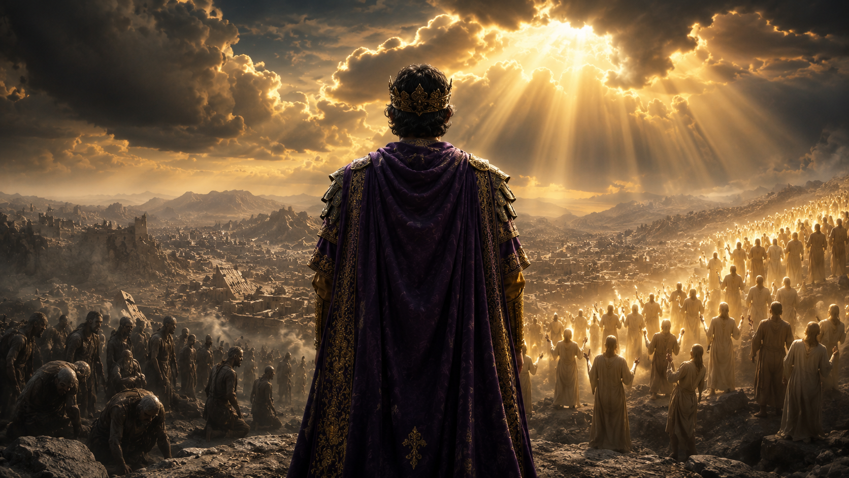
Notes:
the climax to the tribulation is resurrection

