Slide 1
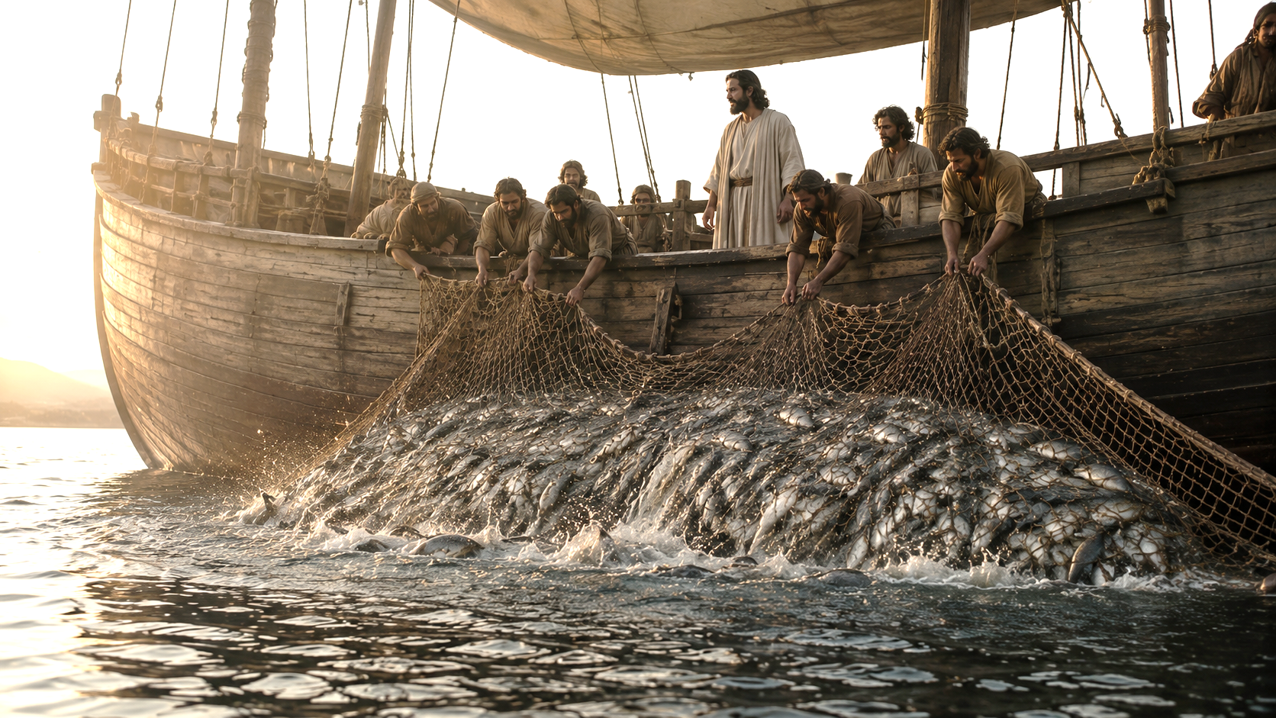

Slide 2

Notes:
Why did the fish become a symbol of Christianity?

Slide 3

Notes:
in Greek spells out

Slide 4
Notes:
like the one in our text

Slide 5
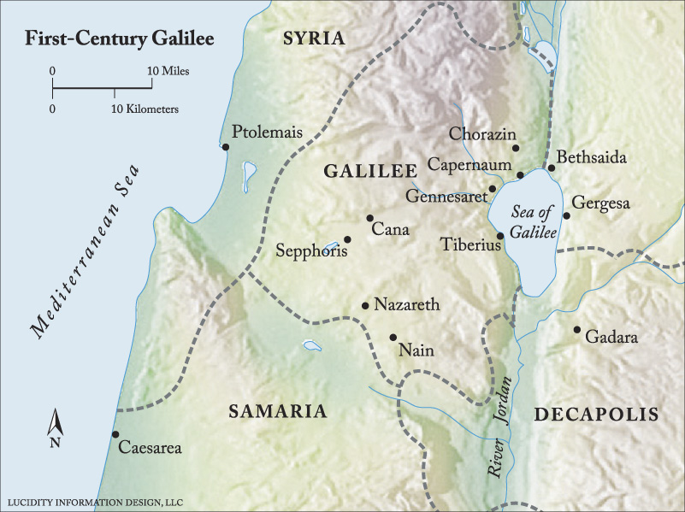
Notes:
We’re in Galilee

Slide 6
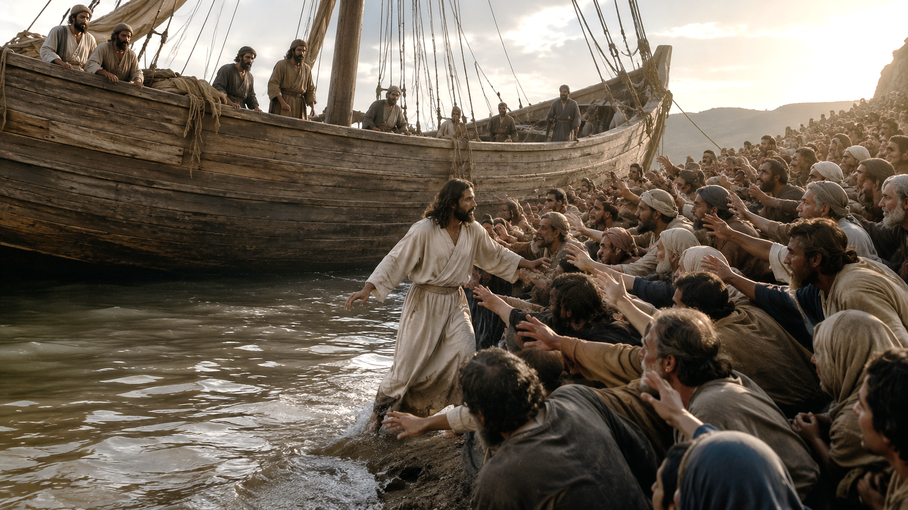
Notes:
the crowds got bigger

Slide 7
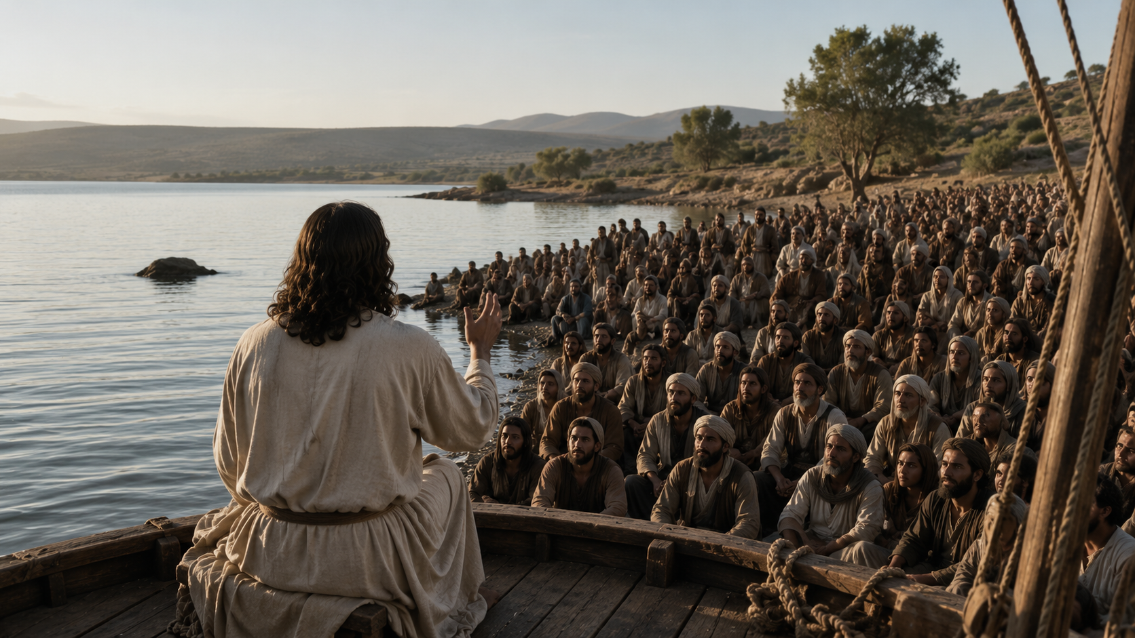
Notes:
He got into one of the boats

Slide 8
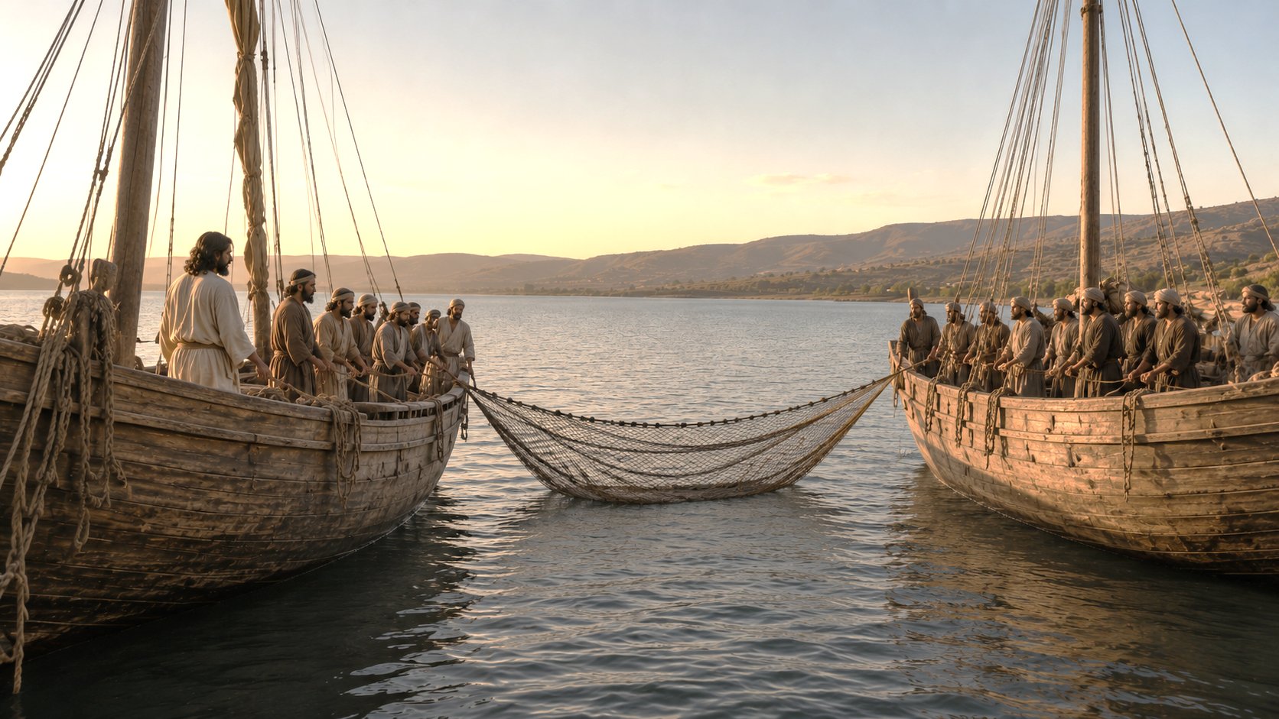
Notes:
Verse 4 – “Launch out into the deep”

Slide 9
Notes:
v. 6 – “their net brake”

