Slide 1
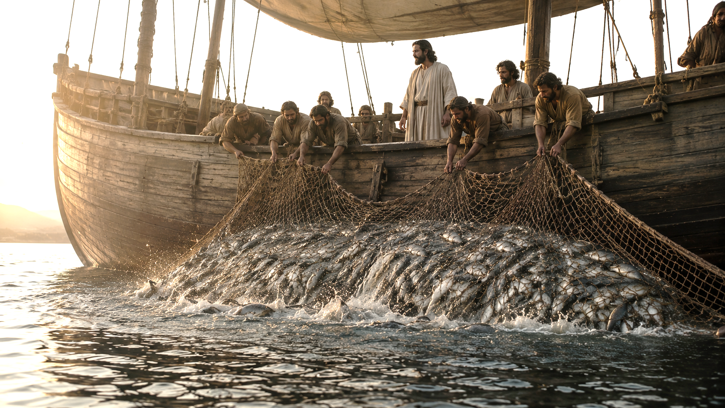
Notes:
beginning

Slide 2
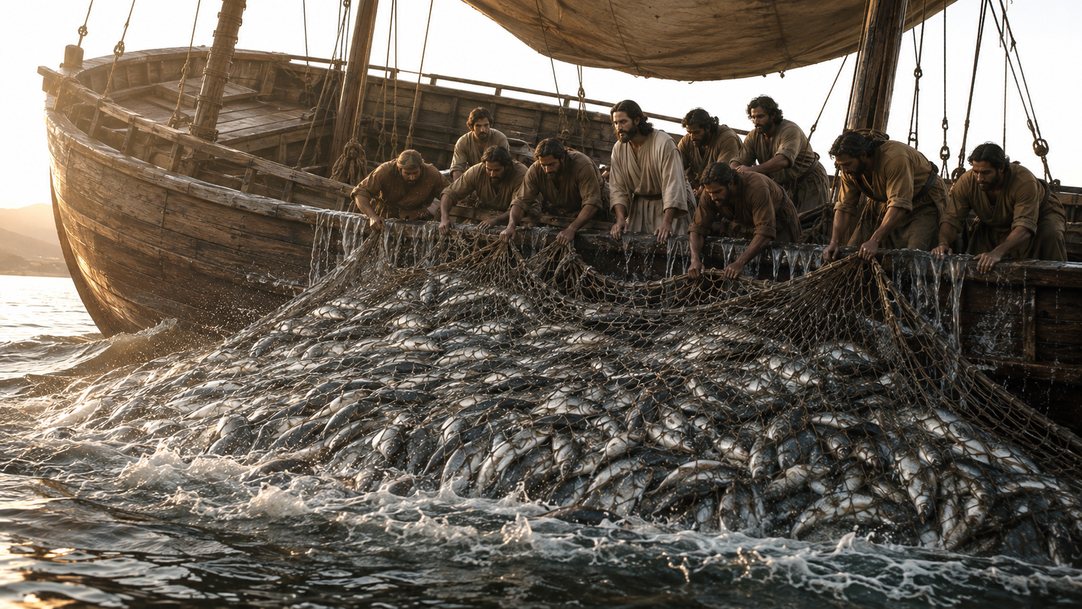
Notes:
the ships began to sink

Slide 3
Nehemiah 9:6
Thou, even thou, art LORD alone; thou hast made heaven, the heaven of heavens, with all their host, the earth, and all things that are therein, the seas, and all that is therein…

Slide 4
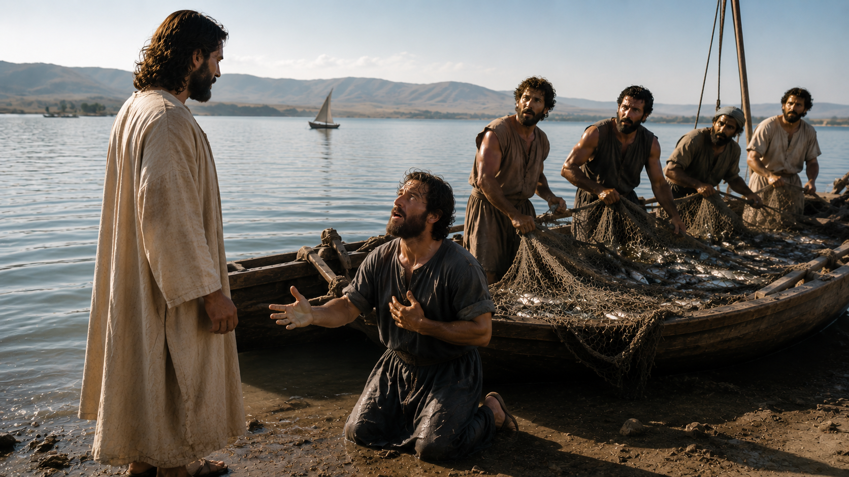
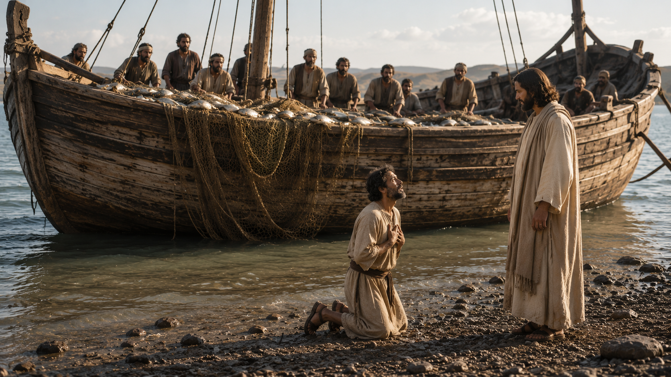
Notes:
Simon’s knees buckle

Slide 5
Deuteronomy 13:4
Ye shall walk after the LORD your God, and fear him, and keep his commandments, and obey his voice, and ye shall serve him, and cleave unto him.

Slide 6
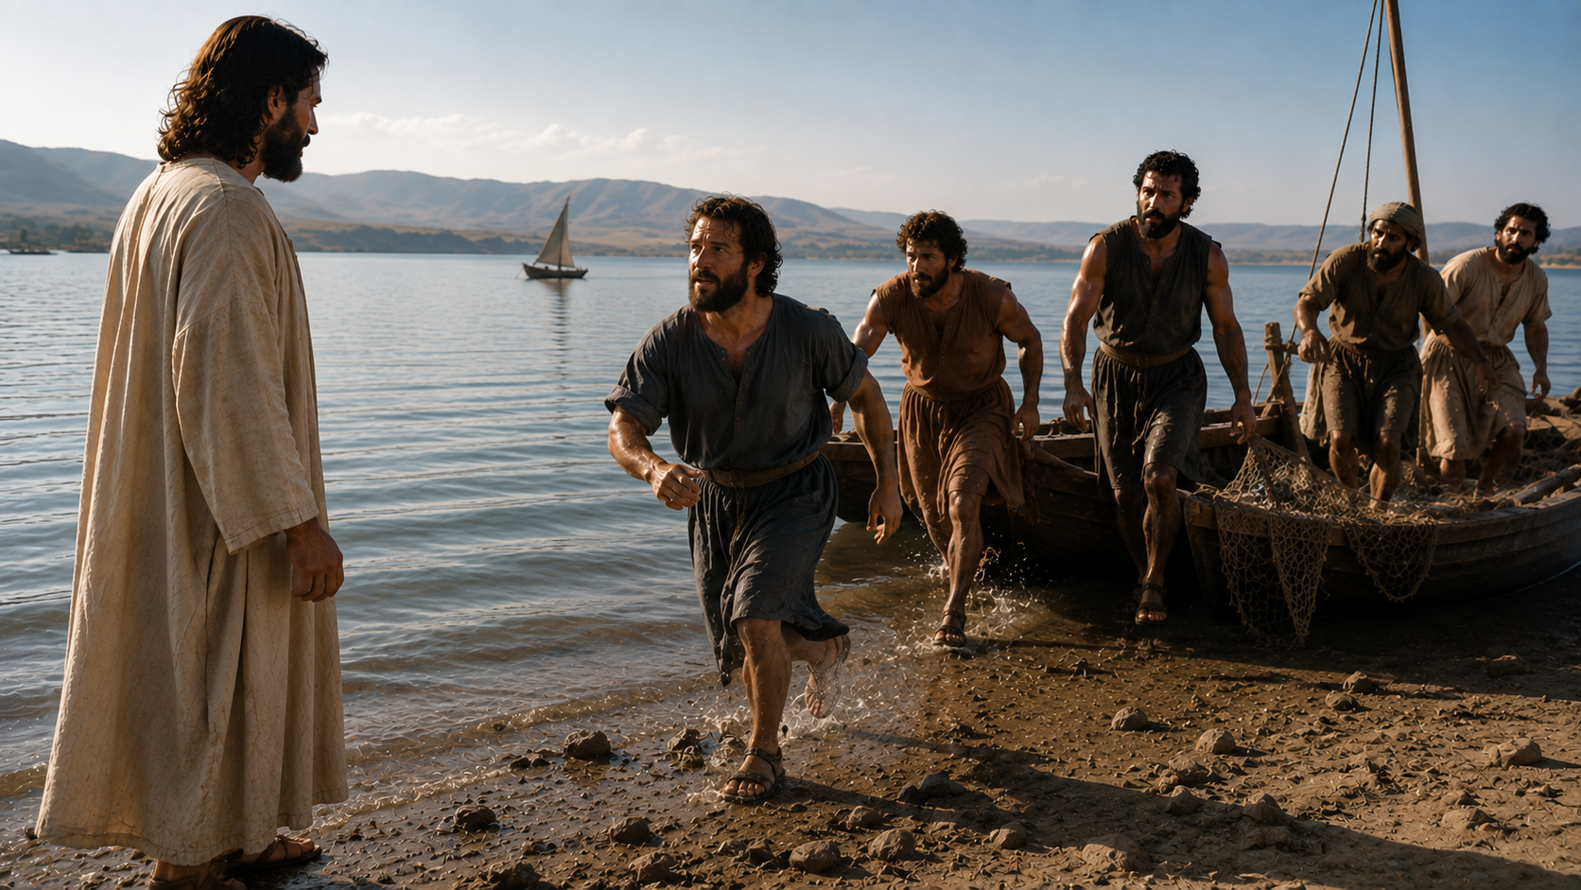
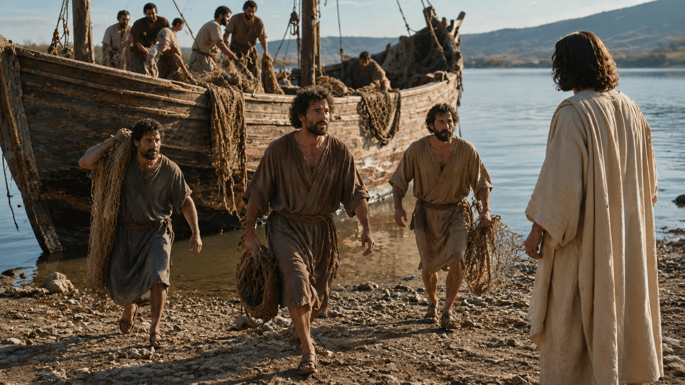
Notes:
Peter feared that he would be destroyed

