Slide 1

Notes:
beginning

Slide 2
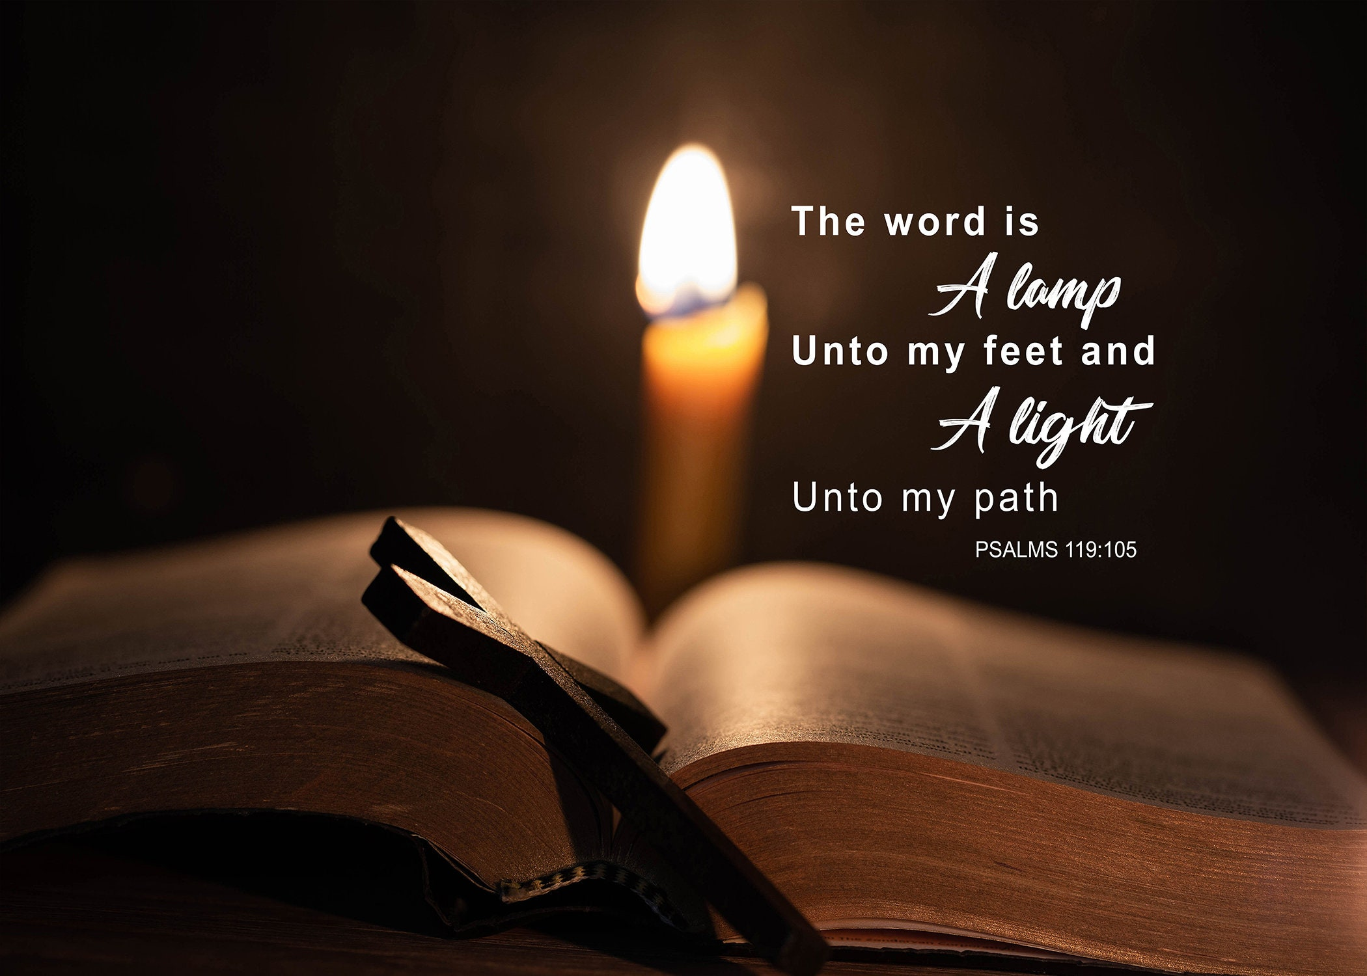
Notes:
lamp to our feet

Slide 3
1 Peter 1:10
Of which salvation the prophets have enquired and searched diligently, who prophesied of the grace that should come unto you:

Slide 4
1 Peter 1:11
Searching what, or what manner of time the Spirit of Christ which was in them did signify, when it testified beforehand the sufferings of Christ, and the glory that should follow.

Slide 5
1 Peter 1:12
Unto whom it was revealed, that not unto themselves, but unto us they did minister the things, which are now reported unto you by them that have preached the gospel unto you with the Holy Ghost sent down from heaven; which things the angels desire to look into.

Slide 6
Matthew 13:17
For verily I say unto you, That many prophets and righteous men have desired to see those things which ye see, and have not seen them; and to hear those things which ye hear, and have not heard them.

Slide 7
Matthew 13:16
But blessed are your eyes, for they see: and your ears, for they hear.

Slide 8
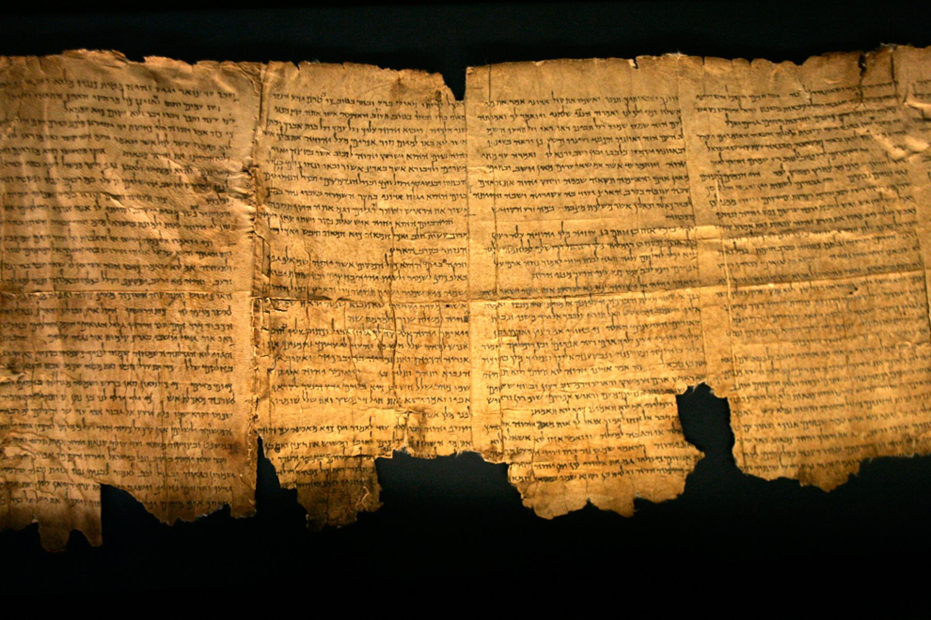
Notes:
Now roll up the scroll

Slide 9
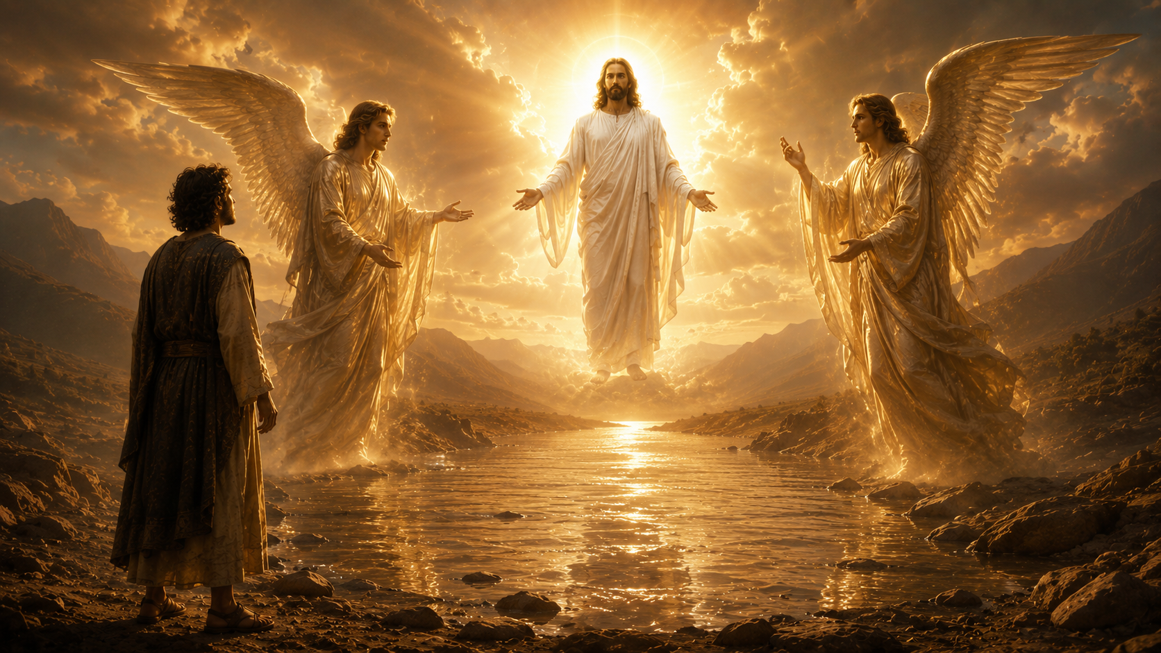
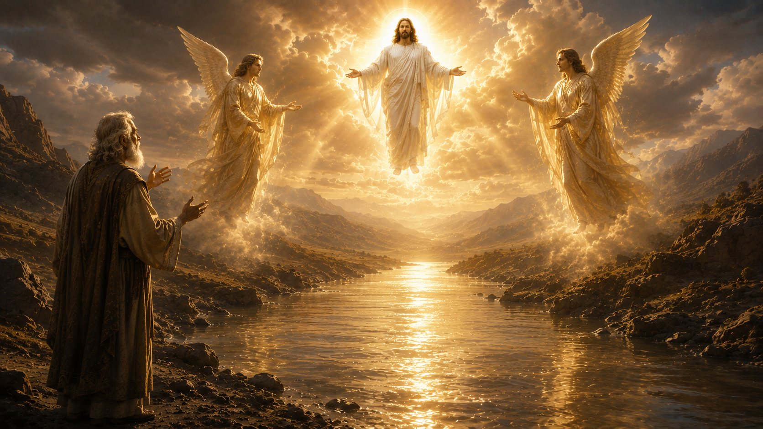
Notes:
Two other angels

Slide 10
Matthew 24:29-31
Immediately after the tribulation of those days shall the sun be darkened, and the moon shall not give her light, and the stars shall fall from heaven, and the powers of the heavens shall be shaken: ³⁰ And then shall appear the sign of the Son of man in heaven: and then shall all the tribes of the earth mourn, and they shall see the Son of man coming in the clouds of heaven with power and great glory. ³¹ And he shall send his angels with a great sound of a trumpet, and they shall gather together his elect from the four winds, from one end of heaven to the other.

