Slide 1
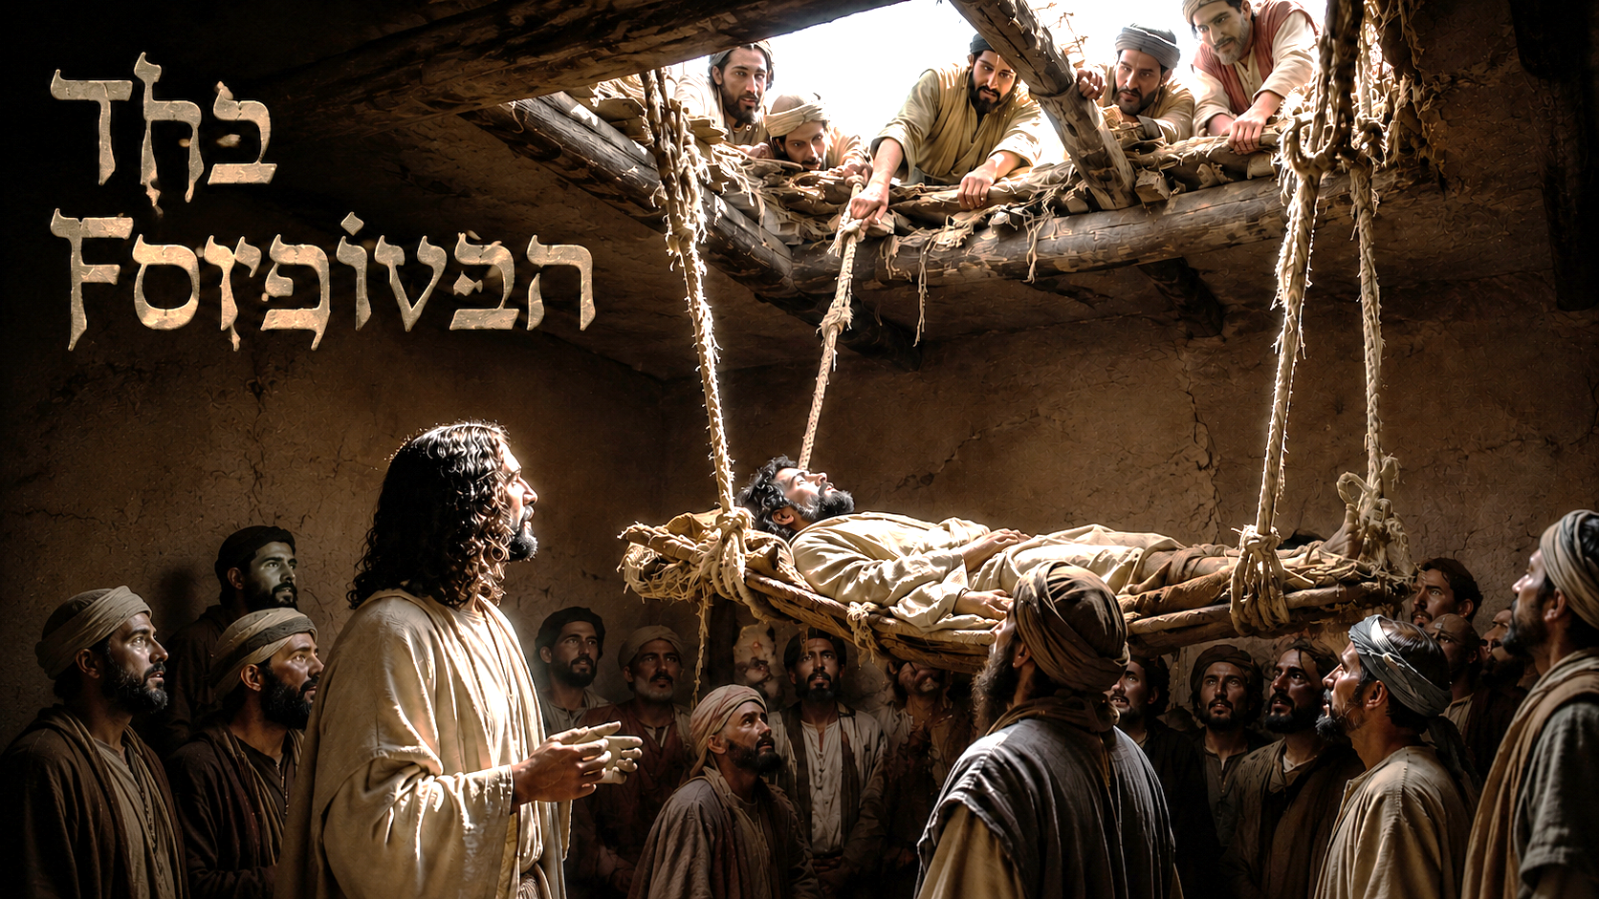

Slide 2
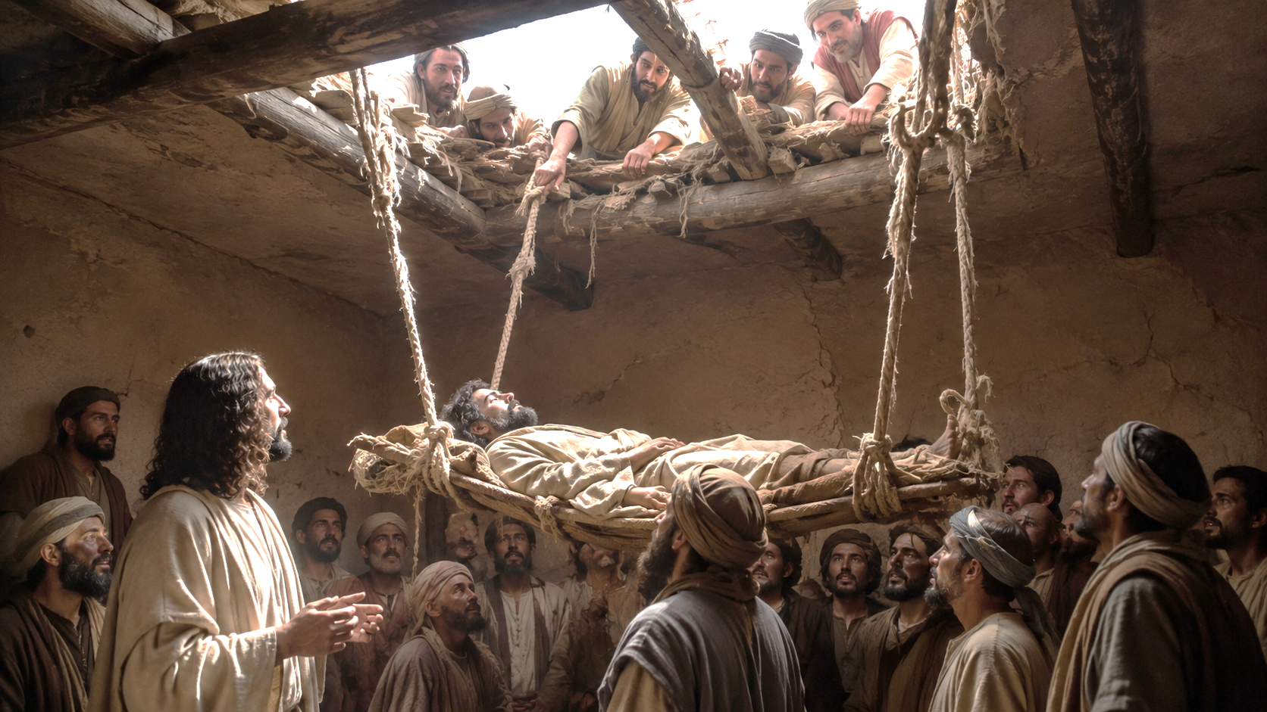
Acts 13:38
Be it known unto you therefore, men and brethren, that through this man is preached unto you the forgiveness of sins:

Slide 3
Ephesians 1:7
In whom we have redemption through his blood, the forgiveness of sins, according to the riches of his grace;

Slide 4
Ephesians 4:32
And be ye kind one to another, tenderhearted, forgiving one another, even as God for Christ's sake hath forgiven you.

Slide 5
Exodus 34:6-7
…The LORD God, merciful and gracious, long-suffering, and abundant in goodness and truth, 7 Keeping mercy for thousands, forgiving iniquity and transgression and sin, and that will by no means clear the guilty;

Slide 6
Nehemiah 9:17
… but thou art a God ready to pardon, gracious and merciful, slow to anger, and of great kindness, and forsookest them not.

Slide 7
Psalm 103:12
As far as the east is from the west, so far has He removed our transgressions from us.

Slide 8
Micah 7:18-19
Who is a God like unto thee, that pardoneth iniquity, and passeth by the transgression of the remnant of his heritage? he retaineth not his anger for ever, because he delighteth in mercy. 19 He will turn again, he will have compassion upon us; he will subdue our iniquities; and thou wilt cast all their sins into the depths of the sea.

Slide 9
Isaiah 55:7
Let the wicked forsake his way, and the unrighteous man his thoughts: and let him return unto the LORD, and he will have mercy upon him; and to our God, for he will abundantly pardon.

Slide 10
Isaiah 38:17
Behold, for peace I had great bitterness: but thou hast in love to my soul delivered it from the pit of corruption: for thou hast cast all my sins behind thy back.

Slide 11
Isaiah 43:25
I, even I, am he that blotteth out thy transgressions for mine own sake, and will not remember thy sins.

Slide 12
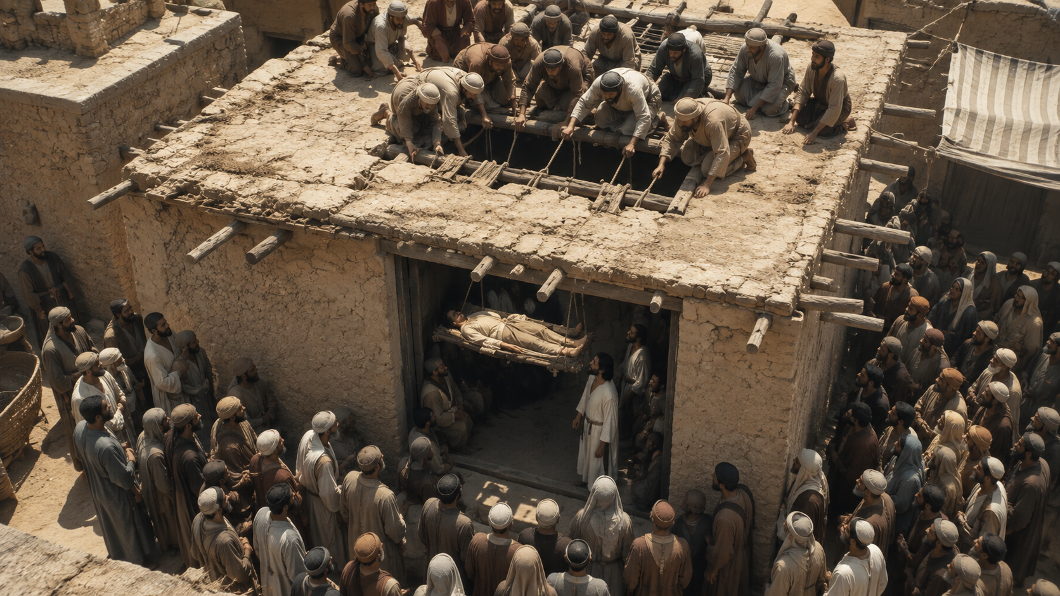
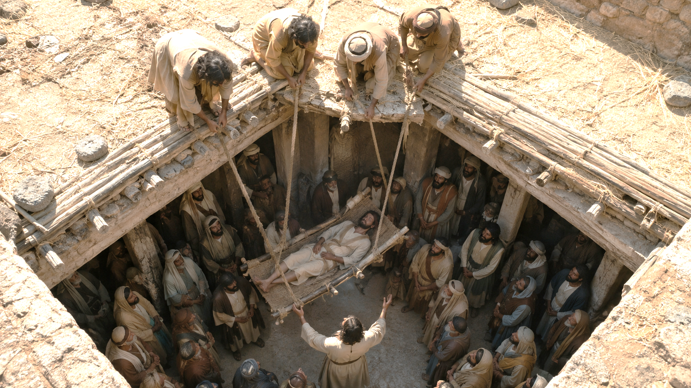
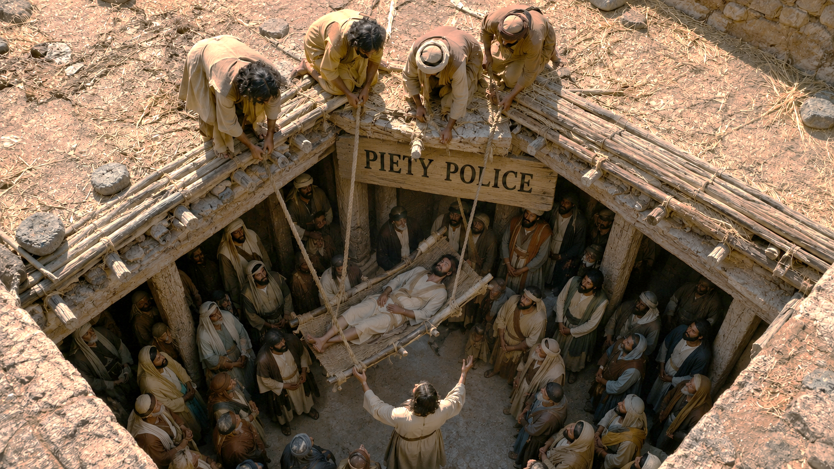
Notes:
in verse 21 the scribes and the Pharisees

Slide 13
Notes:
with 100% assurance

