Slide 1
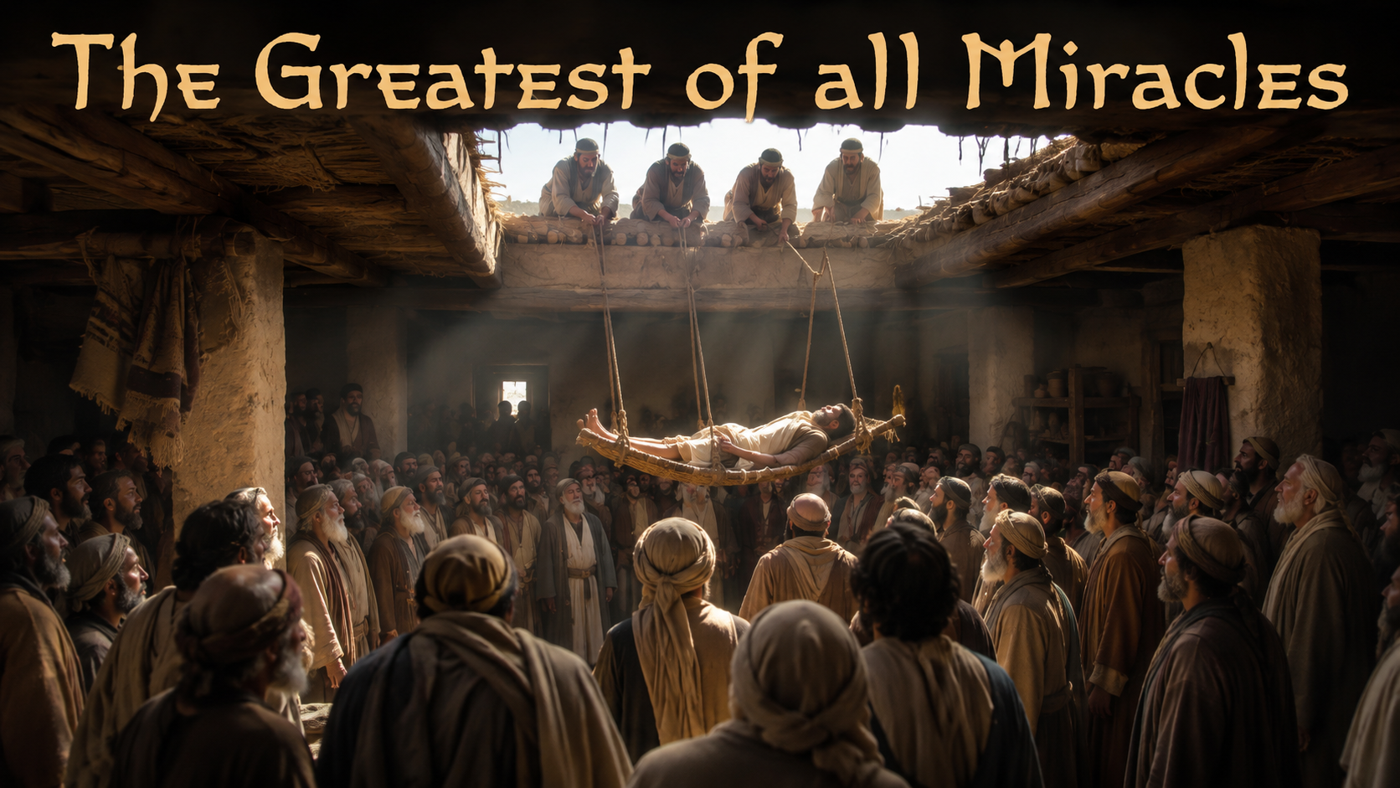
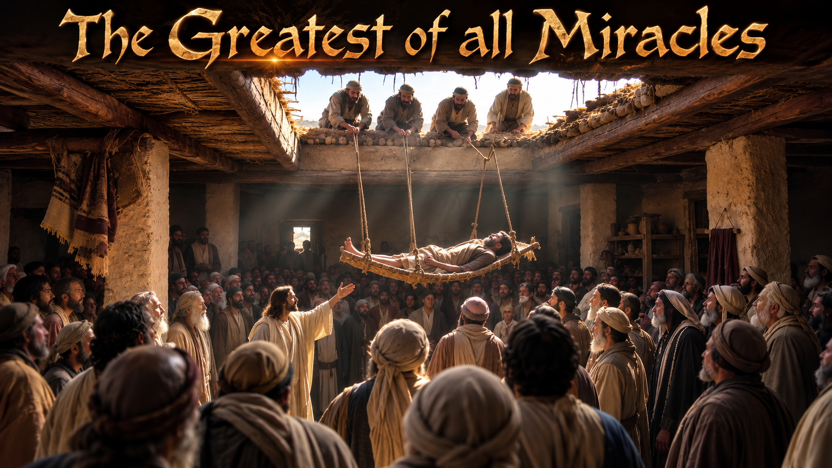
Notes:
Very beginning of message

Slide 2
Proverbs 17:15
He that justifieth the wicked, and he that condemneth the just, even they both are abomination to the LORD.

Slide 3
Proverbs 24:24
He that saith unto the wicked, Thou are righteous; him shall the people curse, nations shall abhor him:

Slide 4
Romans 4:5
But to him that worketh not, but believeth on him that justifieth the ungodly, his faith is counted for righteousness.

Slide 5
Psalms 32:1-2
Blessed is he whose transgression is forgiven, whose sin is covered. 2 Blessed is the man unto whom the LORD imputeth not iniquity…

Slide 6
Leviticus 24:23
And Moses spake to the children of Israel, that they should bring forth him that had cursed out of the camp, and stone him with stones.

Slide 7
I believe there is power in the blood of the Lamb
I believe there is healing in the touch of His hand
But the greatest of all miracles
Was when Jesus saved me
Yes, I know what Jesus did for me
Notes:
When I say “sing with me”

