Slide 1
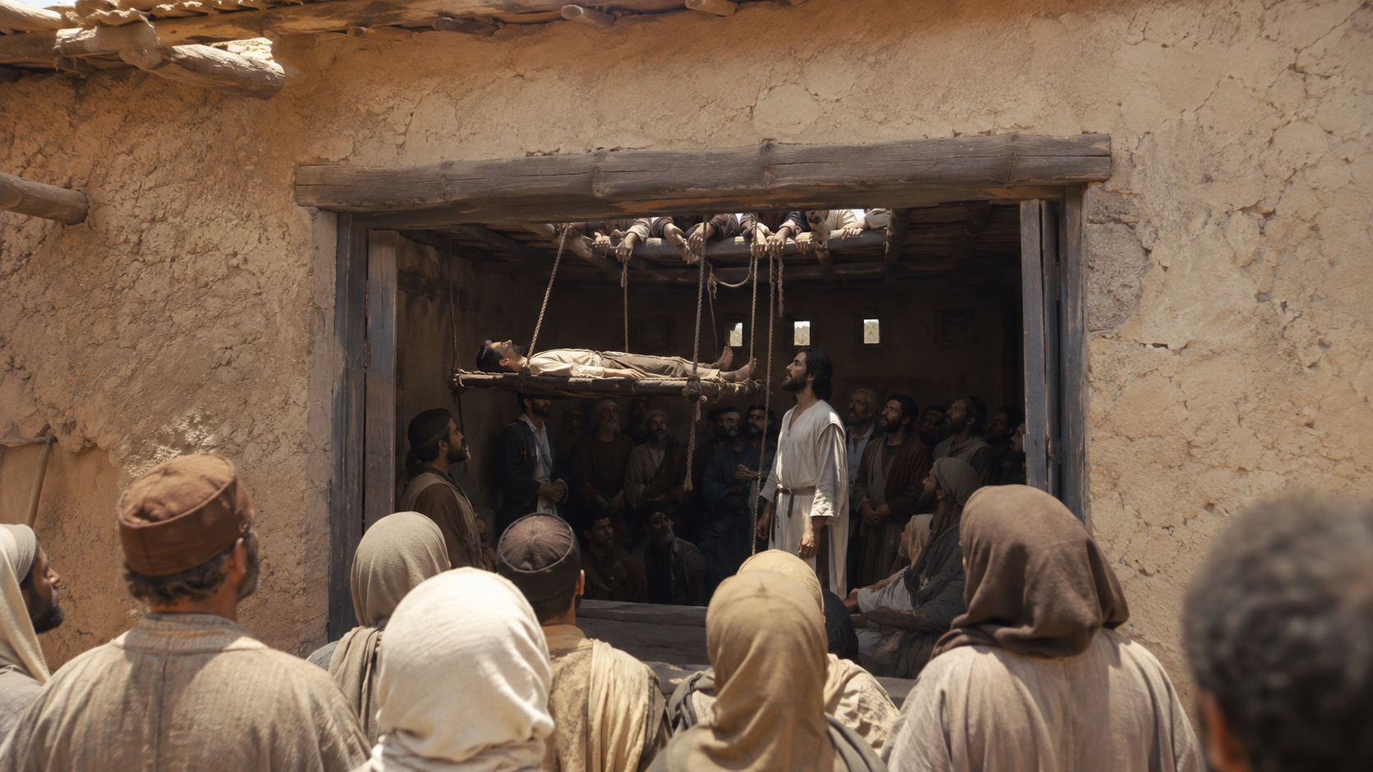

Slide 2
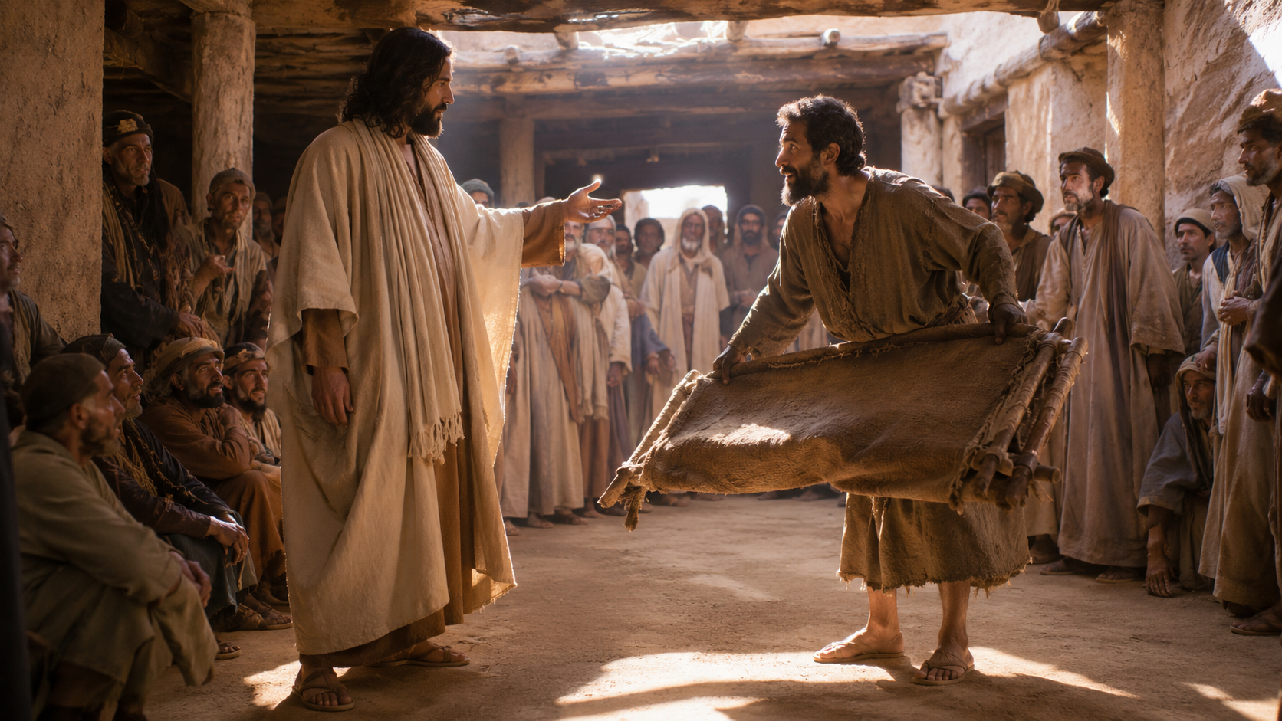
Notes:
to take the controversy to a fever pitch

Slide 3
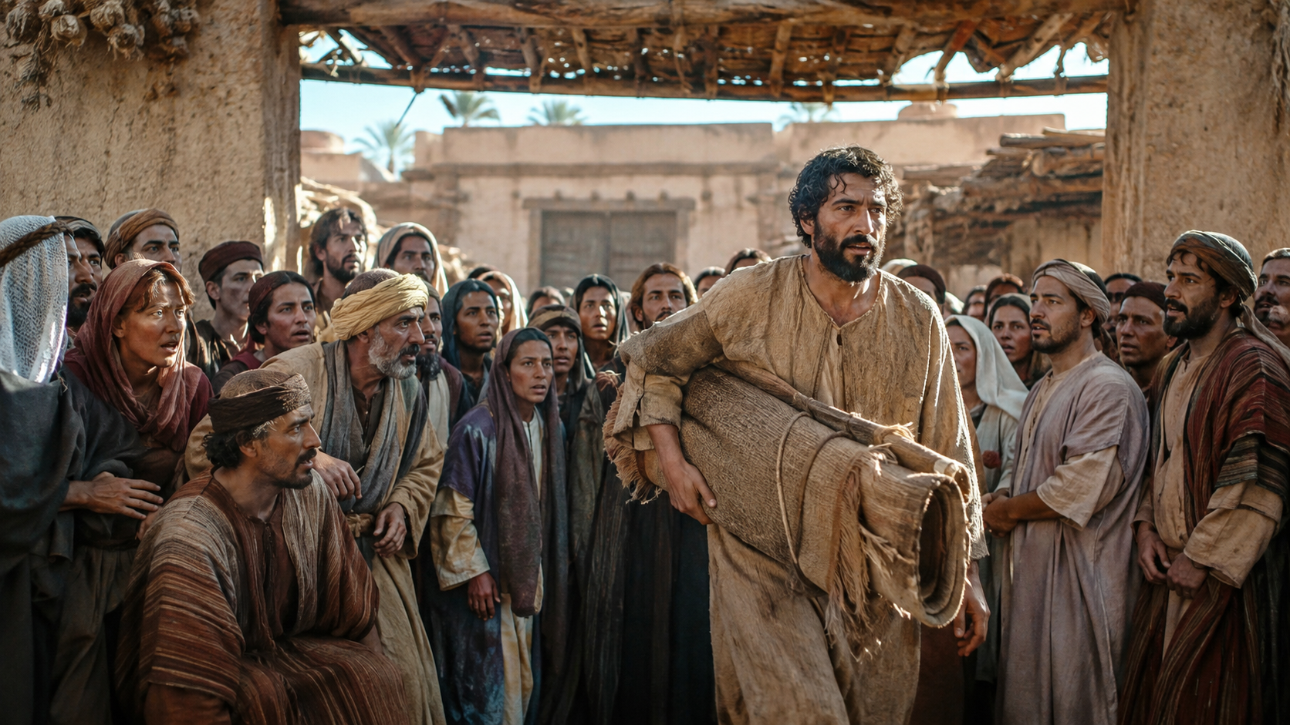
Notes:
he just went home

