Slide 1
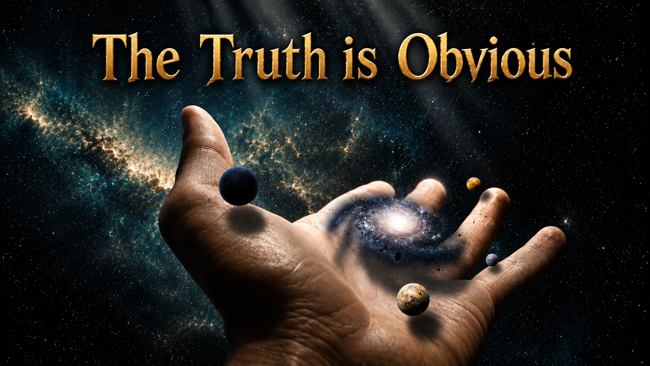
Notes:
beginning

Slide 2
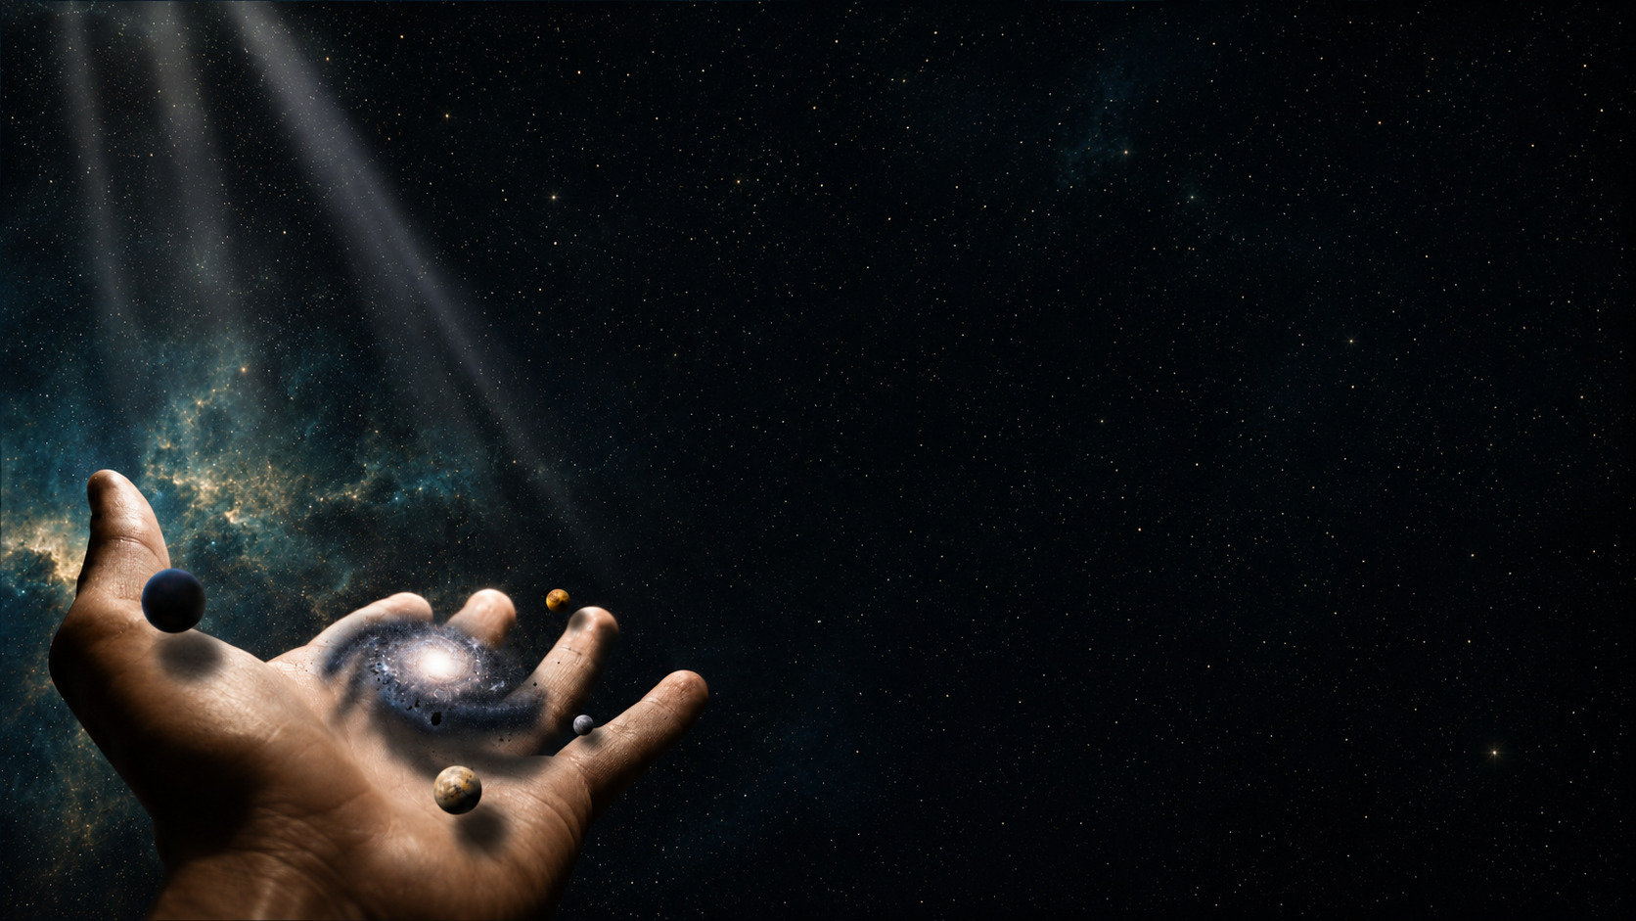
Psalms 19:1
The heavens declare the glory of God; and the firmament sheweth his handywork.

Slide 3
John 1:1-3
In the beginning was the Word, and the Word was with God, and the Word was God. 2 The same was in the beginning with God. 3 All things were made by him; and without him was not any thing made that was made.

Slide 4
Hebrews 11:3
Through faith we understand that the worlds were framed by the word of God, so that things which are seen were not made of things which do appear.

Slide 5
Colossians 1:16
For by him were all things created, that are in heaven, and that are in earth, visible and invisible, whether they be thrones, or dominions, or principalities, or powers: all things were created by him, and for him:

Slide 6
Deuteronomy 4:32
For ask now of the days that are past, which were before thee, since the day that God created man upon the earth…

Slide 7
Psalms 104:1-2
Bless the LORD, O my soul. O LORD my God, thou art very great… who stretchest out the heavens like a curtain:

Slide 8
Psalms 104:5
Who laid the foundations of the earth, that it should not be removed for ever.

Slide 9
Psalms 104:24
O LORD, how manifold are thy works! in wisdom hast thou made them all: the earth is full of thy riches.

Slide 10
Psalms 148:1-5
Praise ye the LORD. Praise ye the LORD from the heavens: praise him in the heights. 2 Praise ye him, all his angels: praise ye him, all his hosts. 3 Praise ye him, sun and moon: praise him, all ye stars of light. 4 Praise him, ye heavens of heavens,
and ye waters that be
above the heavens. 5 Let
them praise the name of
the LORD: for he commanded,
and they were created.

Slide 11
Isaiah 40:28
Hast thou not known? hast thou not heard, that the everlasting God, the LORD, the Creator of the ends of the earth, fainteth not, neither is weary? there is no searching of his understanding.

Slide 12
Isaiah 42:5
Thus saith God the LORD, he that created the heavens, and stretched them out; he that spread forth the earth, and that which cometh out of it; he that giveth breath unto the people upon it, and spirit to them that walk therein:

Slide 13
Isaiah 45:6-8
I am the LORD, and there is none else. 7 I form the light, and create darkness: I make peace, and create evil: I the LORD do all these things. 8 Drop down, ye heavens, from above, and let the skies pour down righteousness: let the
earth open, and let them bring
forth salvation, and let
righteousness spring up together;
I the LORD have created it.

Slide 14
Isaiah 45:9
Woe unto him that striveth with his Maker!

Slide 15
Isaiah 45:12, 18
I have made the earth, and created man upon it: I, even my hands, have stretched out the heavens, and all their host have I commanded. 18 For thus saith the LORD that created the heavens; God himself that formed the earth and made it;
he hath established it,
he created it not in vain,
he formed it to be inhabited:
I am the LORD; and
there is none else.

Slide 16
Malachi 2:10
Have we not all one father? hath not one God created us?

Slide 17
Mark 10:6
But from the beginning of the creation God made them male and female.

Slide 18
Mark 13:19
For in those days shall be affliction, such as was not from the beginning of the creation which God created unto this time, neither shall be.

Slide 19
Ephesians 3:9
And to make all men see what is the fellowship of the mystery, which from the beginning of the world hath been hid in God, who created all things by Jesus Christ:

Slide 20
1 Peter 4:19
Wherefore let them that suffer according to the will of God commit the keeping of their souls to him in well doing, as unto a faithful Creator.

Slide 21
Revelation 4:11
Thou art worthy, O Lord, to receive glory and honour and power: for thou hast created all things, and for thy pleasure they are and were created.

Slide 22
Revelation 5:13
And every creature which is in heaven, and on the earth...

Slide 23
Revelation 5:13
And every creature which is in heaven, and on the earth...
created thing
Notes:
Created things

Slide 24
Revelation 10:6
And sware by him that liveth for ever and ever, who created heaven, and the things that therein are, and the earth, and the things that therein are, and the sea,
and the things which are
therein, that there
should be time no longer:

Slide 25
Revelation 14:6
And I saw another angel fly in the midst of heaven, having the everlasting gospel to preach unto them that dwell on the earth, and to every nation,
and kindred, and
tongue, and people,

Slide 26
Revelation 14:7
Saying with a loud voice, Fear God, and give glory to him; for the hour of his judgment is come: and worship him that made heaven, and earth, and the sea, and the fountains of waters.

Slide 27
Nehemiah 9:6
Thou, even thou, art LORD alone; thou hast made heaven, the heaven of heavens, with all their host, the earth, and all things that are therein, the seas, and all that is therein, and thou preservest
them all; and the host
of heaven worshippeth thee.

Slide 28
Psalms 33:6, 9
By the word of the LORD were the heavens made; and all the host of them by the breath of his mouth. 9 For he spake, and it was done; he commanded, and it stood fast.

Slide 29
Acts 14:15
We also are men of like passions with you, and preach unto you that ye should turn from these vanities unto the living God, which made heaven, and earth, and the sea, and all things that are therein:

Slide 30
Acts 17:24
God that made the world and all things therein, seeing that he is Lord of heaven and earth, dwelleth not in temples made with hands;

Slide 31
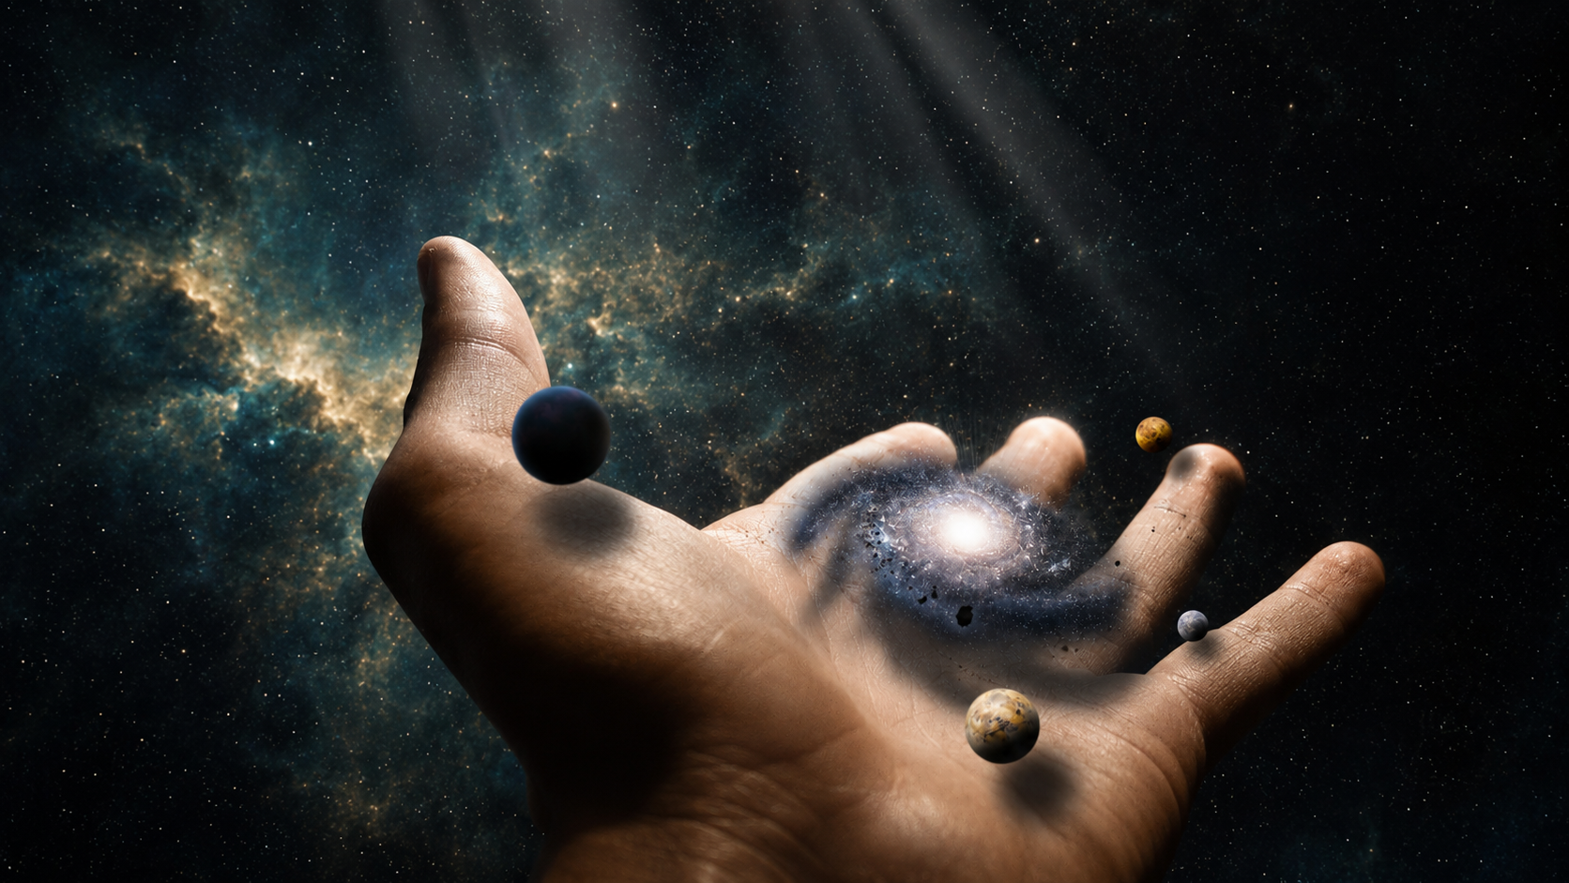
“In the beginning God created the heaven and the earth.”
Notes:
Then look at what was made by the hands of God!

Slide 32
Notes:
The truth about our Creator is obvious

