Slide 1
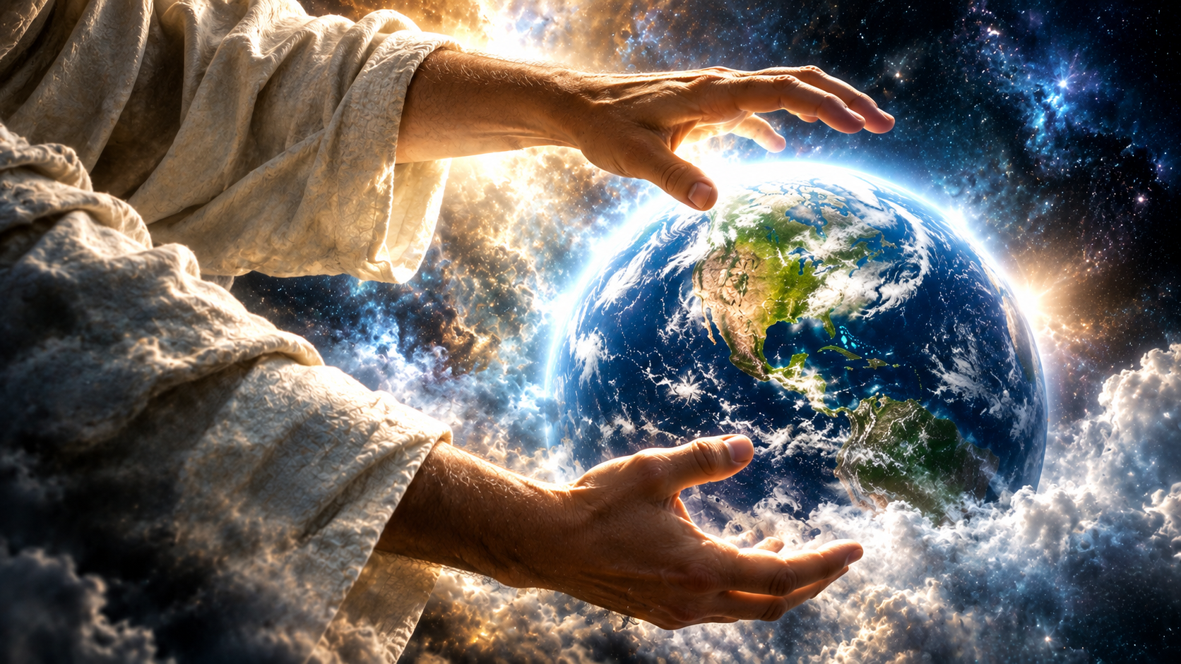
Notes:
beginning

Slide 2
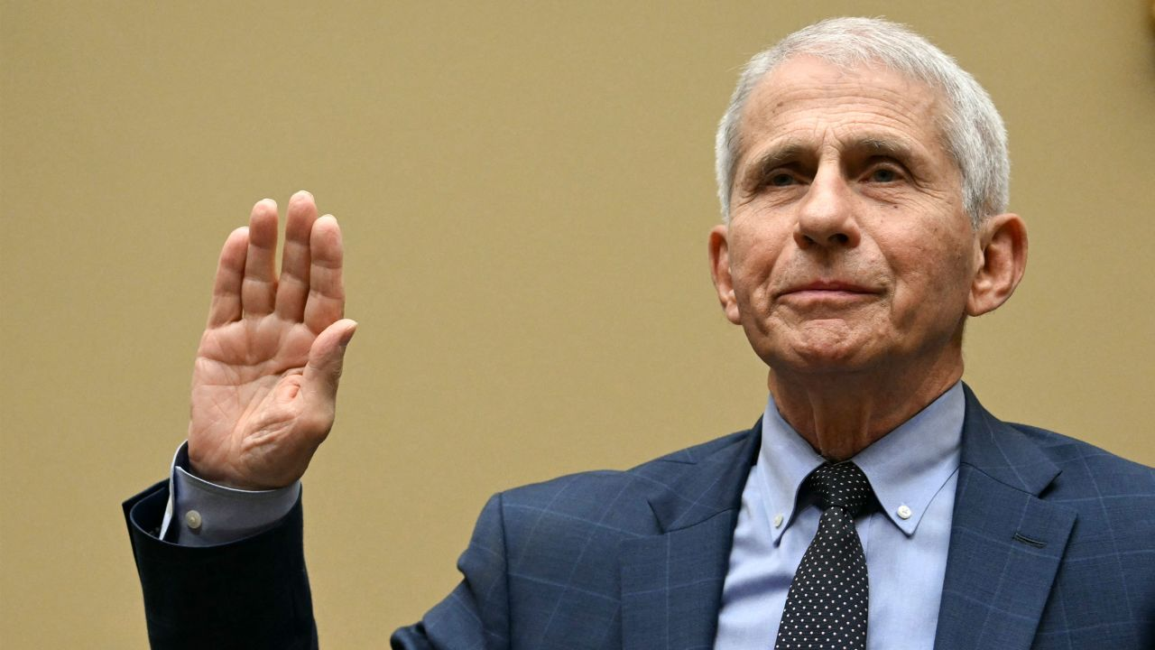
Notes:
especially when sinful man

Slide 3
Job 26:7
He stretcheth out the north over the empty place, and hangeth the earth upon nothing.

Slide 4
Hebrews 11:3
Through faith we understand that the worlds were framed by the word of God, so that things which are seen were not made of things which do appear.

Slide 5
Psalms 33:6,9
By the word of the LORD were the heavens made; and all the host of them by the breath of his mouth. 9 For he spake, and it was done; he commanded, and it stood fast

Slide 6
Psalms 148:5
Let them praise the name of the LORD: for he commanded, and they were created.

Slide 7
Hebrews 1:10
10 And, Thou, Lord, in the beginning hast laid the foundation of the earth; and the heavens are the works of thine hands:

Slide 8
Job 26:7
He stretcheth out the north over the empty place, and hangeth the earth upon nothing.

Slide 9
Romans 4:17
… God, who quickeneth the dead, and calleth those things which be not as though they were.

Slide 10
John 1:3
All things were made by him; and without him was not any thing made that was made.

Slide 11
Genesis 2:2
And on the seventh day God ended his work which he had made; and he rested on the seventh day from all his work which he had made.

Slide 12
Hebrews 4:3,10
… the works were finished from the foundation of the world. 10 For he that is entered into his rest, he also hath ceased from his own works, as God did from his.

Slide 13
Genesis 1:31
And God saw every thing that he had made, and, behold, it was very good. And the evening and the morning were the sixth day.

Slide 14
Exodus 20:9-11
Six days shalt thou labor, and do all thy work: 10 But the seventh day is the sabbath of the LORD thy God: in it thou shalt not do any work… 11 For in six days the LORD made heaven and earth, the sea, and all that in them is, and rested the seventh day:

Slide 15
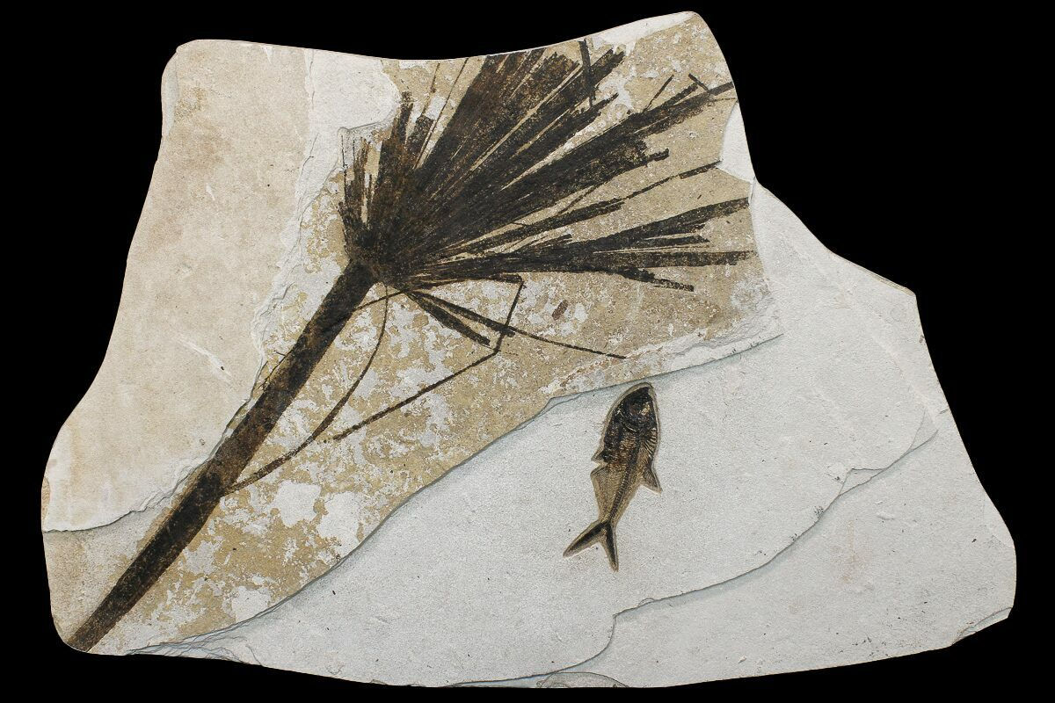
Notes:
Fish fossils

