Slide 1
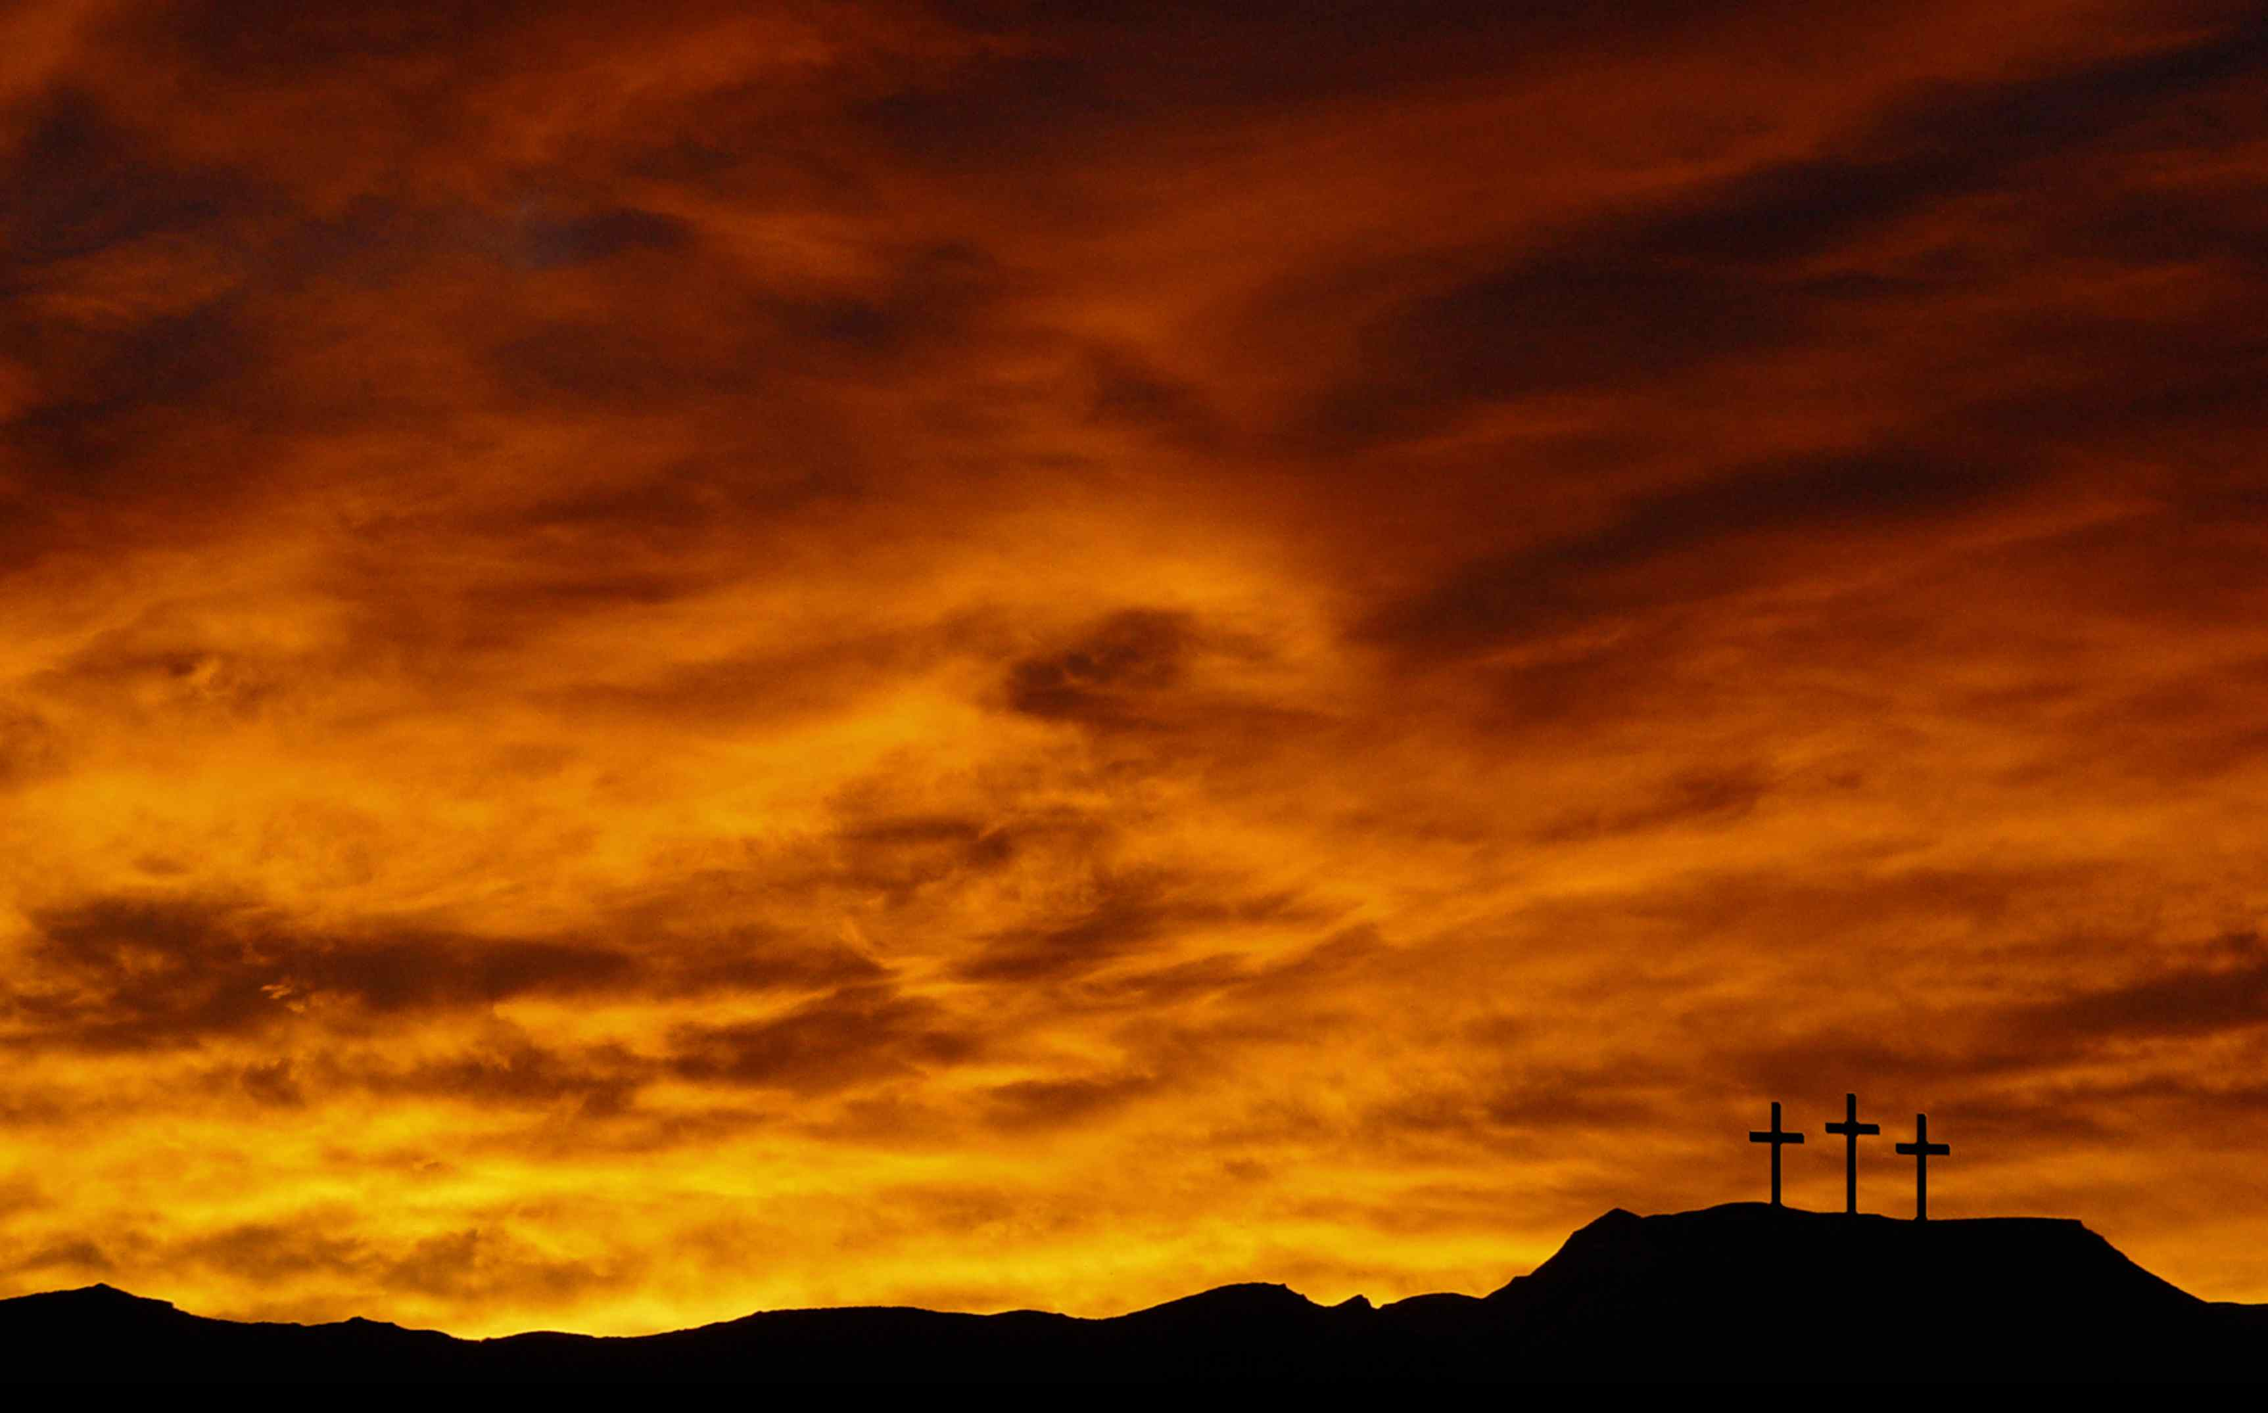
Notes:
music

Slide 2

Notes:
Start slide just BEFORE starting video

Slide 3


Slide 4
1 Thessalonians 5:23
… I pray God your whole spirit and soul and body be preserved blameless unto the coming of our Lord Jesus Christ.

Slide 5
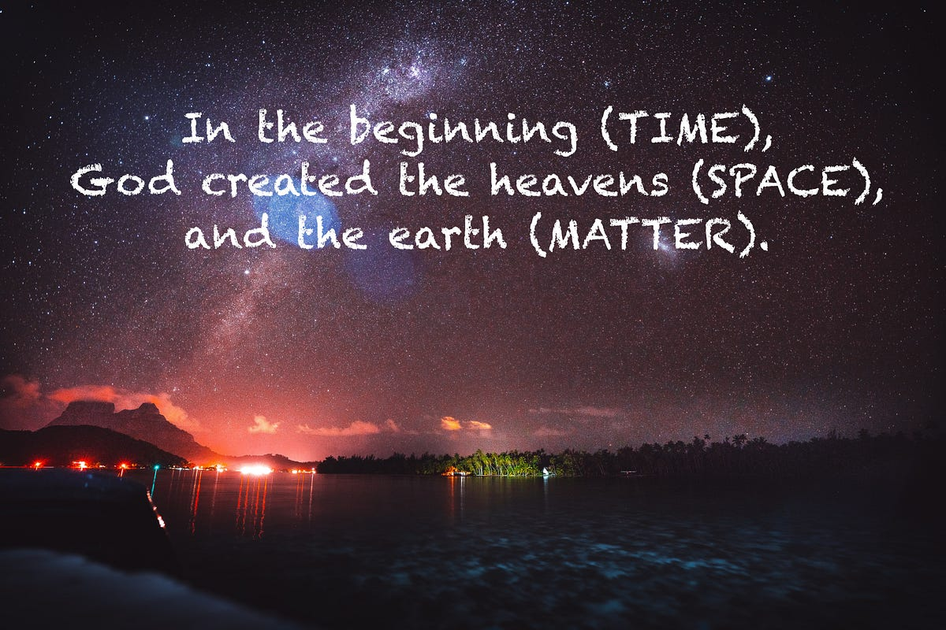
Notes:
He created these three

Slide 6
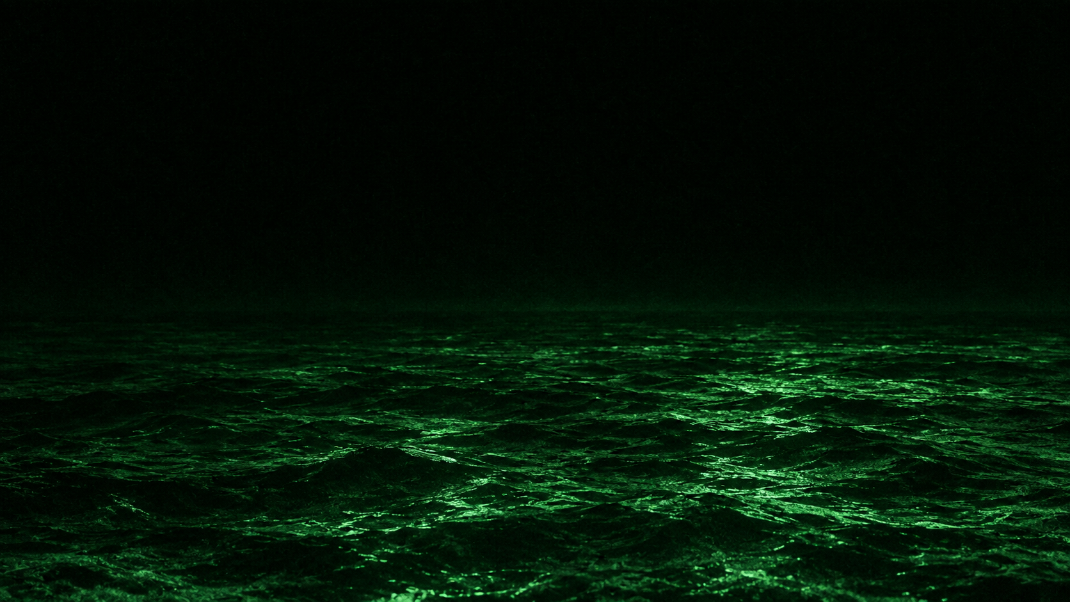
Notes:
It was desolate

Slide 7
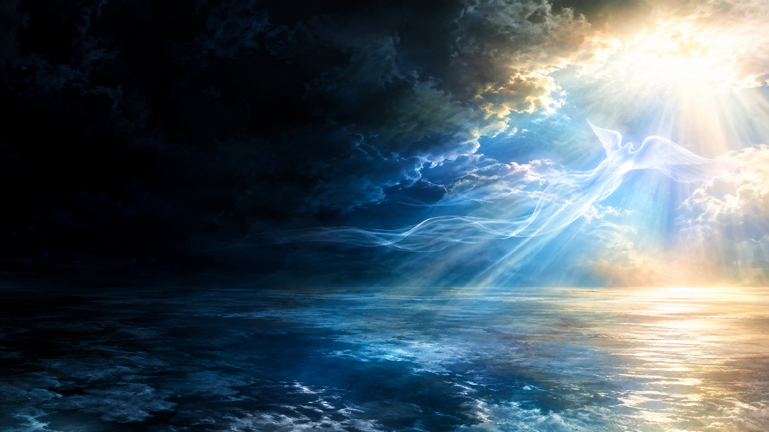
Notes:
God said, let there be light

Slide 8
1 John 1:5
… God is light, and in him is no darkness at all.

Slide 9
Psalms 104:2
Who coverest thyself with light as with a garment: who stretchest out the heavens like a curtain:

Slide 10
Revelation 21:23
And the city had no need of the sun, neither of the moon, to shine in it: for the glory of God did lighten it, and the Lamb is the light thereof.

Slide 11

Notes:
God separated heaven from earth

Slide 12
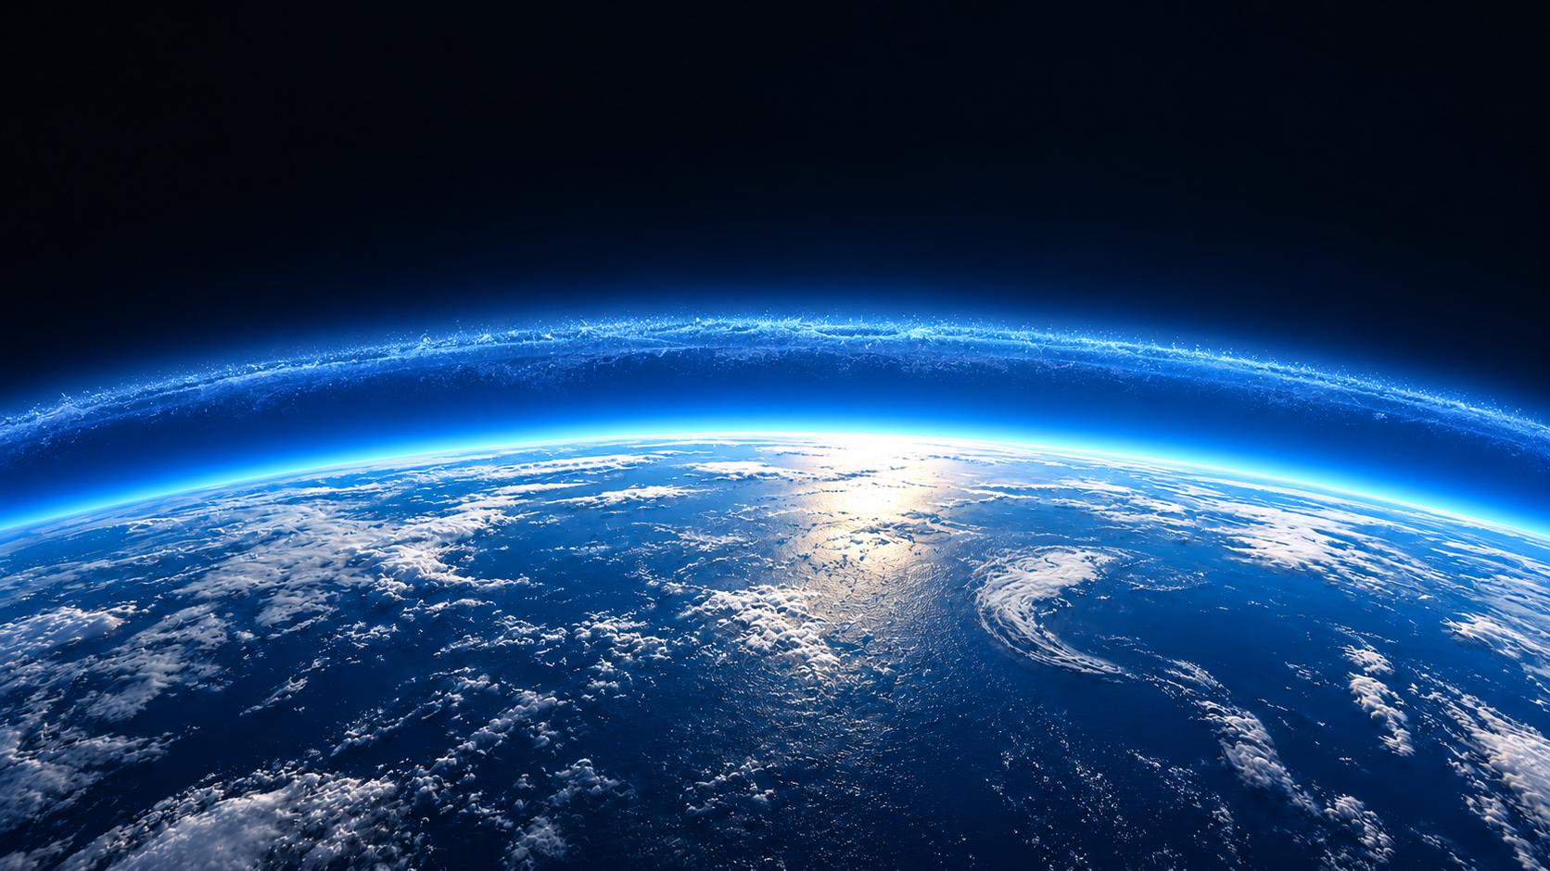
Notes:
originally there was a canopy

Slide 13
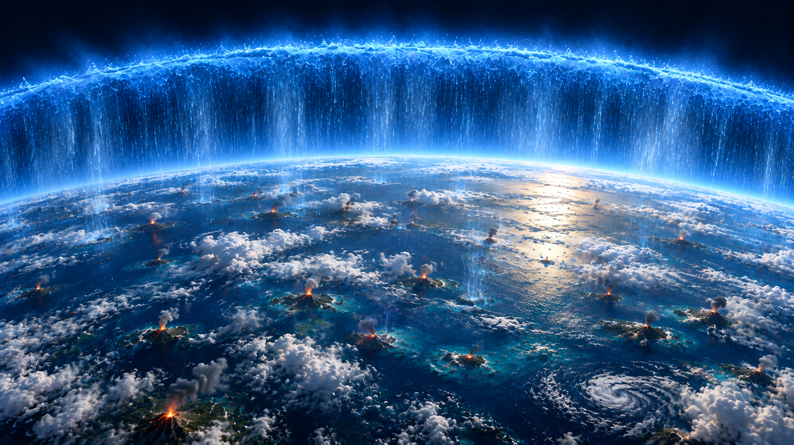
Notes:
would lead to volcanism

Slide 14

Notes:
v. 7 ends “and it was so.”

Slide 15
Psalms 104:1-3
Bless the LORD, O my soul. O LORD my God, thou art very great; thou art clothed with honour and majesty. 2 Who coverest thyself with light as with a garment: who stretchest out the heavens like a curtain: 3 Who layeth the beams of his chambers in the waters: who maketh the clouds his chariot: who walketh upon the wings of the wind:

Slide 16
Psalms 19:1
The heavens declare the glory of God; and the firmament sheweth his handywork.

Slide 17
Psalms 8:3-4
When I consider thy heavens, the work of thy fingers, the moon and the stars, which thou hast ordained; 4 What is man, that thou art mindful of him? and the son of man, that thou visitest him?

Slide 18
