Slide 1
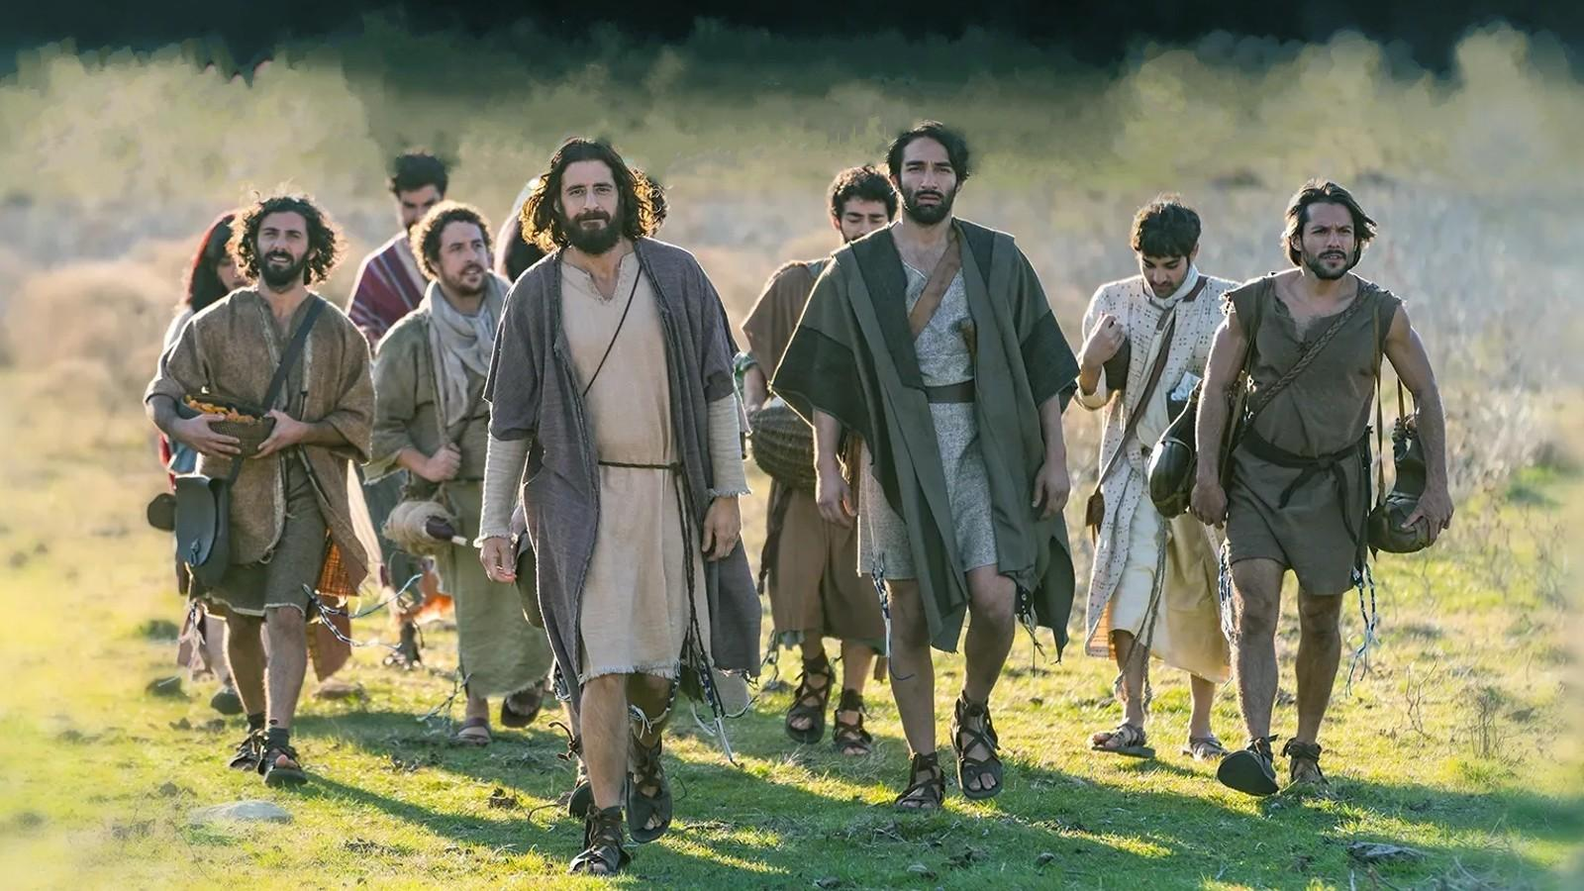

Slide 2
1 Corinthians 1:20-21
Where is the wise? where is the scribe? where is the disputer of this world? hath not God made foolish the wisdom of this world? ²¹ For after that in the wisdom of God the world by wisdom knew not God, it pleased God by the foolishness of preaching to save them that believe.

Slide 3
1 Corinthians 1:26-28
For ye see your calling, brethren, how that not many wise men after the flesh, not many mighty, not many noble, are called: 27 But God hath chosen the foolish things of the world to confound the wise; and God hath chosen the weak things of the world to confound the things which are mighty; 28 And base things of the world, and things which are despised, hath God chosen, yea, and things which are not, to bring to nought things that are:

Slide 4
John 15:16
Ye have not chosen me, but I have chosen you, and ordained you, that ye should go and bring forth fruit…

Slide 5
Luke 22:29-30
And I appoint unto you a kingdom, as my Father hath appointed unto me; 30 That ye may eat and drink at my table in my kingdom, and sit on thrones judging the twelve tribes of Israel.

Slide 6
Revelation 21:12-14
And had a wall great and high, and had twelve gates, and at the gates twelve angels, and names written thereon, which are the names of the twelve tribes of the children of Israel: 14 And the wall of the city had twelve foundations, and in them the names of the twelve apostles of the Lamb.

Slide 7
Mark 3:14
And he ordained twelve, that they should be with him, and that he might send them forth to preach,

Slide 8
Ephesians 2:20
And are built upon the foundation of the apostles and prophets, Jesus Christ himself being the chief corner stone;

Slide 9
Ephesians 3:5
Which in other ages was not made known unto the sons of men, as it is now revealed unto his holy apostles and prophets by the Spirit;

Slide 10
Acts 2:42
And they continued stedfastly in the apostles' doctrine…

Slide 11
Ephesians 4:11
And he gave some, apostles; and some, prophets; and some, evangelists; and some, pastors and teachers;

Slide 12
2 Corinthians 12:12
Truly the signs of an apostle were wrought among you in all patience, in signs, and wonders, and mighty deeds.

Slide 13
Luke 18:28-30
Then Peter said, Lo, we have left all, and followed thee. 29 And he said unto them, Verily I say unto you, There is no man that hath left house, or parents, or brethren, or wife, or children, for the kingdom of God's sake, 30 Who shall not receive manifold more in this present time, and in the world to come life everlasting.

Slide 14
Matthew 11:29
Take my yoke upon you, and learn of me…

