Slide 1


Slide 2
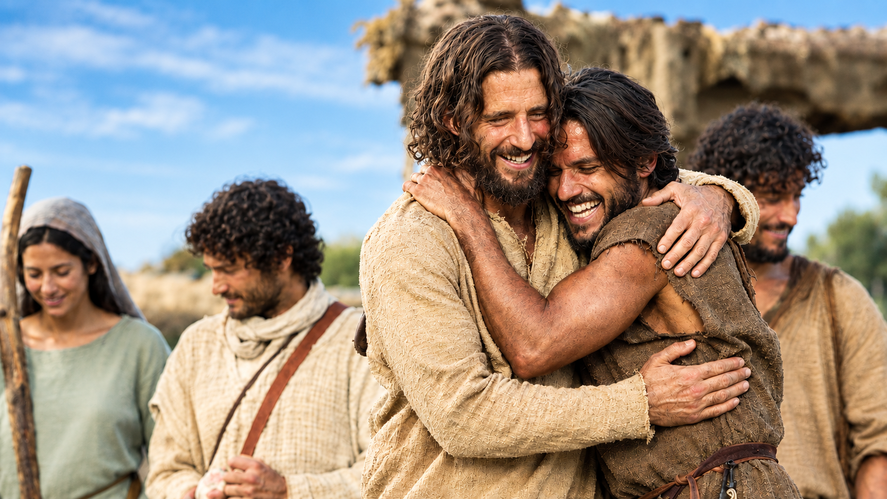
Matthew 10:2
Now the names of the twelve apostles are these; The first, Simon, who is called Peter, and Andrew his brother; James the son of Zebedee, and John his brother;

Slide 3
Luke 22:31
And the Lord said, Simon, Simon, behold, Satan hath desired to have you, that he may sift you as wheat:

Slide 4
Mark 14:37
And he cometh, and findeth them sleeping, and saith unto Peter, Simon, sleepest thou? couldest not thou watch one hour?

Slide 5
Inquisitiveness

Slide 6
Inquisitiveness
Initiative

Slide 7
Inquisitiveness
Initiative
Matthew 16:18
And I say also unto thee, That thou art Peter, and upon this rock I will build my church; and the gates of hell shall not prevail against it.

Slide 8
Inquisitiveness
Initiative
Matthew 16:18
And I say also unto thee, That thou art Peter, and upon this rock I will build my church; and the gates of hell shall not prevail against it.
Matthew 16:23
But he turned, and said unto Peter, Get thee behind me, Satan: thou art an offence unto me:

Slide 9
Inquisitiveness
Initiative
Involvement

Slide 10
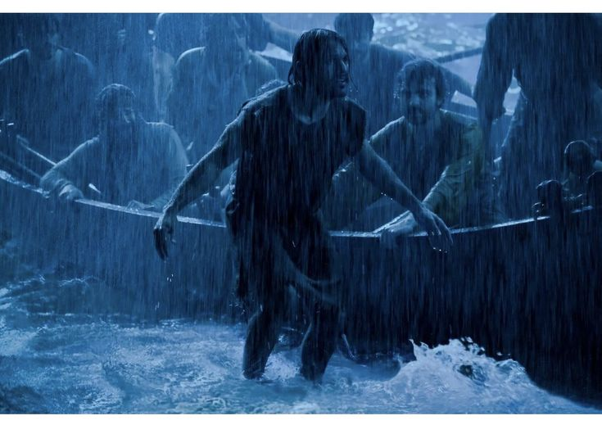
Notes:
And who out of all the disciples jumps out of the boat?

Slide 11
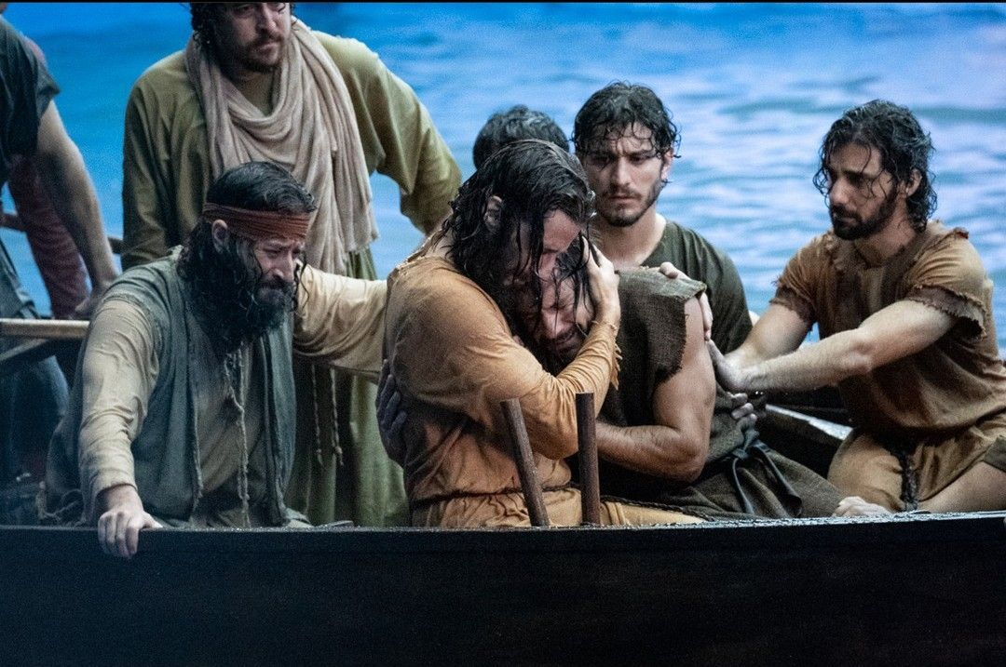
Notes:
And that was another day that Jesus conformed him

Slide 12
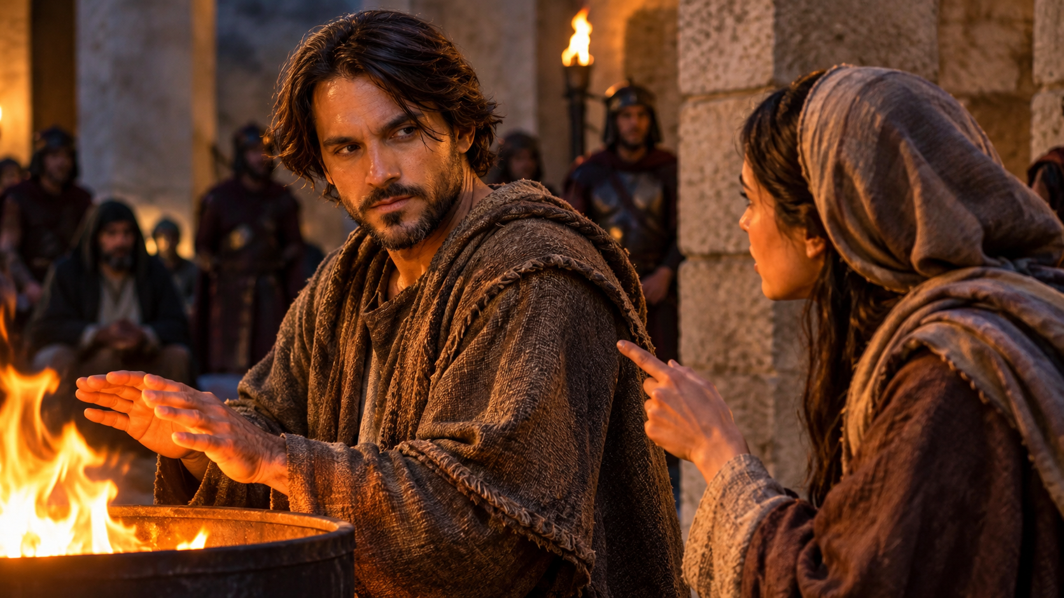
Notes:
well, he denied the Lord

Slide 13
Luke 22:31-32
And the Lord said, Simon, Simon, behold, Satan hath desired to have you, that he may sift you as wheat:
32 But I have prayed for thee, that thy faith fail not: and when thou art converted, strengthen thy brethren.

Slide 14
Notes:
You don’t have to remain a Simon.

